Slide 1
36-617: Applied Linear Models
Two Vignettes: Sensitivity, and Correlated Eta’s
Brian Junker
132E Baker Hall
brian@stat.cmu.edu
TexPoint fonts used in EMF.
Read the TexPoint manual before you delete this box.: AAAAAAAAAA

Slide 2
Announcements
HW10 Due Weds 1159
Quiz08 Survey for credit: Feedback to me on the course (Due Tues 7pm as usual)
Last two classes
Today: Two vignettes: Sensitivity, and Correlated Etas
Weds: Two vignettes: Meta Analysis and Extending Multilevel glm’s
Final Papers Due Friday 1159pm

Slide 3
Outline
Vignette 1: Sensitivity Analysis
Example 1: Sensitivity analysis for prior on $β_{0}$
Example 2: Sensitivity analysis for distribution of $η$’s
Example 3: Estimating the shape of distribution of $η$’s
Vignette 2: Correlated $η$’s: lmer vs stan
Example 4: Naturally uncorrelated $η$’s in stan
Example 5: Implementing correlated $η$’s in stan
Building Covariance Matrices…

Slide 4
Sensitivity Analysis
Examining how much estimates, inferences, and/or predictions change when we change modeling assumptions
George Box: “All models are wrong; some are useful”
Therefore, we should always check to see if we get the same answers from a different (wrong) model that is close to the (wrong) model we chose!
This is a good habit for any statistician or data scientist to acquire (whether doing Bayes or anything else!)
You do not have to check everything
Check the things that will matter for your inferences

Slide 5
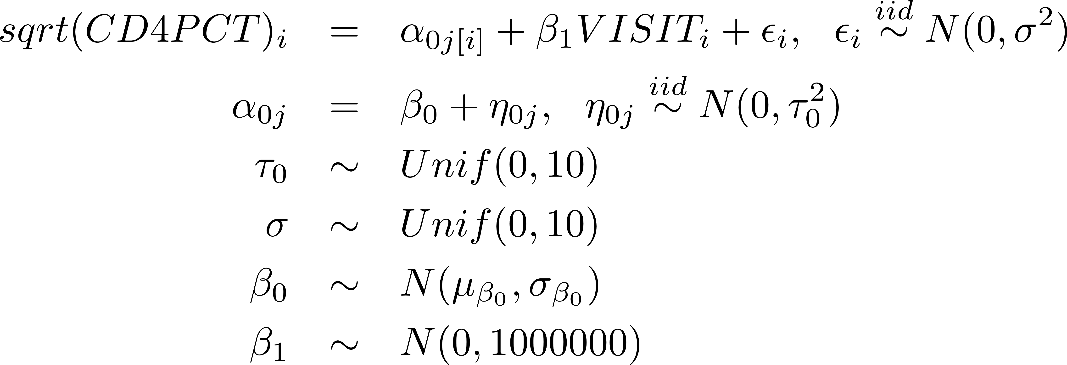
Example 1: Random intercept cd4…
In the model
we chose $μ_{β_{0}}=0$ and $σ_{β_{0}}=1,000,000.$
How much does changing these values affect parameter estimates in the model?

Slide 6
Example 1: “blmer_1.stan”
data {
// data needed for the model
int N;
real y[N];
int newpid[N];
real VISIT[N];
int J;
// mean and SD for beta0
real mu_b0;
real sig_b0;
}
parameters {
real<lower=0, upper=10> sig;
real a0[J];
real a1;
real b0;
real<lower=0, upper=10> tau0;
}
model {
real mu[N];
// level 1: likelihood
for (i in 1:N) {
mu[i] <- a0[newpid[i]] + a1*VISIT[i];
y[i] ~ normal(mu[i],sig);
}
// level 2: prior
for (j in 1:J) {
a0[j] ~ normal(b0,tau0);
}
// add’l priors
b0 ~ normal(mu_b0,sig_b0);
a1 ~ normal(0,1e+6);
sig ~ uniform(0,10);
tau0 ~ uniform(0,10);
}
We can try different mu_b0 and sig_b0 without recompiling the stan program

Slide 7
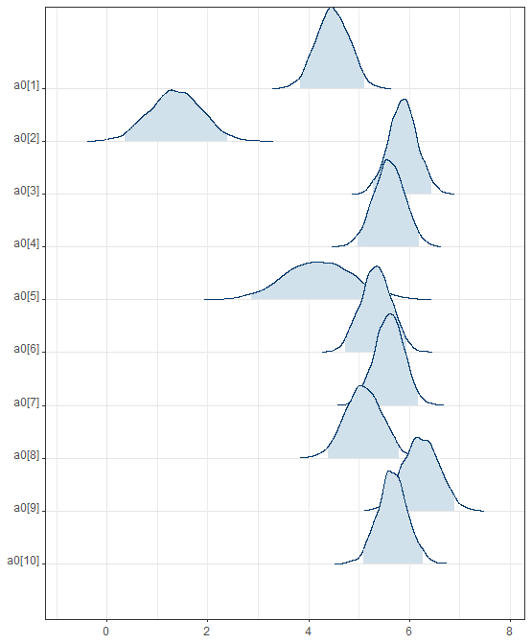
Example 1: Typical Run
blmer_1.data <- c(as.list(cd4), list(y=sqrt(cd4$CD4PCT), N=length(cd4$CD4PCT),
J=max(cd4$newpid),
mu_b0=0, sig_b0=1e+6))
blmer_1.model <- stan(file="blmer_1.stan", data=blmer_1.data, chains=0)
blmer_1.results <- stan(fit=blmer_1.model, data=blmer_1.data)
print(blmer_1.results,pars=c("sig","tau0","a1","b0"))
## mean se_mean sd 2.5% 25% 50% 75% 97.5% n_eff Rhat
## sig 0.77 0 0.02 0.74 0.76 0.77 0.79 0.81 4965 1
## tau0 1.41 0 0.07 1.28 1.36 1.41 1.46 1.56 6860 1
## a1 -0.03 0 0.00 -0.04 -0.03 -0.03 -0.03 -0.02 2348 1
## b0 4.78 0 0.10 4.58 4.71 4.78 4.85 4.98 4460 1
mcmc_areas_ridges(blmer_1.results, pars=paste0("a0[",1:10,"]"),prob_outer=0.95)
R code for running all the examples is in the file “sensitivity-and-correlated-etas.r”

Slide 8
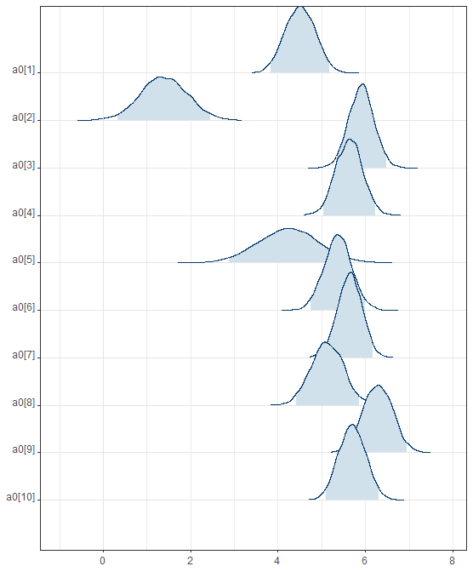
Example 1: Suppose in a prev. study we obtained ${\hat{β}}_{0}=6.12, SE({\hat{β}}_{0}$)=0.25
blmer_1.data <- c(as.list(cd4),
list(y=sqrt(cd4$CD4PCT),
N=length(cd4$CD4PCT),
J=max(cd4$newpid),
mu_b0=6.12,
sig_b0=0.25))
blmer_1.results.new <- stan(fit=blmer_1.model, data=blmer_1.data)
print(blmer_1.results.new,pars=c("sig","tau0","a1","b0"))
## mean se_mean sd 2.5% 25% 50% 75% 97.5% n_eff Rhat
## sig 0.77 0 0.02 0.74 0.76 0.77 0.79 0.81 4460 1
## tau0 1.42 0 0.07 1.29 1.37 1.42 1.47 1.57 6237 1
## a1 -0.03 0 0.00 -0.04 -0.03 -0.03 -0.03 -0.02 2509 1
## b0 4.96 0 0.09 4.78 4.90 4.96 5.03 5.15 5711 1
mcmc_areas_ridges(blmer_1.results.new, pars=paste0("a0[",1:10,"]"),prob_outer=0.95)

Slide 9
Example 1: Sensitivity to $μ_{β_{0}}, σ_{β_{0}}$
mean sd
m = 4 s = 0.1 : sig 0.7742 0.0190
m = 4 s = 0.1 : tau0 1.4546 0.0734
m = 4 s = 0.1 : a1 -0.0242 0.0044
m = 4 s = 0.1 : b0 4.3869 0.0745
m = 4 s = 0.2 : sig 0.7743 0.0195
m = 4 s = 0.2 : tau0 1.4178 0.0702
m = 4 s = 0.2 : a1 -0.0273 0.0044
m = 4 s = 0.2 : b0 4.6281 0.0908
m = 4 s = 0.4 : sig 0.7741 0.0194
m = 4 s = 0.4 : tau0 1.4125 0.0693
m = 4 s = 0.4 : a1 -0.0289 0.0044
m = 4 s = 0.4 : b0 4.7361 0.0930
m = 8 s = 0.1 : sig 0.7763 0.0193
m = 8 s = 0.1 : tau0 2.7867 0.1637
m = 8 s = 0.1 : a1 -0.0413 0.0045
m = 8 s = 0.1 : b0 7.2429 0.1087
m = 8 s = 0.2 : sig 0.7755 0.0194 m = 8 s = 0.2 : tau0 1.5571 0.0880
m = 8 s = 0.2 : a1 -0.0384 0.0044
m = 8 s = 0.2 : b0 5.4943 0.1087
mean sd
m = 8 s = 0.4 : sig 0.7739 0.0189
m = 8 s = 0.4 : tau0 1.4234 0.0690
m = 8 s = 0.4 : a1 -0.0322 0.0045
m = 8 s = 0.4 : b0 4.9681 0.0962
m = 12 s = 0.1 : sig 0.7735 0.0193
m = 12 s = 0.1 : tau0 7.0191 0.3339
m = 12 s = 0.1 : a1 -0.0356 0.0044
m = 12 s = 0.1 : b0 11.6489 0.1042
m = 12 s = 0.2 : sig 0.7738 0.0192
m = 12 s = 0.2 : tau0 5.6746 0.3335
m = 12 s = 0.2 : a1 -0.0368 0.0045
m = 12 s = 0.2 : b0 10.2884 0.2302
m = 12 s = 0.4 : sig 0.7744 0.0194
m = 12 s = 0.4 : tau0 1.4688 0.0770
m = 12 s = 0.4 : a1 -0.0354 0.0046
m = 12 s = 0.4 : b0 5.2186 0.1062
mb0 <- c(4,8,12)
sb0 <- c(0.1,0.2,0.4)
parlist <- c("sig","tau0","a1","b0")
res <- NULL
for (m in mb0) {
for (s in sb0) {
blmer_1.data <- c(as.list(cd4), list(y=sqrt(cd4$CD4PCT), N=length(cd4$CD4PCT), J=max(cd4$newpid), mu_b0=m,sig_b0=s))
tmp.fit <- stan(fit=blmer_1.model, data=blmer_1.data)
tmp.res <- summary(tmp.fit)$ summary[parlist,c(1,3)]
row.names(tmp.res) <- paste("m =",m,"s =",s,":“,
row.names(tmp.res))
res <- rbind(res,tmp.res)
}}
round(res,4)
As $μ_{β_{0}}$gets further from 4.78, ${\hat{β}}_{0}$ gets dragged too
The effect gets weaker as $σ_{β_{0}}$ grows
$τ_{0}$ also affected; other parameters not so much…

Slide 10
Example 2: Sensitivity to shape of $η$ distribution
Suppose there are outliers that we can’t get rid of, but they affect the values of $α_{0j}$ and $β_{0}$
We could replace $η_{0j}∼N\left(0,τ_{0}^{2}\right)$ with $η_{0j}∼t_{df}\left(0,τ_{0}^{2}\right)$, a scaled t-distribution
The $t_{df}$ distribution has fatter tails than the normal
Outliers will affect means less
Since the $α_{0j}$ will vary less, $τ_{0}$ should be smaller
Maybe $σ^{2}$ will be smaller too?
Try this for several different df values…
lmer() can’t do this!)

Slide 11
Example 2: blmer_1_t_prior.stan
model {
real mu[N];
// level 1: likelihood
for (i in 1:N) {
mu[i] <- a0[newpid[i]] + a1*VISIT[i];
y[i] ~ normal(mu[i],sig);
}
// level 2: prior
for (j in 1:J) {
a0[j] ~ student_t(df,b0,tau0);
}
// add’l priors
b0 ~ normal(0,1e+6);
a1 ~ normal(0,1e+6);
sig ~ uniform(0,10);
tau0 ~ uniform(0,10);
}
blmer_t_prior.data <- c(as.list(cd4),
list(y=sqrt(cd4$CD4PCT),
N=length(cd4$CD4PCT),
J=max(cd4$newpid),
df=1))
blmer_t_1_prior <-
stan(fit=blmer_t_prior.model, data=blmer_t_prior.data)
blmer_t_prior.data <- . . . df=3 . . .
blmer_t_3_prior <- stan(fit=blmer_t_prior.model,
data=blmer_t_prior.data)
blmer_t_prior.data <- . . . df=10 . . .
blmer_t_10_prior <- stan(fit=blmer_t_prior.model, data=blmer_t_prior.data)
blmer_t_prior.data <- . . . df=20 . . .
blmer_t_20_prior <- stan(fit=blmer_t_prior.model,
data=blmer_t_prior.data)

Slide 12
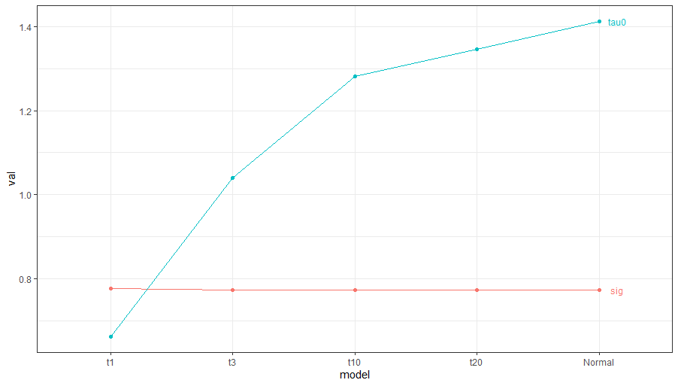
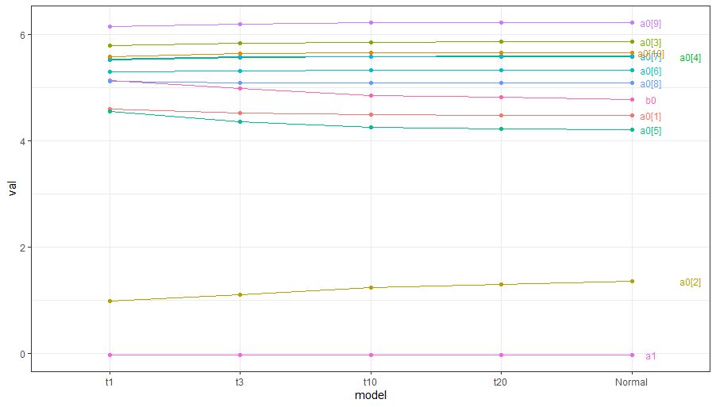
Example 2: Sensitivity to shape of $η$ distribution
## R code to set up the table...
t1 t3 t10 t20 Normal
sig 0.78 0.77 0.77 0.77 0.77
tau0 0.66 1.04 1.28 1.35 1.41
a1 -0.03 -0.03 -0.03 -0.03 -0.03
b0 5.14 4.99 4.86 4.82 4.78
a0[1] 4.60 4.52 4.49 4.49 4.48
a0[2] 0.99 1.11 1.25 1.29 1.36
a0[3] 5.80 5.84 5.86 5.87 5.87
a0[4] 5.53 5.57 5.58 5.59 5.60
a0[5] 4.55 4.37 4.26 4.22 4.21
a0[6] 5.30 5.33 5.34 5.34 5.34
a0[7] 5.54 5.58 5.59 5.60 5.60
a0[8] 5.12 5.10 5.10 5.10 5.09
a0[9] 6.16 6.20 6.22 6.23 6.23
a0[10] 5.59 5.65 5.66 5.66 5.67
## ggplot stuff...
Small sample sizes ($n≤2)$; shrink toward $b_{0}$

Slide 13
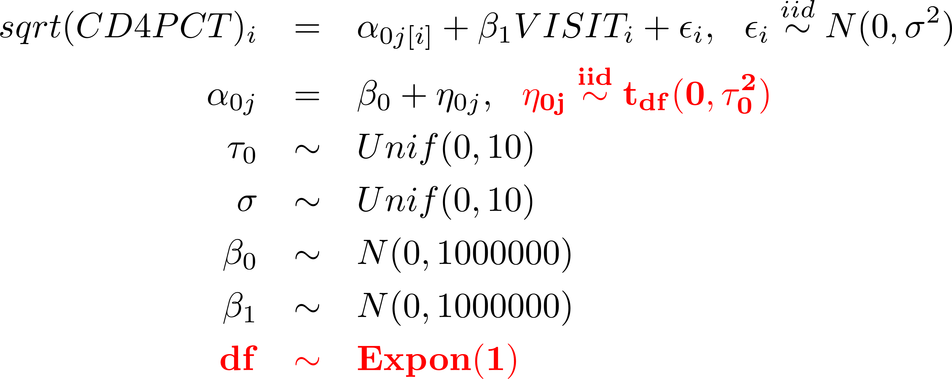
Example 3: Estimating shape of $η$ distribution
Because of the flexibility of Bayesian model-building, we can also consider
and estimate df along with all of the other parameters in the model
Let the data choose the $η$ distribution!
lmer() can’t do this!)

Slide 14
Example 3: blmer_1_df_est.stan
model { real mu[N];
// level 1: likelihood
for (i in 1:N) {
mu[i] <- a0[newpid[i]] + a1*VISIT[i];
y[i] ~ normal(mu[i],sig);
}
// level 2: prior
for (j in 1:J) {
a0[j] ~ student_t(df,b0,tau0);
}
// add’l priors
b0 ~ normal(0,1e+6);
a1 ~ normal(0,1e+6);
sig ~ uniform(0,10);
tau0 ~ uniform(0,10);
df ~ gamma(1,1); // exponential dist.
}
blmer_df_est.data <- c(as.list(cd4), list(y=sqrt(cd4$CD4PCT), N=length(cd4$CD4PCT), J=max(cd4$newpid))
blmer_df_est.model <- stan(file="blmer_1_df_est.stan", data=blmer_df_est.data,chains=0)
blmer_df_est<- stan(fit=blmer_df_est.model, data=blmer_df_est.data)
print(blmer_df_est,par=c("df",parlist))
mean se_mean sd 2.5% 25% 50% 75% 97.5% n_eff Rhat
df 4.79 0.03 1.46 2.62 3.77 4.56 5.56 8.32 2915 1
sig 0.77 0.00 0.02 0.74 0.76 0.77 0.79 0.81 4520 1
tau0 1.14 0.00 0.10 0.95 1.08 1.14 1.21 1.33 3740 1
a1 -0.03 0.00 0.00 -0.04 -0.03 -0.03 -0.03 -0.02 1961 1
b0 4.94 0.00 0.10 4.74 4.87 4.94 5.01 5.14 3715 1
a0[1] 4.51 0.00 0.32 3.87 4.29 4.51 4.73 5.14 9152 1
a0[2] 1.16 0.01 0.56 0.07 0.78 1.15 1.54 2.25 8510 1
a0[3] 5.85 0.00 0.29 5.30 5.65 5.85 6.06 6.43 8229 1
a0[4] 5.58 0.00 0.30 4.99 5.38 5.58 5.79 6.19 7024 1
a0[5] 4.32 0.01 0.64 3.00 3.92 4.32 4.74 5.54 8011 1
a0[6] 5.33 0.00 0.31 4.73 5.12 5.33 5.53 5.96 7266 1
a0[7] 5.59 0.00 0.29 5.01 5.40 5.58 5.78 6.15 8496 1
a0[8] 5.09 0.00 0.36 4.37 4.86 5.10 5.33 5.81 7823 1
a0[9] 6.21 0.00 0.35 5.55 5.97 6.21 6.45 6.89 6648 1
a0[10] 5.66 0.00 0.30 5.07 5.45 5.65 5.86 6.26 8797 1
Looks like df$≈$5 is about right…
You would probably want to try some different priors on df to see how much the estimated df is affected (sensitivity analysis again!).

Slide 15
Correlated $η$’s: lmer vs stan
For the random-intercepts/random-slopes model
it’s generally better to estimate $ρ_{01}$ rather than forcing $ρ_{01}≡0.$
This happens “automatically” with lmer(y ~ 1 + VISIT + (1 + VISIT | newpid))
OTOH Stan assumes independence unless you build $ρ_{01}$ into the model!

Slide 16
Example 4: Uncorrelated $η$’s in stan
model {
real mu[N];
// level 1: likelihood
for (i in 1:N) {
mu[i] <- a0[newpid[i]] + a1[newpid[i]]*VISIT[i];
y[i] ~ normal(mu[i],sig);
}
// level 2: prior
for (j in 1:J) {
a0[j] ~ normal(b0,tau0);
a1[j] ~ normal(b1,tau1);
}
// add'l priors
b0 ~ normal(0,1e+6);
b1 ~ normal(0,1e+6);
sig ~ uniform(0,10);
tau0 ~ uniform(0,10);
tau1 ~ uniform(0,10);
}
This model corresponds to the lmer model
lmer(y ~ 1 + VISIT + (1|newpid) + (0+VISIT|newpid))
Since we didn’t specify a correlation in the stan model, stan assumes the correlation is zero.
We’ll put $ρ$ in the model, and build up the covariance matrix from $τ_{0}^{2}, τ_{1}^{2},$ and $τ_{01}=τ_{0}τ_{1}ρ$
This stan model is in the file
“blmer_2_indep.stan”
R code for running this stan model and comparing it with corresponding lmer() models is in the file “sensitivity-and-correlated-etas.r”

Slide 17
Example 5: Correlated $η$’s in stan
data {
int N;
real y[N];
int newpid[N];
real VISIT[N];
int J;
}
parameters {
real<lower=0, upper=10> sig;
matrix[J,2] A;
real b0;
real b1;
real<lower=0, upper=10> tau0;
real<lower=0, upper=10> tau1;
real<lower=-1,upper=+1> rho;
}
transformed parameters {
real a0[J];
real a1[J];
vector[2] B;
matrix[2,2] Tau;
for (j in 1:J) {
a0[j] <- A[j,1];
a1[j] <- A[j,2];
}
B[1] <- b0;
B[2] <- b1;
Tau[1,1] <- tau0^2;
Tau[2,2] <- tau1^2;
Tau[1,2] <- rho*tau0*tau1;
Tau[2,1] <- Tau[1,2];
}
model {
real mu[N];
// level 1: likelihood
for (i in 1:N) {
mu[i] <- a0[newpid[i]] + a1[newpid[i]]*VISIT[i];
y[i] ~ normal(mu[i],sig);
}
// level 2: prior
for (j in 1:J) {
A[j,1:2] ~ multi_normal(B,Tau);
}
// add'l priors
b0 ~ normal(0,1e+6);
b1 ~ normal(0,1e+6);
sig ~ uniform(0,10);
tau0 ~ uniform(0,10);
tau1 ~ uniform(0,10);
rho ~ uniform(-1,1);
}
This stan model is in the file
“blmer_2.stan”

Slide 18
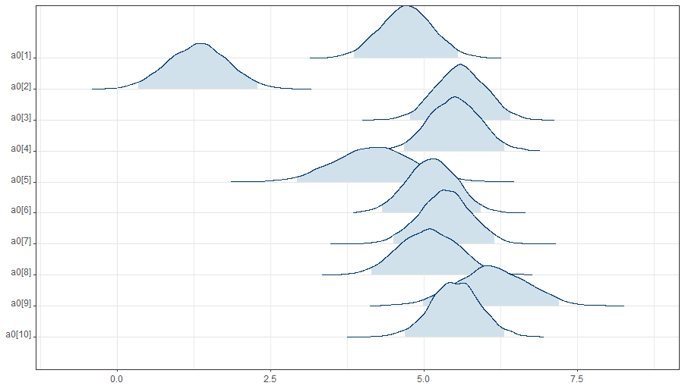
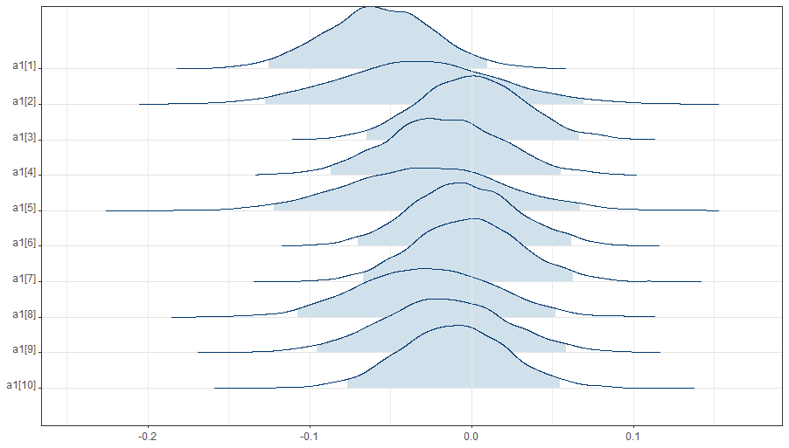
Example 5: Correlated $η$’s in stan
blmer_2.data <- c(as.list(cd4), list(y=sqrt(cd4$CD4PCT), N=length(cd4$CD4PCT), J=max(cd4$newpid)))
blmer_2.model <-stan(file="blmer_2.stan", data=blmer_2.data, chains=0)
blmer_2.results <-stan(fit=blmer_2.model, data=blmer_2.data) print(blmer_2.results,pars=parlist) mean se_mean sd 2.5% 25% 50% 75% 97.5% n_eff Rhat
sig 0.72 0.00 0.02 0.68 0.70 0.72 0.73 0.76 2136 1.00
tau0 1.40 0.00 0.07 1.26 1.35 1.40 1.45 1.56 2580 1.00
tau1 0.05 0.00 0.01 0.03 0.04 0.05 0.05 0.06 452 1.01
rho -0.07 0.00 0.13 -0.31 -0.17 -0.07 0.02 0.19 987 1.01
b0 4.77 0.00 0.10 4.58 4.71 4.77 4.84 4.97 5321 1.00
b1 -0.03 0.00 0.01 -0.04 -0.03 -0.03 -0.02 -0.02 2489 1.00 display(lmer(y~VISIT + (VISIT|newpid))
coef.est coef.se
(Intercept) 4.77 0.10
VISIT -0.03 0.01
Groups Name Std.Dev. Corr
newpid (Intercept) 1.40
VISIT 0.05 -0.09
Residual 0.72
## bayesplot stuff…

Slide 19
Building Covariance Matrices “by Hand”…
The basic idea was to recognize that if we have $K+1$ $η^{′}s$, then
where $τ_{j}^{2}=Var\left(η_{j}\right)$, $ρ_{jk}=Corr\left(η_{j},η_{k}\right)$, and then put uniform priors on all $τ_{j}$’s and $ρ_{jk}$’s.
This “should work” but can sometimes produce unworkable sets of correlations (see next slide)…

Slide 20
Building Covariance Matrices…
The “by-hand” approach above can have “bad initialization” in stan…
By default, stan initializes parameters essentially from prior
Some sets of $ρ$’s initialized this way are impossible¹ as correlations.
E.g. can’t have $ρ_{12}=−1, ρ_{23}=−1 and ρ_{13}=−1$ . . .
Stan offers a more principled approach that won’t fail; see
https://stla.github.io/stlapblog/posts/StanLKJprior.html
https://arxiv.org/abs/1506.06201v1
https://mc-stan.org/docs/2_25/reference-manual/correlation-matrix-transform-section.html
Gelman & Hill discuss a different approach, using the "Wishart distribution“ (like a matrix version of the chi-squared or gamma distribution)
¹See for example https://stats.stackexchange.com/questions/72790/bound-for-the-correlation-of-three-random-variables or https://www.jstor.org/stable/23020502

Slide 21
Summary
Vignette 1: Sensitivity Analysis
Example 1: Sensitivity analysis for prior on $β_{0}$
Example 2: Sensitivity analysis for distribution of $η$’s
Example 3: Estimating the shape of distribution of $η$’s
Vignette 2: Correlated $η$’s: lmer vs stan
Example 4: Naturally uncorrelated $η$’s in stan
Example 5: Implementing correlated $η$’s in stan
Building Covariance Matrices…

