Slide 1
36-617: Applied Linear Models
Logistic Regression/GLMs: estimation & diagnostics
Brian Junker
132E Baker Hall
brian@stat.cmu.edu
TexPoint fonts used in EMF.
Read the TexPoint manual before you delete this box.: AAAAAAAAAAAAAAA

Slide 2
Announcements…
Take-home midterm due Wed 11:59pm
No quiz today
Next Monday: class survey (for credit) instead of quiz
HW05 will come out Weds, due Weds again
This week: More on logistic regression, GLMs
Next week:
A brief introduction to nonparametric regression
Readings:
Sheather, Appendix on nonparametric smoothing
ISLR, Ch 7

Slide 3
Outline
An example where AIC (and BIC) are not comparable across “model families”
MLE’s and diagnostics for logistic regression
Finding MLE’s by Newton’s Method
Predicted values
Residuals
Goodness of Fit, Deviance Residuals
Hat Matrix, Standardized Residuals, Cook’s Distance
Interpreting R’s casewise diagnostic plots
Alternative residuals: DHARMa

Slide 4
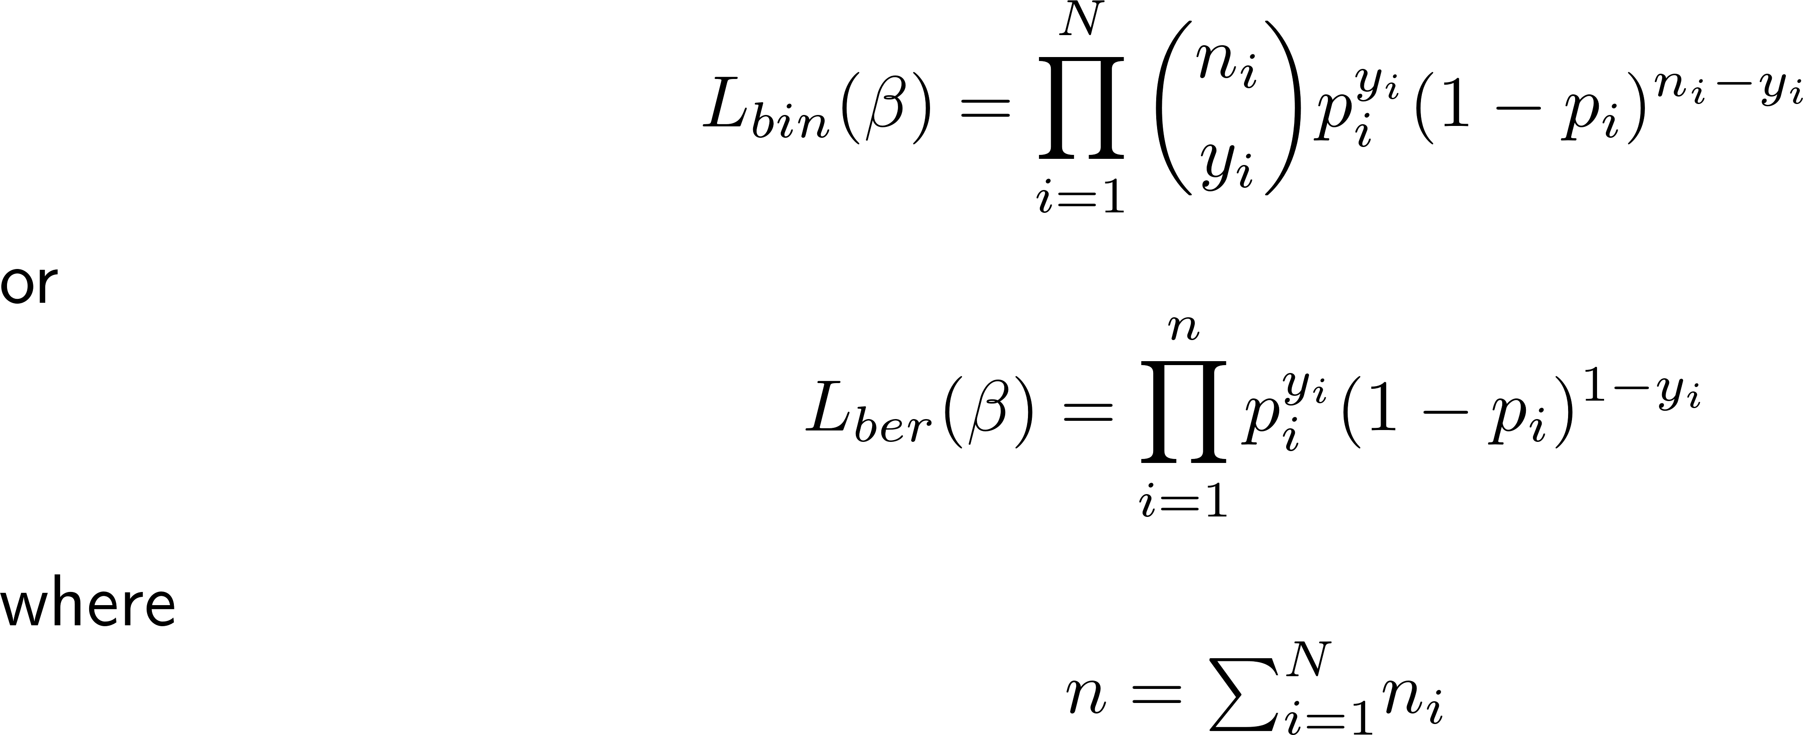
An example of non-comparability of AIC/BIC
Logistic regression model says
Suppose we have i=1..N binomial outcomes with n_{i} trials per outcome and y_{i} successes per outcome. We can write the likelihood as

Slide 5
The log-likelihoods are so

Slide 6
Example…
> data <- read.table("MissAmericato2008.txt",header=T)
> # arranged so that each row represents yi = # of top 10 > # finalists from each state in the US, in ni = 9 years > glm.1 <- glm(cbind(Top10,9-Top10) ~ . - abbreviation, + data=data, family=binomial)
> newdata <- data[1,]
> for (r in 1:dim(data)[1]) {
+ row <- data[r,]
+ row$Top10 <- 1
+ reps <- data$Top10[r]
+ if (reps>0) for (j in 1:reps) {
+ newdata <- rbind(newdata,row)
+ }
+ row$Top10 <- 0
+ if(reps<9) for (j in 1:(9-reps)) {
+ newdata <- rbind(newdata,row)
+ }
+ }
> newdata <- newdata[-1,]
> # arranged so that each state is represented by 10 rows, > # with a 1 or 0 indicating “top 10 finalist” or not, from that > # state, in each of 10 years. > glm.2 <- glm(Top10 ~ . - abbreviation, data=newdata,
+ family=binomial)
> round(cbind(coef(summary(glm.1)),coef(summary(glm.2))),2) > # --------- glm.1 ------- --------- glm.2 --------
Est SE z p Est SE z p
(Intercept) -7.52 2.53 -2.97 0.00 -7.52 2.53 -2.97 0.00
LogPopulation 0.60 0.18 3.36 0.00 0.60 0.18 3.36 0.00
LogContestants 1.37 0.41 3.32 0.00 1.37 0.41 3.32 0.00
LogTotalArea -0.36 0.14 -2.64 0.01 -0.36 0.14 -2.64 0.01
Latitude -0.06 0.03 -2.15 0.03 -0.06 0.03 -2.15 0.03
Longitude 0.01 0.01 0.67 0.51 0.01 0.01 0.67 0.51
> round(data.frame(AIC=c(glm.1=AIC(glm.1),glm.2=AIC(glm.2)), + BIC=c(glm.1=BIC(glm.1),glm.2=BIC(glm.2))),2)
AIC BIC
glm.1 144.57 156.16
glm.2 420.83 446.24
glm.1 fit the data as a binomial logistic regr.
glm.2 fit the data as a Bernoulli logistic regr.
The fit to the data is the same, estimated betas, SE’s, etc. all the same; AIC & BIC “should” reflect this
AIC & BIC show different values for glm.1 & glm.2, because “normalizing constants” different

Slide 7
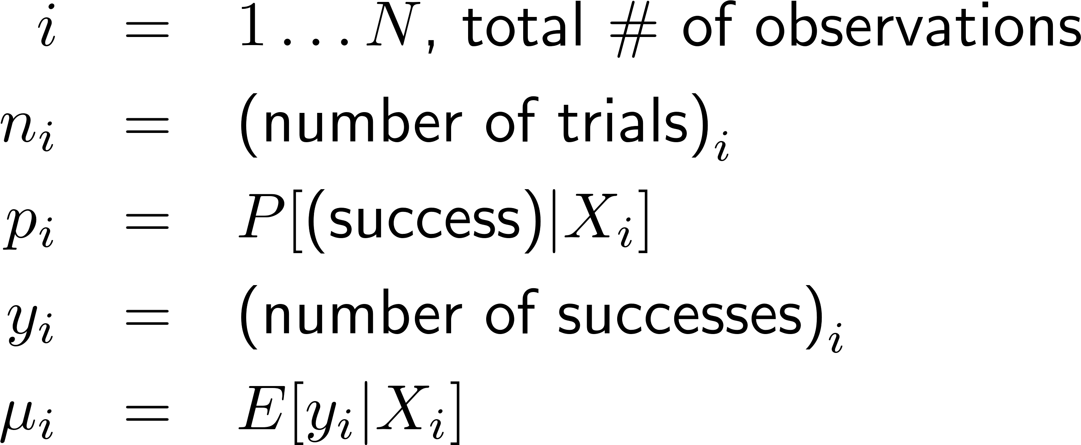
MLE’s & Diagnostics for Binomial Logistic Regression…
Let
For Bernoulli, n_{i}=1, μ_{i}=p_{i}, and y_{i} = 0, 1
For Binomial, n_{i}>1, μ_{i}=n_{i}p_{i} and y_{i}=0,1,…,n_{i}

Slide 8
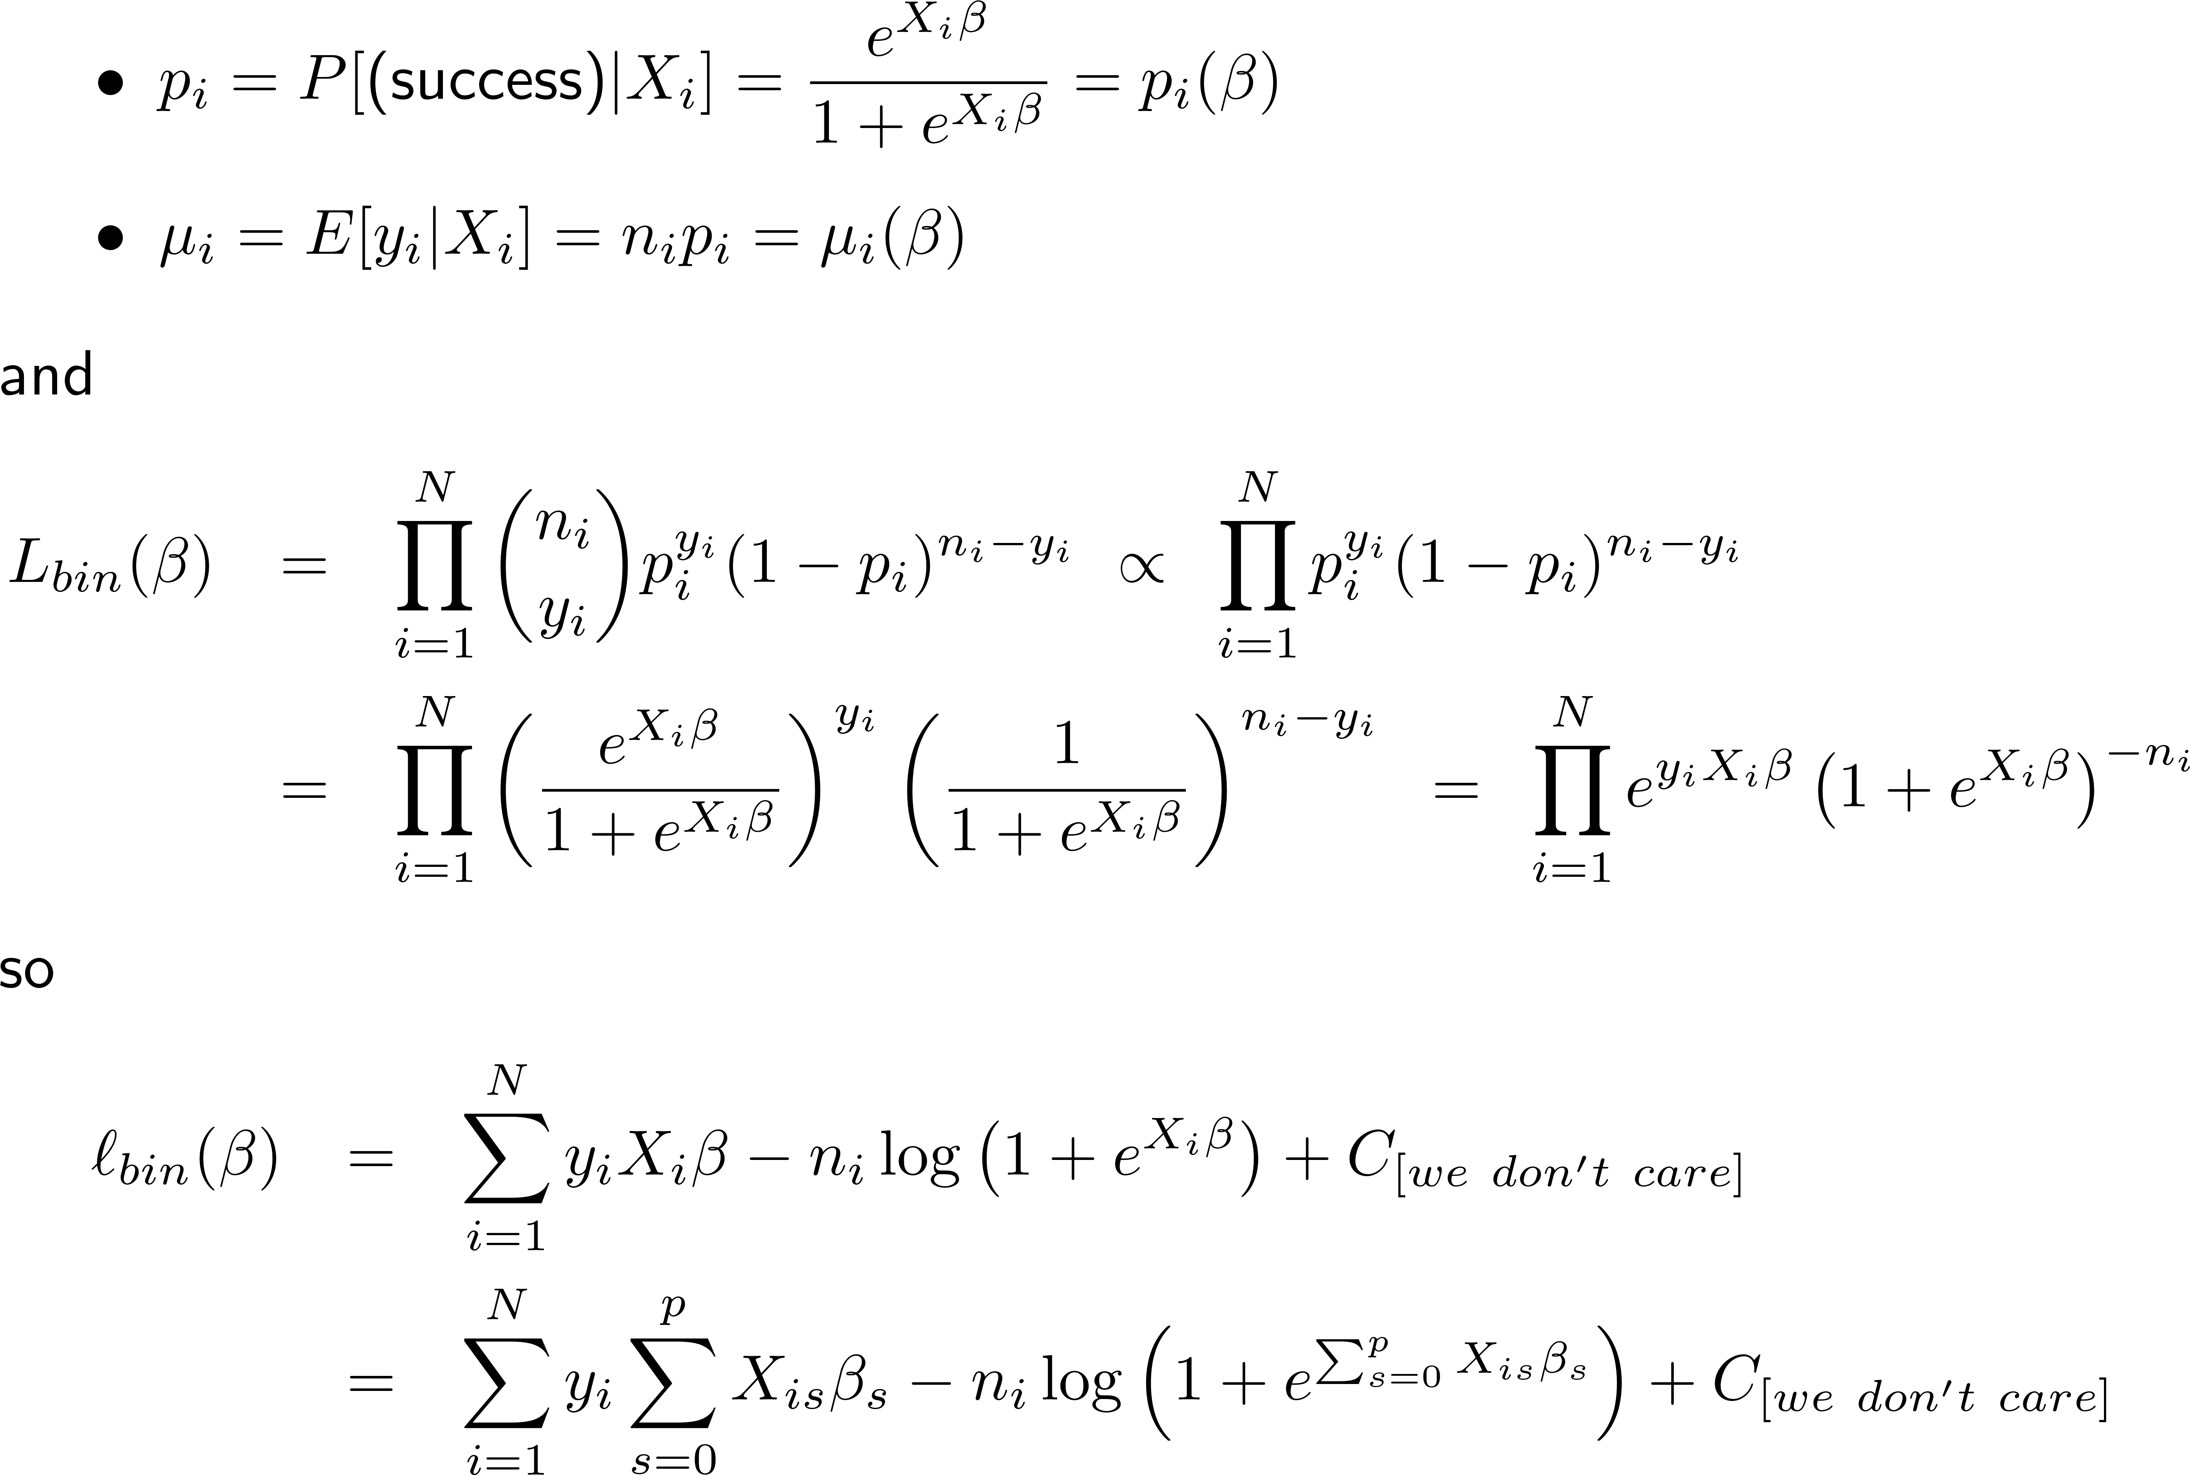
For Binomial logistic regression

Slide 9
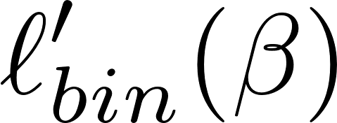
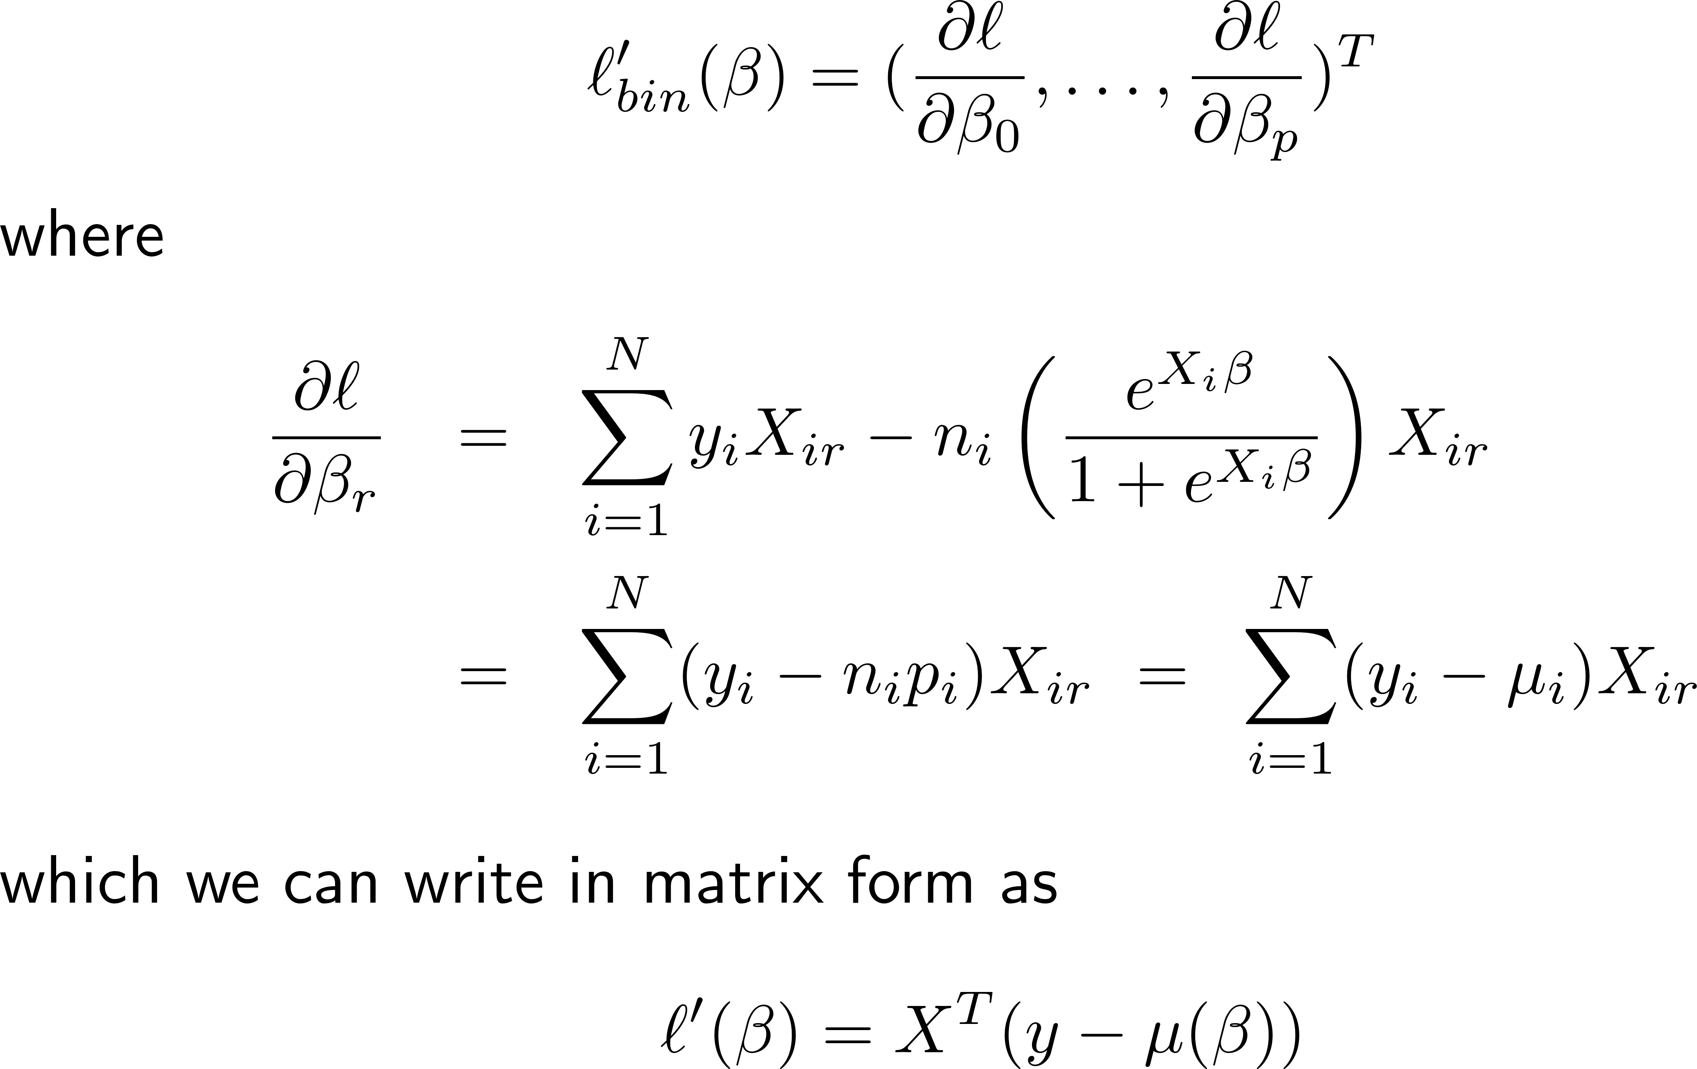
To Maximize, set the gradient to zero and solve for .

Slide 10
Checking the maximum…

Slide 11
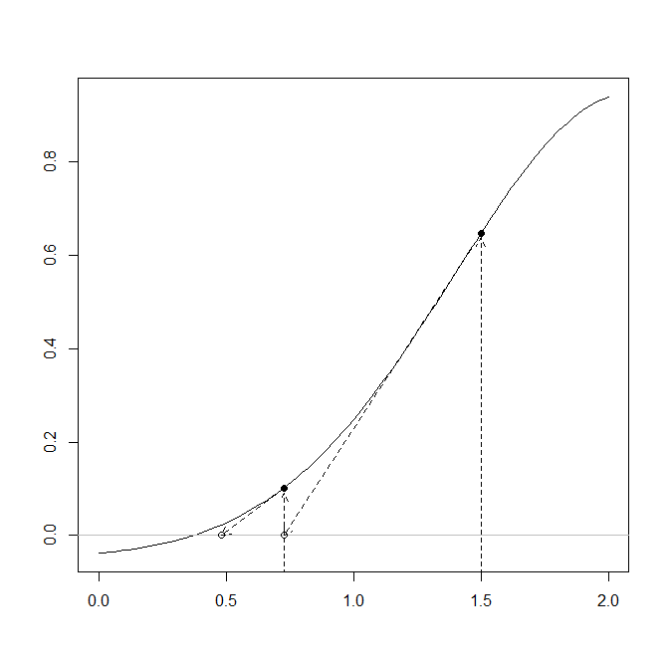
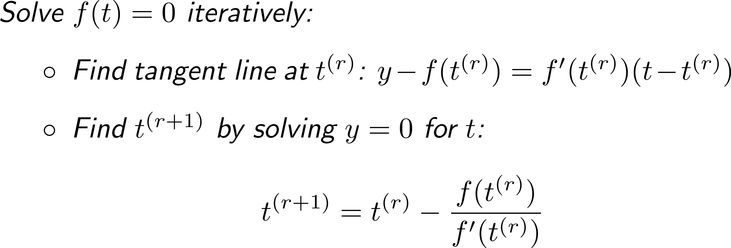
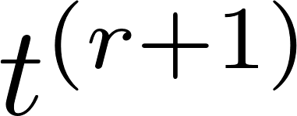
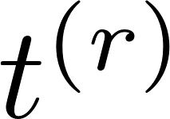
Finding MLE’s by Newton’s method

Slide 12
Summary (so far…)
The log-likelihood for Binomial¹ logistic regression is (proportional to)
We can find the MLE’s by solving by iteration²
given³ by the square roots of the diagonal elements of
¹Same for Bernoulli, but with N=n and n_{i}=1 ²With more work, can convert this to a weighted least squares calculation
³By std MLE theory (CLT for MLE’s)

Slide 13
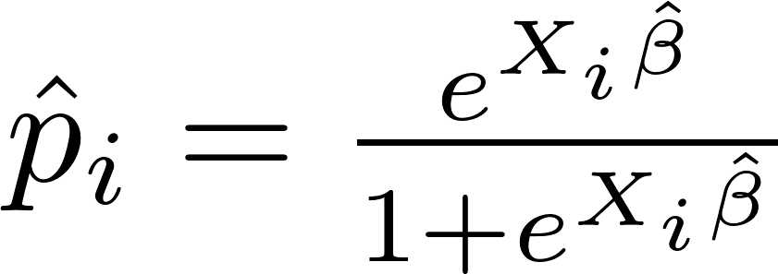
Predicted values for logistic regression
Predicted or fitted values that may be useful:
raw: fitted(glm.1)*glm.1$prior.weights
response: fitted(glm.1) or predict(glm.1,type=“response”)
link: predict(glm.1)or predict(glm.1,type=“link”)
(there is another prediction type, predict(…, type=“terms”), that is not very useful for us…)
You can add SE’s by adding se.fit=TRUE to the predict() arguments…

Slide 14
Logistic Regression Residuals¹
Residuals that correspond to fitted values:
Raw residuals: resid(glm.1,type=“response”) *glm.1$prior.weights
Response residuals: resid(glm.1,type=“response”)
Pearson residuals: resid(glm.1,type=“pearson”)
Note that the Pearson residuals can be written in vector form as
¹“Deviance” residuals are on the next page…

Slide 15
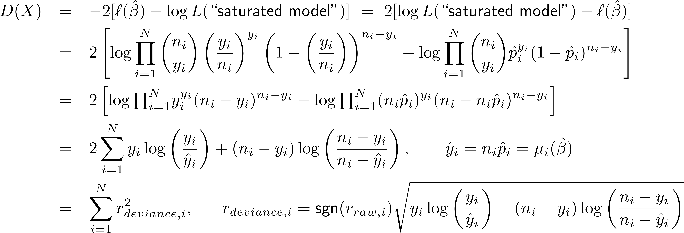
Logistic Regression Goodness of Fit
Pearson Chi-squared statistic
(Residual) Deviance statistic
Both are when the model is correct (small is good)
D(X) a little better than P(X); need n_{i}>5 or so for either to be trustworthy
r_{deviance,i} tends to follow normal distribution better than other residuals

Slide 16
Logistic Regression Hat Matrix
For logistic regression, define
This mostly works like a hat matrix
Sadly , but no matrix can satisfy this since logistic regression doesn’t produce a linear fit¹
But H still acts like a projection matrix:
¹This projection property actually does work in the guts of weighted least squares, but we will skip this for now.

Slide 17
Leverage and “standardized” resids
h_{ii} = (i^{th} diag element of H) is again a measure of leverage
h_{ii}>2(p+1)/n is a common rule of thumb for “high leverage”
Again use (1-h_{ii}) to correct for under-estimated standard errors:
Standardized Pearson Residuals:
Deviance Residuals:
Standardized Deviance Residuals:

Slide 18
Cook’s Distance
For ordinary regression, Cook’s Distance was
We can imitate this for logistic regression
Again, D_{i} gives us a measure of both
“outlierness” (how large is y_{i} – n_{i}p_{i} ?)
“leverage” (how large is h_{ii} ?)

Slide 19
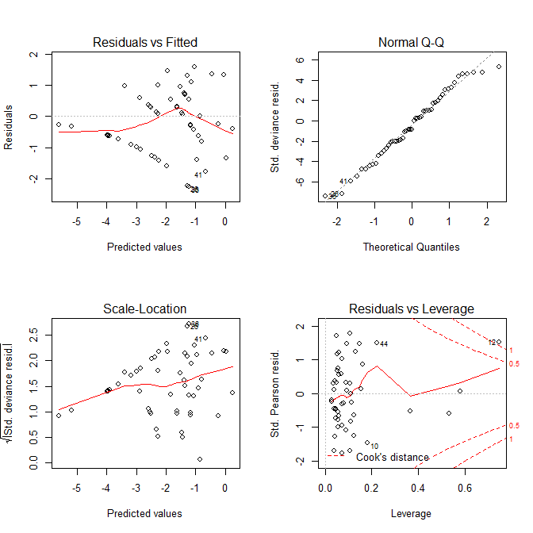
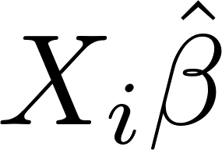
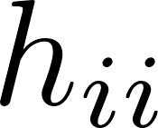
Interpreting casewise diagnostic plots for logistic regression
Raw residual plot nearly useless
Except for detecting extreme under- or over-prediction
Binned raw residuals somewhat useful
Normal QQ plot useful
s_{deviance,i} nearly normal when model holds
Scale-location plot mostly useless
Since Var(y_{i}) = n_{i}p_{i}(1-p_{i}) depends on location, always expect patterns here
Plot of h_{ii}, D_{i}, s_{pearson} quite useful
Less useful for Bernoulli logistic regression than for Binomial

Slide 20
Alternative residuals for glm’s
residuals will be uniformly distributed
See “DHARMa overview.pdf”
for some additional detail

Slide 21
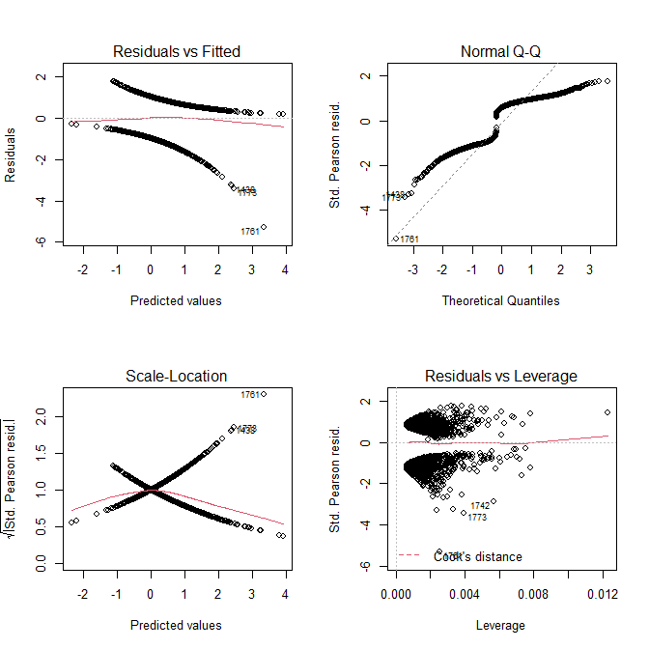
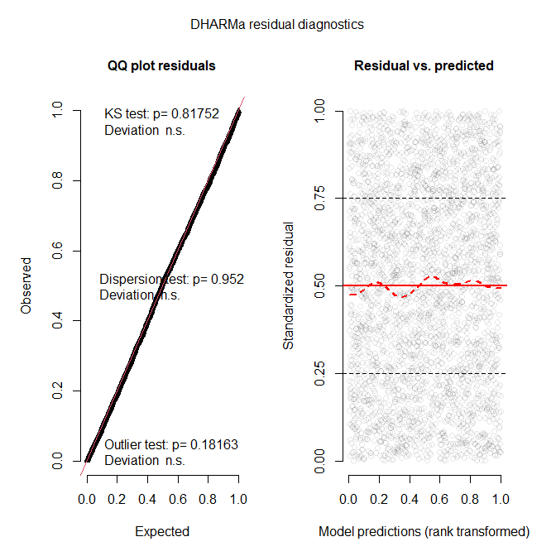
Example: the wells data…
> library(DHARMa)
> data <- read.table("wells.dat",header=T)
> summary(glm.all <- glm(switch ~ .,
+ data=data,family=binomial))
Est SE z Pr(>|z|)
(Int) -0.16 0.10 -1.57 0.12
arsenic 0.47 0.04 11.23 0.00
dist -0.01 0.00 -8.57 0.00
assoc -0.12 0.08 -1.61 0.11
educ 0.04 0.01 4.43 0.00
> par(mfrow=c(2,2))
> plot(glm.all)
> dev.new()
> simdata <- simulateResiduals(glm.all)
> plot(simdata)

Slide 22
A strategy for checking residuals of glm’s
Fit mymodel <- glm(y ~ x1 + x2 + ..., data=mydata, family=binomial) as usual
Check the residuals vs leverage plot (lower right) from plot(mymodel) for high leverage or influential observations
Use residual plot from DHARMa to check
Residuals Unif(0,1) (suggests model is good fit)?
Skewed left or right? Overdispersed? Underdispersed?
Outlying residuals?

Slide 23
Summary
An example where AIC (and BIC) are not comparable across “model families”
MLE’s and diagnostics for logistic regression
Finding MLE’s by Newton’s Method
Predicted values
Residuals
Goodness of Fit, Deviance Residuals
Hat Matrix, Standardized Residuals, Cook’s Distance
Interpreting R’s casewise diagnostic plots
Alternative residuals: DHARMa

