Slide 1
36-617: Applied Linear Models
Graphical Tools for Transformations
Brian Junker
132E Baker Hall
brian@stat.cmu.edu
TexPoint fonts used in EMF.
Read the TexPoint manual before you delete this box.: AAAAAAAAA

Slide 2
Announcements
Quiz 02 – I’m grading this afternoon
HW01 – Grades should be out soon
Reading
This week: Sheather Ch 6 (diagnostics & transformations)
(supplemental: ISLR 3.3.3; G&H Ch 4)
Next week:
For Monday: Sheather 6.4, 6.5, 6.6
For Wednesday: At least Sheather 7.1, 7.2 (not sure I’ll get farther in one lecture…) [Quiz will focus on 7.1, 7.2]
HW 03 out on Canvas
Due Mon 1159pm

Slide 3
Outline
From last time:
Variance Stabilization for Y
Can residual plots distinguish y⁽¹⁾ = β₀ + β₁x² + ε, vs. y⁽²⁾ = (β₀ + β₁x + ε)² ?
Inverse Response Plot for Y
Added Variable Plots
Marginal Model Plots
Perspective and recommendations

Slide 4
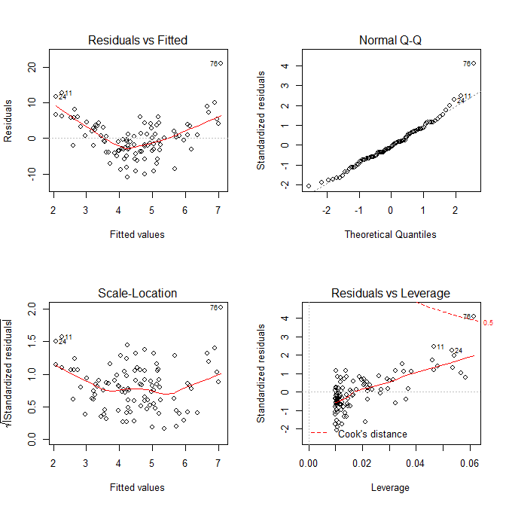
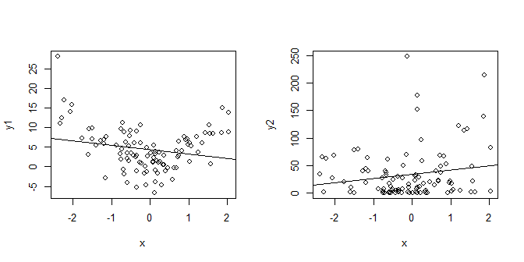
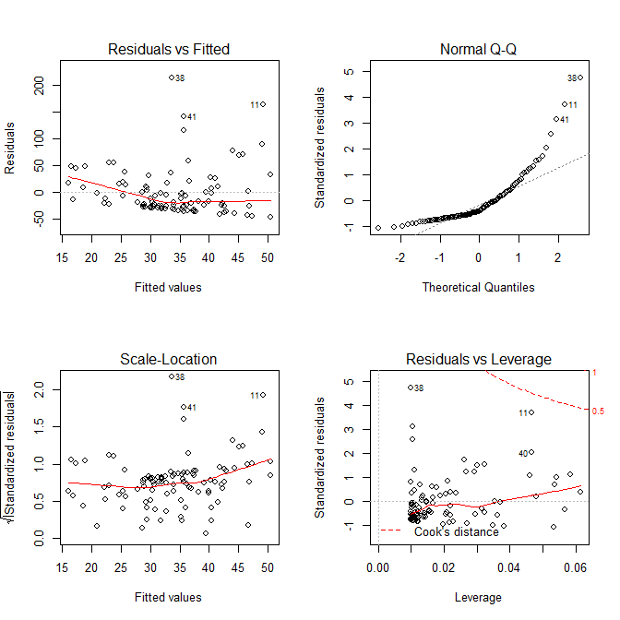
Can residual plots distinguish y⁽¹⁾ = β₀ + β₁x² + ε, vs. y⁽²⁾ = (β₀ + β₁x + ε)² ?
x <- rnorm(100,0,1)
y1 <- 1 + 3*x^2 + rnorm(100,0,4)
y2 <- (1 + 3*x + rnorm(100,0,4))^2
lm.1 <- lm(y1~x)
lm.2 <- lm(y2~x)
par(mfrow=c(2,2))
plot(x,y1); abline(lm.1)
plot(x,y2); abline(lm.2)
par(mfrow=c(2,2))
plot(lm.1)
plot(lm.2)

Slide 5
Functional form of Y: Inverse Response Plot
Suppose then of course
It turns out¹ that if x has an elliptically symmetric distribution, then g can be estimated from a plot of vs , where are predicted values from
¹Li and Duan (1989), Cook and Weisberg (1994)

Slide 6
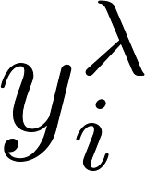
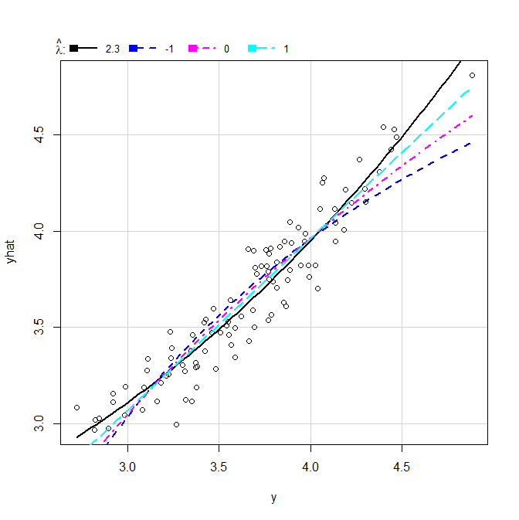
Implementing Inverse Response Plots In R
library(car) (“Companion to Applied Regression”)
invResPlot(): show inverse response plot ( vs. ) and calculate the power for by nonlinear least-squares^{(*)}
> z <- rnorm(100,4,1)
> y <- (1 + 3*z + rnorm(100,0,.25))^(1/2)
> lm.1 <- lm(y ~ z)
> invResPlot(lm.1)
lambda RSS
1 2.300377 1.711786
2 -1.000000 2.711177
3 0.000000 2.211967
4 1.000000 1.874950
y’ = y^(2.3)
y’ = 1/y
y’ = log(y)
y’ = y
^{(*)} Specify particular lamdas to try with
the lambda=c(…) argument.

Slide 7
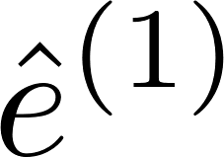
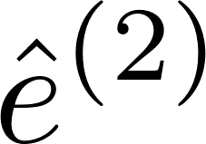
Added-Variable Plots (add Z? or f(Z)?)
Suppose the true model is
Let us fit the models
If we multiply the true model by (I-H_{X}), we get so, plotting (or regressing) on will reveal !

Slide 8
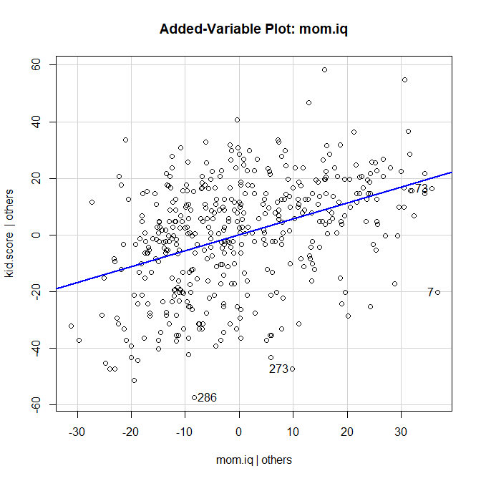
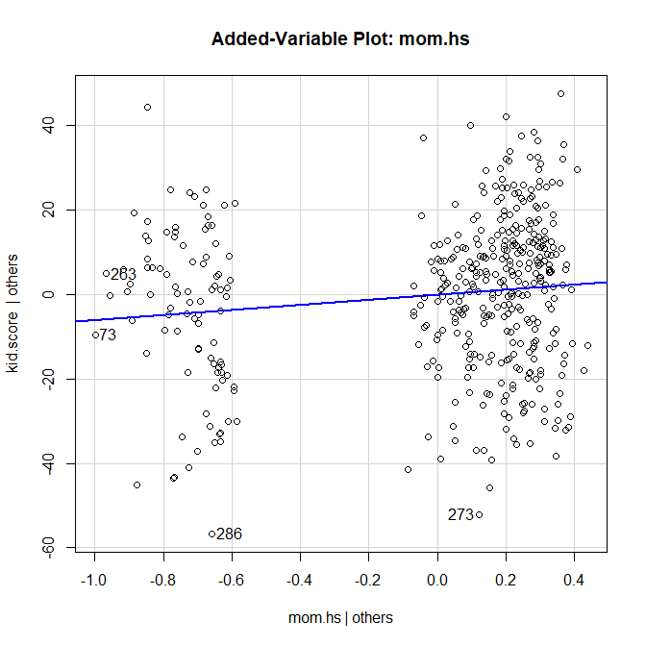
Added-Variable Plots – Example…
> library(car) > lm.3
Call:
lm(formula = kid.score ~ mom.iq + mom.hs, data = kidiq)
Coefficients:
(Intercept) mom.iq mom.hs
25.7315 0.5639 5.9501
> avPlot(lm.3,"mom.iq")
> avPlot(lm.3,"mom.hs")

Slide 9
Added-Variable Plots – Interpretations
Shows γ as the effect of Z after controlling for X, on Y, after controlling for X
Allows you to visually assess the importance of γ , after controlling for all the other X’s.
A visual form of the t-statistic!
Also allows you to check for nonlinearity in predicting Y from Z, after controlling for X
Another plot that allows us to assess nonlinearity is the “marginal model plot” – later in this lecture

Slide 10
Added-Variable Plots – Example…
> library(car) > lm.3
Call:
lm(formula = kid.score ~ mom.iq + mom.hs, data = kidiq)
Coefficients:
(Intercept) mom.iq mom.hs
25.7315 0.5639 5.9501
> avPlot(lm.3,"mom.iq")
> avPlot(lm.3,"mom.hs")

Slide 11
An example
Coefficients:
Est SE t p
(Int) -0.05 0.82 -0.06 0.95
x1 1.77 0.87 2.03 0.04 *
x2 3.44 0.82 4.20 0.00 ***
---
Residual standard error: 8.13 on 97 degrees of freedom
Multiple R-squared: 0.1722, Adjusted R-squared: 0.1551
F-statistic: 10.09 on 2 and 97 DF, p-value: 0.0001045
> library(car) > x1 <- rnorm(100)
> x2 <- rnorm(100)
> y <- 1 + x1 + 2*x2 + + 10*x1*x2 + rnorm(100)
>
> lm.x1px2 <- lm(y ~ x1 + x2)
> lm.x1mx2 <- lm(y ~ x1 * x2)
>
> summary(lm.x1px2)
Call:
lm(formula = y ~ x1 + x2)

Slide 12
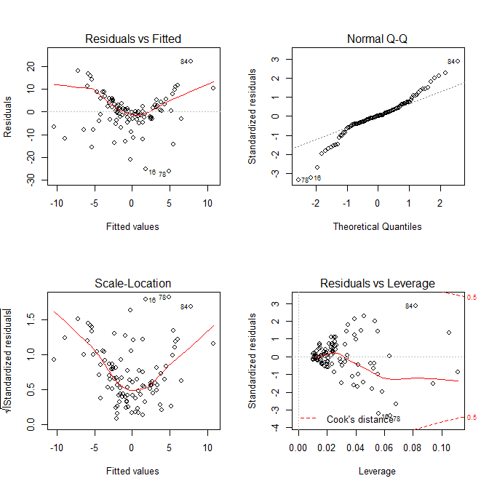
Casewise Diagnostic Plots
> par(mfrow=c(2,2))
> plot(lm.x1px2)

Slide 13
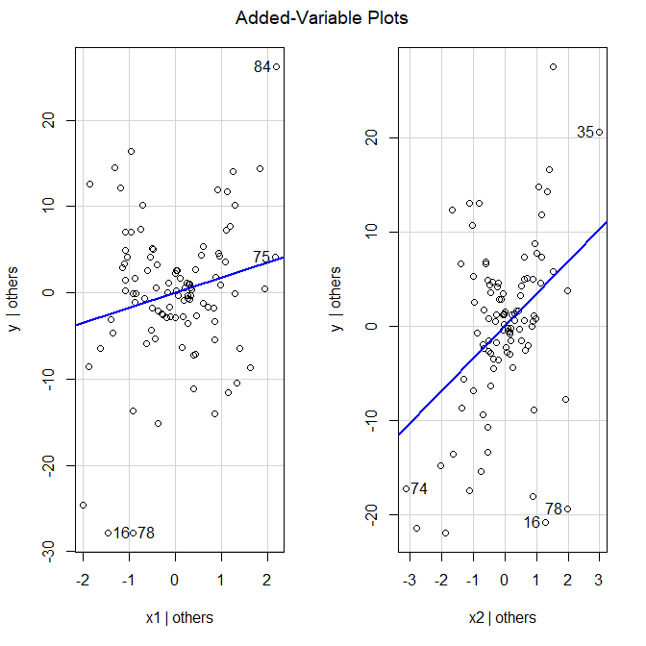
Added Variable Plots
> avPlots(lm.x1px2)

Slide 14
Marginal Model Plot
The idea is very simple:
Plot y against a predictor (e.g. one of the or even ); we’ll call it x.
Use a nonparametric regression procedure (e.g. loess) to estimate E[y|x]
Use the fitted model to estimate E[y|x]
The two should agree. If they do not,
x or y may need to be transformed
A term may be missing in the model
(or both!)

Slide 15
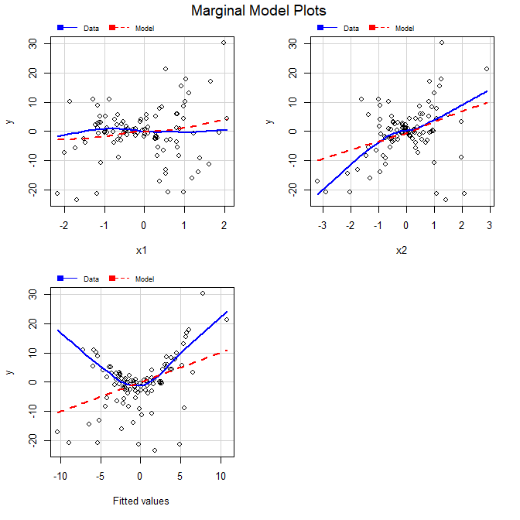
Marginal Model Plots
> mmps(lm.x1px2)
Blue line: Nonparametric smooth estimate of E[y|x]
Red dashed line: Estimate of E[y|x] from the fitted regression model

Slide 16
The “right” model (with interaction)
> summary(lm.x1mx2)
Call:
lm(formula = y ~ x1 * x2)
Coefficients:
Est SE t p
(Int) 0.77 0.11 7.06 0.00 ***
x1 0.69 0.12 5.93 0.00 ***
x2 2.03 0.11 18.33 0.00 ***
x1:x2 9.90 0.13 73.58 0.00 ***
---
Residual standard error: 1.079 on 96 degrees of freedom
Multiple R-squared: 0.9856, Adjusted R-squared: 0.9851
F-statistic: 2187 on 3 and 96 DF, p-value: < 2.2e-16

Slide 17
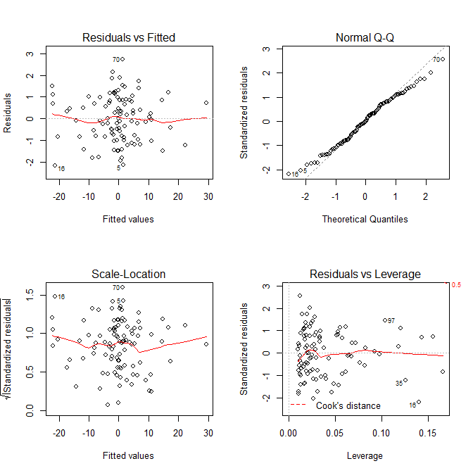
Casewise Diagnostic Plots
> par(mfrow=c(2,2))
> plot(lm.x1mx2)

Slide 18
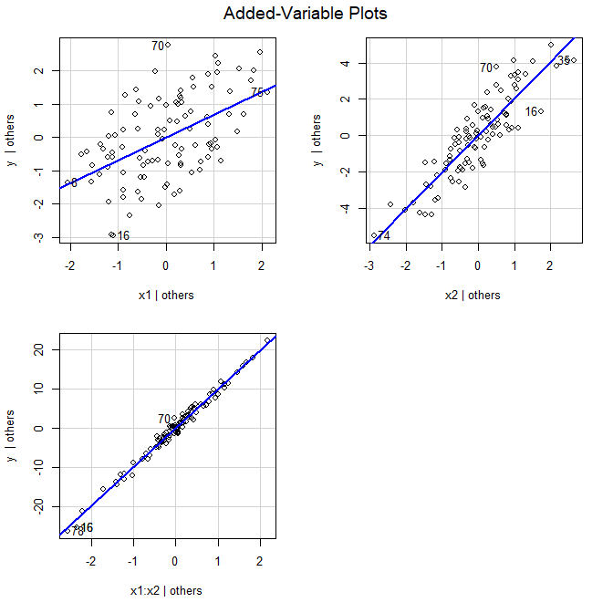
Added Variable Plots
> avPlots(lm.x1mx2)

Slide 19
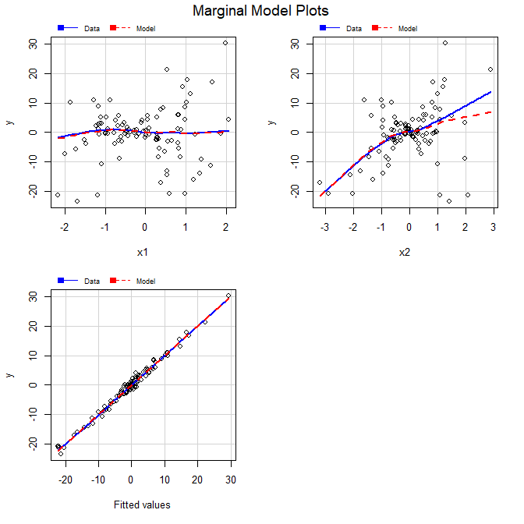
Marginal Model Plots
> mmps(lm.x1mx2)

Slide 20
Another example
> y <- 1 + x1 + x2^2 + + rnorm(100)
>
> lm.x1px2 <- lm(y ~ x1 + x2)
> lm.x1mx2 <- lm(y ~ x1 * x2)
> lm.x1px2sq <- lm(y ~ x1 + + I(x2^2))
>
> summary(lm.x1px2)
Call:
lm(formula = y ~ x1 + x2)
Coefficients:
Est SE t p
(Int) 1.82 0.19 9.49 0.00 ***
x1 1.24 0.20 6.08 0.00 ***
x2 -0.30 0.19 -1.55 0.12
---
Residual standard error: 1.904 on 97 degrees of freedom
Multiple R-squared: 0.3014, Adjusted R-squared: 0.287
F-statistic: 20.93 on 2 and 97 DF, p-value: 2.779e-08

Slide 21
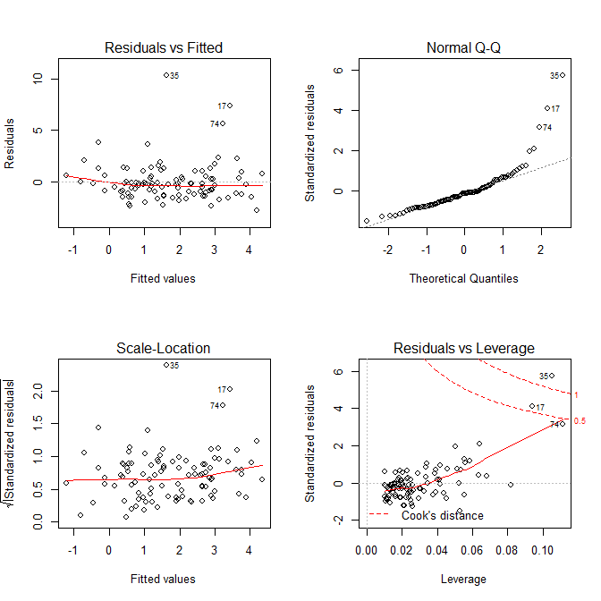
Casewise Diagnostic Plots
> par(mfrow=c(2,2))
> plot(lm.x1px2)

Slide 22
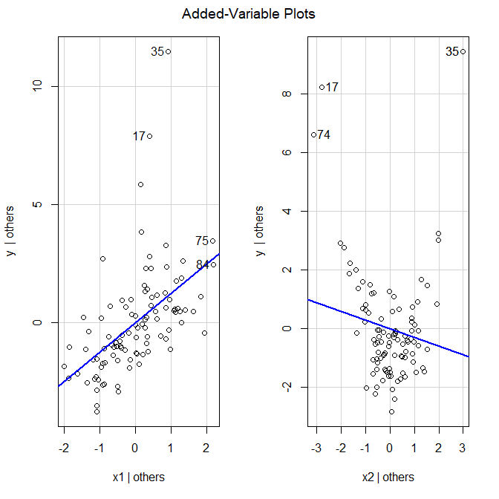
Added Variable Plots
> avPlots(lm.x1px2)

Slide 23
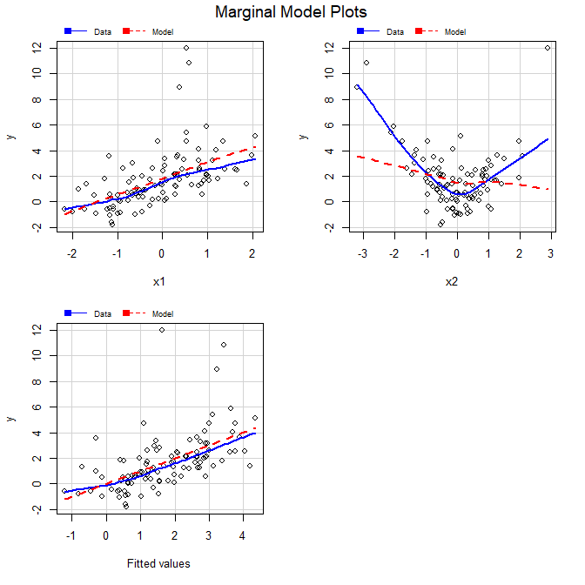
Marginal Model Plots
> mmps(lm.x1px2)

Slide 24
What if we think an interaction will fix it?
> summary(lm.x1mx2)
Call:
lm(formula = y ~ x1 * x2)
Coefficients:
Estimate Std. Error t value Pr(>|t|)
(Intercept) 1.7774 0.1895 9.380 3.19e-15 ***
x1 1.2891 0.2024 6.370 6.52e-09 ***
x2 -0.2321 0.1922 -1.208 0.2301
x1:x2 -0.4607 0.2340 -1.969 0.0518 .
---
Residual standard error: 1.877 on 96 degrees of freedom
Multiple R-squared: 0.3286, Adjusted R-squared: 0.3076
F-statistic: 15.66 on 3 and 96 DF, p-value: 2.29e-08

Slide 25
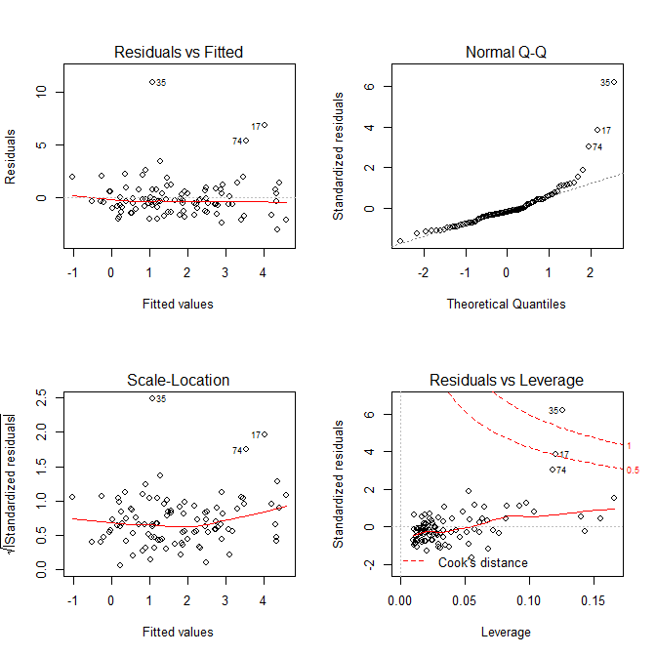
Casewise Diagnostic Plots
> par(mfrow=c(2,2))
> plot(lm.x1mx2)

Slide 26
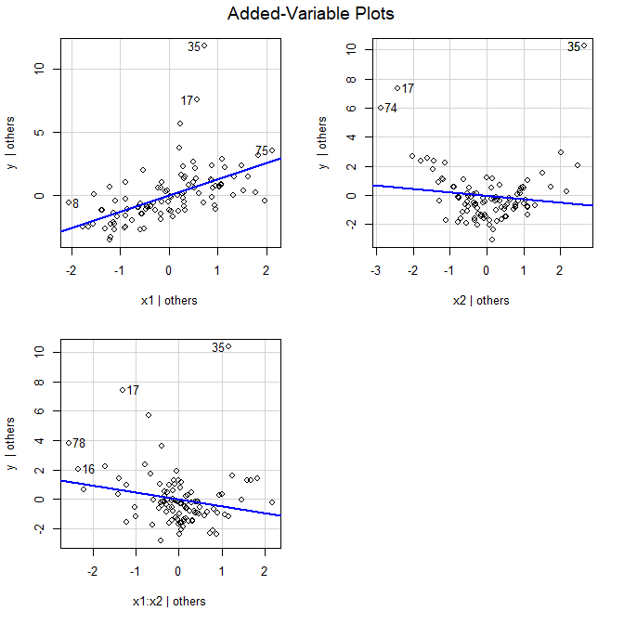
Added Variable Plots
> avPlots(lm.x1mx2)

Slide 27
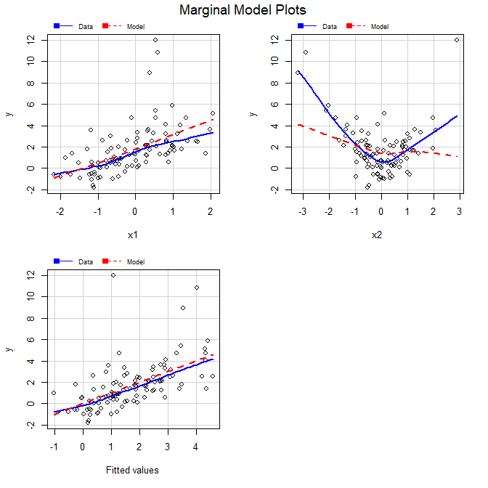
Marginal Model Plots
> mmps(lm.x1mx2)

Slide 28
And now the correct model (with x2 squared term)..
> summary(lm.x1px2sq)
Call:
lm(formula = y ~ x1 + I(x2^2))
Coefficients:
Estimate Std. Error t value Pr(>|t|)
(Intercept) 0.85241 0.11038 7.722 1.04e-11 ***
x1 1.04216 0.10171 10.247 < 2e-16 ***
I(x2^2) 0.96300 0.05522 17.438 < 2e-16 ***
---
Residual standard error: 0.9481 on 97 degrees of freedom
Multiple R-squared: 0.8269, Adjusted R-squared: 0.8233
F-statistic: 231.6 on 2 and 97 DF, p-value: < 2.2e-16

Slide 29
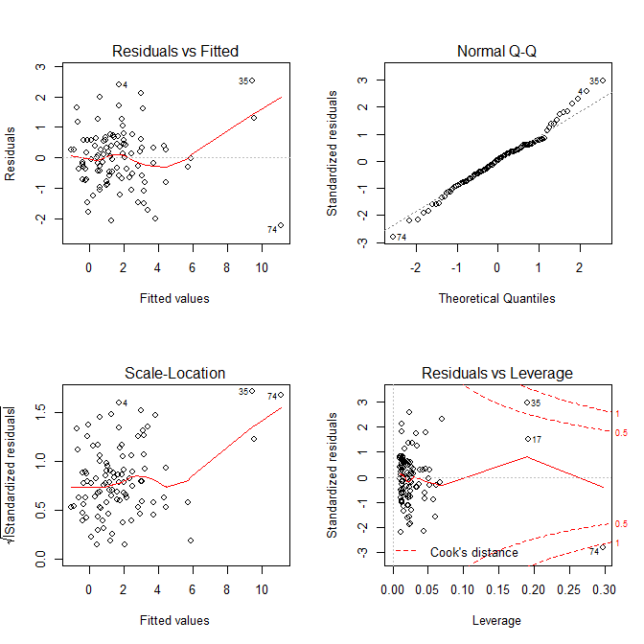
Casewise Diagnostic Plots
> par(mfrow=c(2,2))
> plot(lm.x1px2sq)

Slide 30
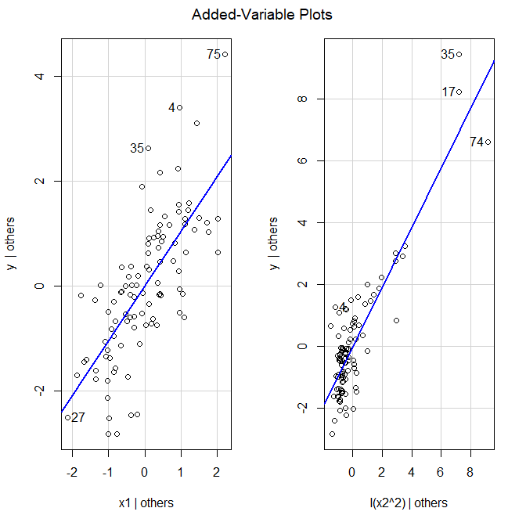
Added Variable Plots
> avPlots(lm.x1px2sq)

Slide 31
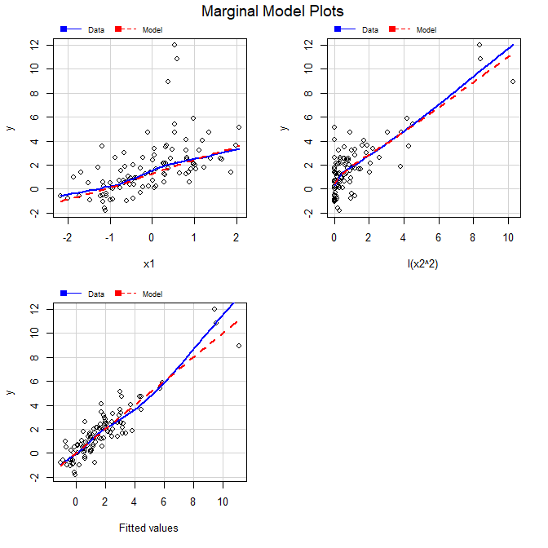
Marginal Model Plots
> mmps(lm.x1px2sq)

Slide 32
Moral of the Story
Nonlinearity can show up in lots of ways, in lots of graphs
In casewise diagnostic plots
As nonlinearity
As nonconstant variance
As Non-normality (!!!)
In added-variable and marginal model plots
Nonlinearity shows up more clearly
Not always obvious what the right transformation would be.

Slide 33
Perspectives and Recommendations
Substantive (investigator-driven) considerations always come first
Power transforms of X to reduce leverage & Power transforms of Y to improve distribution of
By hand, or Box-Cox rounded to a simple power
Inverse response plot for power transform of Y
Visually appealing, but Box-Cox probably better (directly addresses distribution of )
Added Variable Plots and Marginal Model Plots can indicate nonlinearity, missing interactions, etc.
There does not always exist a “perfect” transform!

Slide 34
Summary
From last time:
Variance Stabilization for Y
Can residual plots distinguish y⁽¹⁾ = β₀ + β₁x² + ε, vs. y⁽²⁾ = (β₀ + β₁x + ε)² ?
Inverse Response Plot for Y
Added Variable Plots
Marginal Model Plots
Perspective and recommendations

