Slide 1
36-617: Applied Linear Models
Transformation of Variables
Brian Junker
132E Baker Hall
brian@stat.cmu.edu
TexPoint fonts used in EMF.
Read the TexPoint manual before you delete this box.: AAAAAAAAA

Slide 2
Announcements
Quiz 02 available at 5pm – due Tues at 7pm
HW02 – Due tonight at 11:59pm
Reading
This week: Sheather Ch 6 (diagnostics & transformations)
(supplemental: ISLR 3.3.3; G&H Ch 4)
Next week: Sheather Ch 7 (variable selection)
(supplemental: ISLR Ch 6; G&H Ch 4)
HW 03 out on Canvas
Due Mon 1159pm

Slide 3
Outline
Quick Review of Casewise Diagnostic Plots
Transformations -- Why & How for X and Y
Aside: the approach I suggested in HW01 solutions
Substantive (investigator-driven) considerations
Variance Stabilization for Y
Box-Cox for X or Y: Fix distribution(s)
Inverse Response Plot for Y
Perspective and recommendations
Aside: the approach I suggested in HW01 solutions
Can residual plots distinguish y⁽¹⁾ = β₀ + β₁x² + ε, vs. y⁽²⁾ = (β₀ + β₁x + ε)² ?

Slide 4
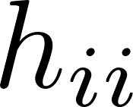
Casewise Diagnostics and Patterns
Mean zero?
Outliers?
Functional depen- dence on ?
Normal?
Outliers?
Large enough sample?
Constant variance?
Outliers?
Functional depen- dence on ?
NE & SE corners:
High leverage
High std resid
D_{i} > 0.5 or so?
Generally these are conversation points
Could reveal things investigator cares about!
Otherwise, look for data collection/recording errors
Delete data only with a good justification!

Slide 5
Transformations
Why to transform
Substantive (investigator-driven) reasons
Improving fit of data to modelling assumptions; makes formal (and informal) inference more valid
Why not to transform
Substantive (investigator-driven) reasons!
What to transform
X: often trying to reduce leverage; normality is an informal target
Y: really trying to improve distribution of , but access is indirect
X and/or Y: linearity wrong; improve functional form y= f(x)
How to transform
We will concentrate on power-function methods for now
Nonparametric function estimation (e.g. gam() in R) provides another approach

Slide 6
Aside: Approach in HW01 Solutions
In the solutions to HW01, I recommended trying each of these approaches:
For all the variables (y as well as the x’s), find any that are asymmetric (skewed) and transform each one to make it more symmetric
OR
Use the scatterplot matrix to find x’s that are nonlinearly related to y, and then transform the x so that it is more linearly related to y.
These are a heuristic one-variable-at-a-time approach to the more general recommendations in this lecture.
They often get you pretty far, and are almost always worth a try.
Limit yourself to simple transformations: $x^{2},\sqrt{y}, \sqrt{x},\log\left(y\right),\log\left(x\right),\exp\left(y\right),\exp\left(x\right), …$
Substantive (investigator) considerations $≫$ math, always!!

Slide 7
Transformations of X
If X is discrete or a design variable, there is usually no sensible transformation to make!
If X is continuous, it has an (empirical) distribution. We might want to transform X for any of three reasons
Substantive: we know Y is a nonlinear function of X, or we want a particular interpretation
Leverage: bring the (empirical) distribution of X closer to normality; reduces high-leverage points
Functional: y = f(X) is not linear and we want to find a better functional form for f()

Slide 8
Substantive Transformation of X
There might be substantive knowledge.
E.g. in physics if Y is the intensity of an effect at distance X, often an inverse-square law applies, so we might replace X with X’ = 1/X².
A better interpretation might be available
Recenter X so that the intercept is interpretable
Rescale X to change units of slope (e.g. to SD’s of X)
Percent change in X matters more than additive change: logarithms…

Slide 9
A Substantive reason for log transform: effect of percent change
For the model :
For the model :
(0.01) is the change in E[y] for a 1% change in x
We consider a small change in x, instead of a 1 unit change
(*)
(*) Since log(1+x) = x – x²/2 +/- … (Taylor series)
See also “log xform and percent interpretation.pdf”

Slide 10
Reducing leverage – power transforms
In regression, we are conditioning on X: so “officially” the distribution of X doesn’t matter
However, if the (empirical) distribution of X is skewed, many X’s will have high leverage.
Helps to make empirical distribution of X more symmetric – pull tails in
If X is skewed left (long left tail), X^{λ}, λ>1, pulls in tail
If X is skewed right (long right tail), X^{λ}, λ <1, pulls in tail
Since , useful to think “x⁰ = log(x)”

Slide 11
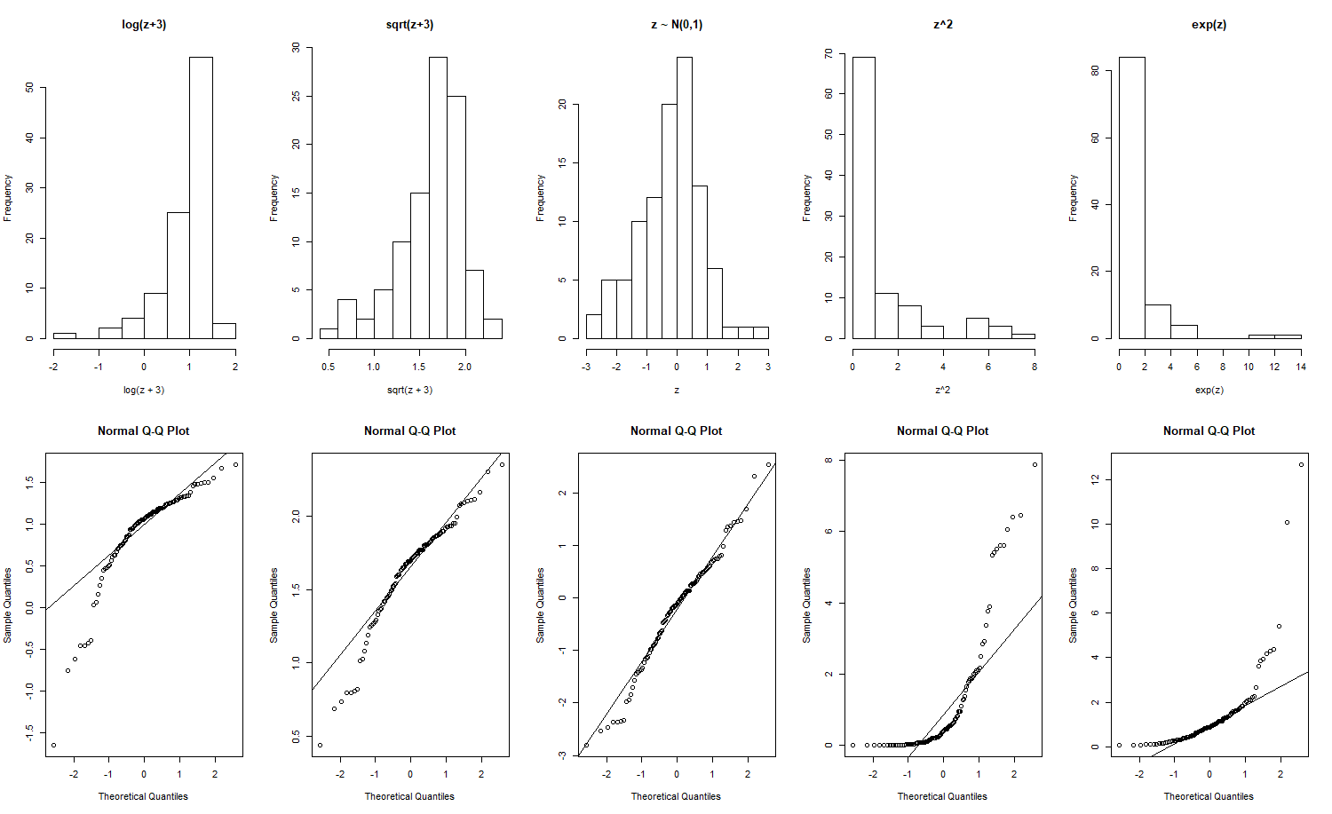
Aside: Reminder of distribution shapes
Short right tail
Long right tail
Short left tail
Long left tail
Transform back
to symmetry:
? ? ? ? ?

Slide 12
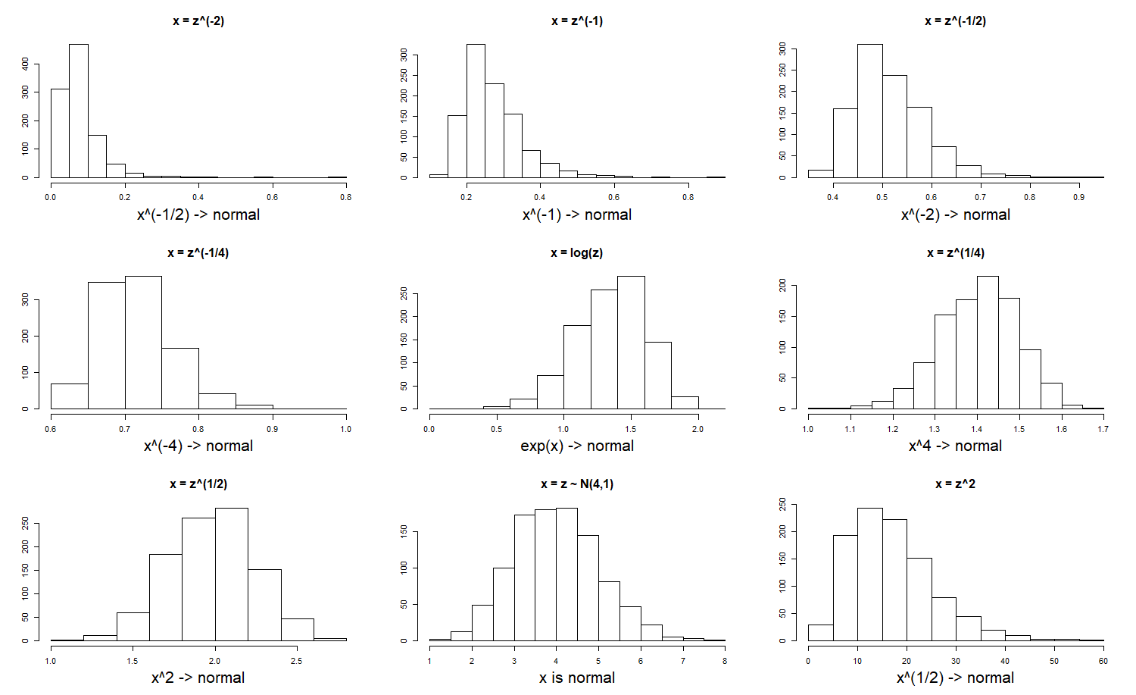
Effect of positive & negative powers: λ ∈ (-2,-1,-1/2, -1/4, 0*, 1/4, 1/2, 1, 2)

Slide 13
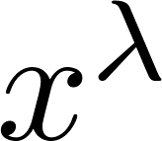
Reducing Leverage: Powers of X
Check for symmetry after trying simple powers
More formally, try to maximize likelihood
Box-Cox: Likelihood simplifies if we replace with
Usually suggests awkward values (λ = 0.33453) that should be “rounded” to a simpler power (λ = 1/3)
x is assumed to be positive!

Slide 14
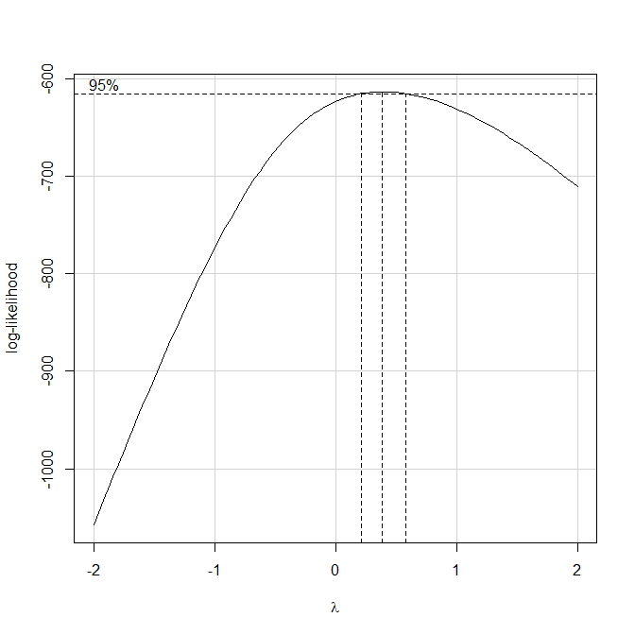
Implementing Box-Cox for X in R
library(car) (“Companion to Applied Regression^{(*)}”)
boxCox(): show Box-Cox likelihood as a function of λ (“profile likelihood”)
powerTransform(): compute optimal λ using the Box-Cox likelihood
> z <- rnorm(100,4,1)
> x <- z^3
> boxCox(x~1)
> powerTransform(x~1)
Estimated transformation parameter
x
0.390494
^{(*)} for Weissberg’s Applied Linear Regression text.

Slide 15
Functional: y = f(x) is not linear
We can replace with
This is also a good idea…
N.b., model (2) still assumes equal additive errors!
(1)
(2)

Slide 16
Transformations of Y
We might want to transform Y for any of three reasons:
Substantive: we know Y is a nonlinear function of X, or we want a particular interpretation
Improve residuals: bring the (empirical) distribution of ε_{i} closer to normality; makes inferences more valid
Functional: y = f(X) is not linear and we want to find a better functional form for f()

Slide 17
Substantive Transformation of Y
There might be substantive knowledge.
If we know 0< Y<100 (e.g. a test or hw score) we may need to transform Y before building a linear predictor for it: e.g. replace Y with log[Y/(100-Y)] ….
Percent change in Y :
For , let , then
= expected pct change in y per unit change in
(*)
(*) Since log(1+x) = x – x²/2 +/- … (Taylor series)
See also “log xform and percent interpretation.pdf”

Slide 18
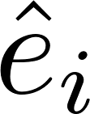
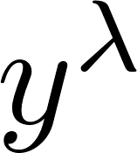
Improve Error (residual) Distribution
We want to replace with to improve the distribution of (or ).
Can do “by hand” or by applying Box-Cox to again, replace with …
$i^{th}$ row of X matrix

Slide 19
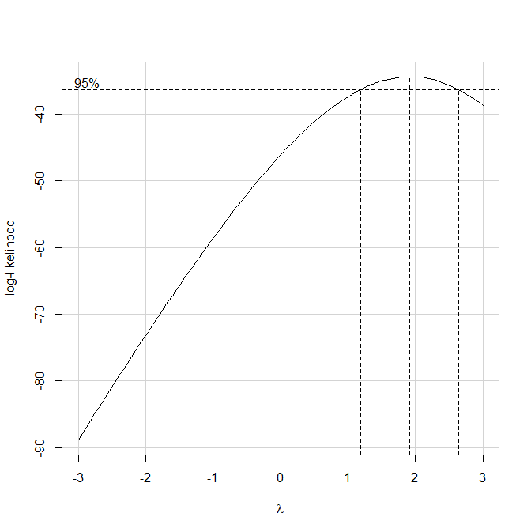
Implementing Box-Cox for Y in R
library(car) (“Companion to Applied Regression”)
boxCox(): show Box-Cox likelihood as a function of λ (“profile likelihood”)
powerTransform(): compute optimal λ using the Box-Cox likelihood
> z <- rnorm(100,4,1)
> y <- (1 + 3*z + rnorm(100,0,.25))^(1/2)
> lm.1 <- lm(y ~ z)
> boxCox(lm.1,lambda=seq(-3,3,.1))
> powerTransform(lm.1)
Estimated transformation parameter
Y1
1.922959

Slide 20
Improve Error (residual) Distribution: Variance-stabilizing Transformations
Suppose E[Y] = μ, and Var(Y) = h(μ). We want a transformation Y*=g(Y) such that Var(Y*)=Const
Taylor’s Theorem says
Therefore
We want this to be constant, i.e.

Slide 21
Variance-Stabilizing Transform Example
If Y ~ Poiss(μ), then we know E[Y]=μ and Var(Y)=μ
So h(μ)=μ, and
Therefore will have approximately constant variance (not depending on E[Y]).
Nonconstant variance in a scale-location plot consider a variance-stabilizing transformation.
“is proportional to”

Slide 22
Functional form of Y: Inverse Response Plot
Suppose then of course
It turns out¹ that if x has an elliptically symmetric distribution, then g can be estimated from a plot of vs , where are predicted values from
¹Li and Duan (1989), Cook and Weisberg (1994)

Slide 23
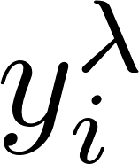
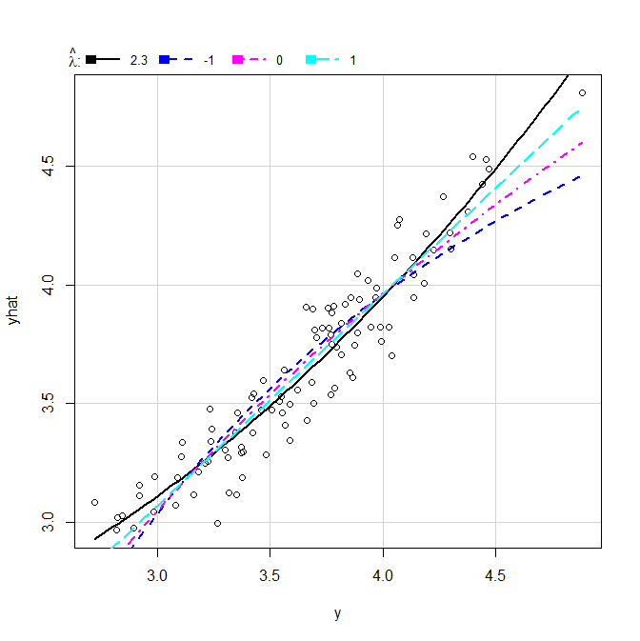
Implementing Inverse Response Plots In R
library(car) (“Companion to Applied Regression”)
invResPlot(): show inverse response plot ( vs. ) and calculate the power for by nonlinear least-squares^{(*)}
> z <- rnorm(100,4,1)
> y <- (1 + 3*z + rnorm(100,0,.25))^(1/2)
> lm.1 <- lm(y ~ z)
> invResPlot(lm.1)
lambda RSS
1 2.300377 1.711786
2 -1.000000 2.711177
3 0.000000 2.211967
4 1.000000 1.874950
y’ = y^(2.3)
y’ = 1/y
y’ = log(y)
y’ = y
^{(*)} Specify particular lamdas to try with
the lambda=c(…) argument.

Slide 24
Perspectives and Recommendations
Substantive (investigator-driven) considerations always come first
Power transforms of X to reduce leverage & Power transforms of Y to improve distribution of
By hand, or Box-Cox rounded to a simple power
Inverse response plot for power transform of Y
Visually appealing, but Box-Cox probably better (directly addresses distribution of )
There does not always exist a “perfect” transform!
Transform for fcn form – depends on resid. plots!

Slide 25
Aside: Approach in HW01 Solutions
In the solutions to HW01, I recommended trying each of these approaches:
For all the variables (y as well as the x’s), find any that are asymmetric (skewed) and transform each one to make it more symmetric
OR
Use the scatterplot matrix to find x’s that are nonlinearly related to y, and then transform the x so that it is more linearly related to y.
These are a heuristic one-variable-at-a-time approach to the more general recommendations in this lecture.
They often get you pretty far, and are almost always worth a try.
Limit yourself to simple transformations: $x^{2},\sqrt{y}, \sqrt{x},\log\left(y\right),\log\left(x\right),\exp\left(y\right),\exp\left(x\right), …$
Substantive (investigator) considerations $≫$ math, always!!

Slide 26
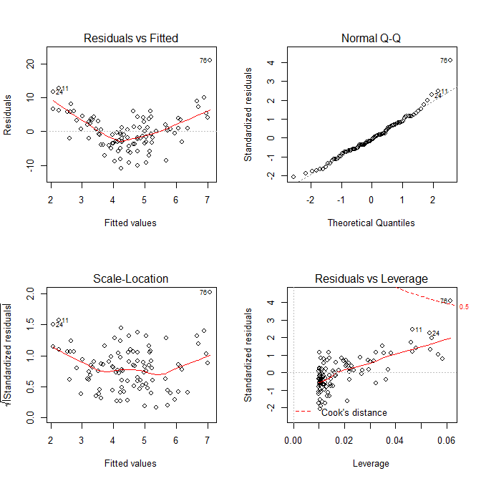
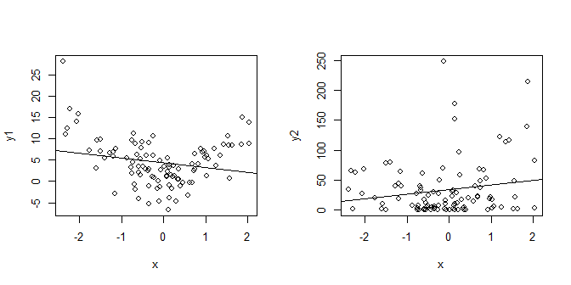
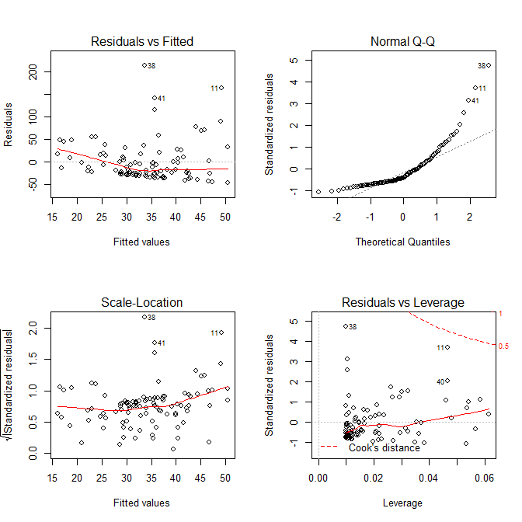
Can residual plots distinguish y⁽¹⁾ = β₀ + β₁x² + ε, vs. y⁽²⁾ = (β₀ + β₁x + ε)² ?
x <- rnorm(100,0,1)
y1 <- 1 + 3*x^2 + rnorm(100,0,4)
y2 <- (1 + 3*x + rnorm(100,0,4))^2
lm.1 <- lm(y1~x)
lm.2 <- lm(y2~x)
par(mfrow=c(2,2))
plot(x,y1); abline(lm.1)
plot(x,y2); abline(lm.2)
par(mfrow=c(2,2))
plot(lm.1)
plot(lm.2)

Slide 27
Outline
Quick Review of Casewise Diagnostic Plots
Transformations -- Why & How for X and Y
Aside: the approach I suggested in HW01 solutions
Substantive (investigator-driven) considerations
Variance Stabilization for Y
Box-Cox for X or Y: Fix distribution(s)
Inverse Response Plot for Y
Perspective and recommendations
Aside: the approach I suggested in HW01 solutions
Can residual plots distinguish y⁽¹⁾ = β₀ + β₁x² + ε, vs. y⁽²⁾ = (β₀ + β₁x + ε)² ?

