Slide 1
36-617: Applied Linear Models
Regression Basics
Brian Junker
132E Baker Hall
brian@stat.cmu.edu
TexPoint fonts used in EMF.
Read the TexPoint manual before you delete this box.: AAAAAAAAA

Slide 2
Monday is a holiday (Labor Day)
No class, no office hours
HW01 will be due Tuesday evening
Since there are no office hours Monday, I will hold an extra office hour:
  Tuesday, 11:30am-12:30pm
  132E Baker Hall

Slide 3
Reading, HW & TA Office Hours
Reading:
  Sheather Ch’s 1-2 – for this week!
  Handouts in week02 folder in Canvas files area – for next week!
    I will not cover everything in the chapters
    You will need to read & try some things on your own!
HW01 out later today; due next Tue at midnight
  Several “technical” exercises (math, R, data analysis, thinking)
  Normally HW due on Mondays, but this Monday is a holiday…
TA (Lorenzo – lthomasel@andrew.cmu.edu) Office hours
  8:45-9:45 Mondays
  12-1 Thursdays
  Location TBA
  Let’s see if the Monday office hour works…

Slide 4
Outline
The Linear Regression Model
  Lazy formulation
  Long formulation
  Matrix formulation
Least Squares and Maximum Likelihood
Distribution of Estimated Coefficients
SST = SSreg + RSS, R², Anova Table
Confidence & Prediction Intervals for y’s
Example….

Slide 5


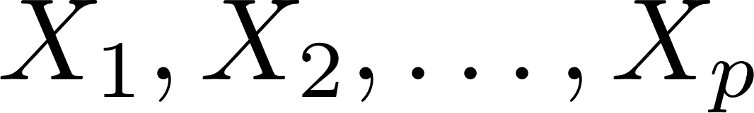

The Linear Regression Model
A lazy formulation
  y is the response variable, a.k.a. dependent variable
  = intercept; = coefficients/slopes/effects
  also have many equivalent names:
    predictors / Independent variables / Regressors / Covariates
  is “error” (better: random deviation from mean)
  Quick, easy hand-waving, emphasizes functional form
  Easy to replace abstract letters with meaningful words…
  (kid.score) = (intcpt) + (coef1)(mom.hs) +
  (coef2)(mom.iq) + (error)

Slide 6
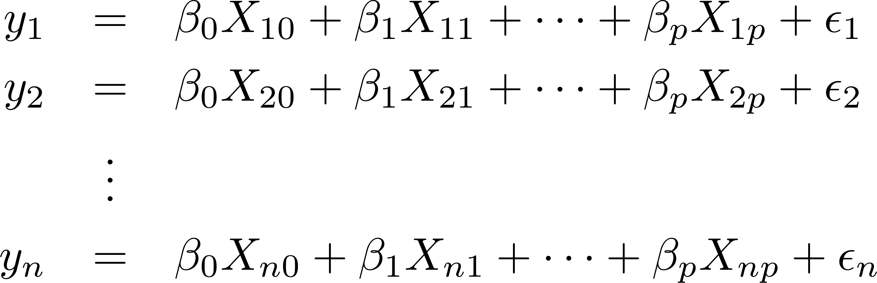
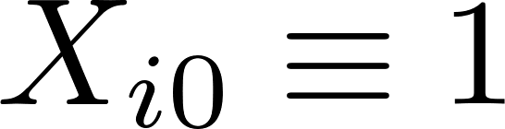
The Linear Regression Model
A longer, more accurate formulation
, a column of 1’s (for the intercept!)
n = number of “units” or “cases”;
k = p+1 = number of “predictors” or “covariates”

Slide 7
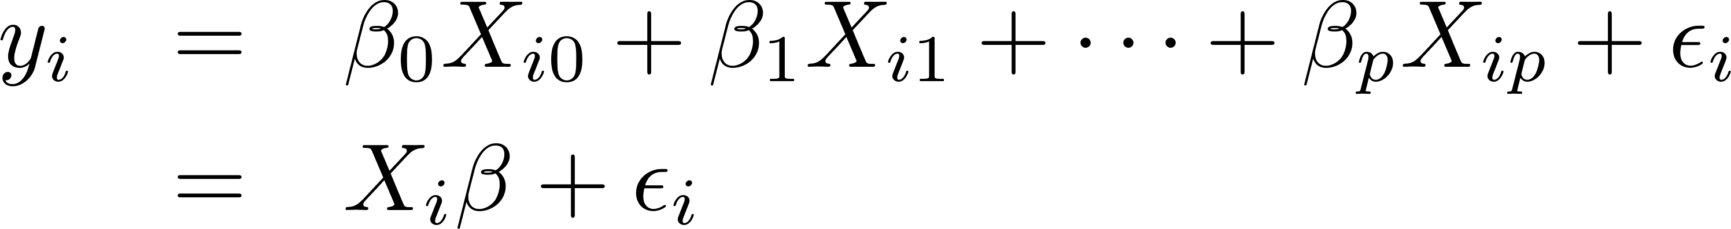
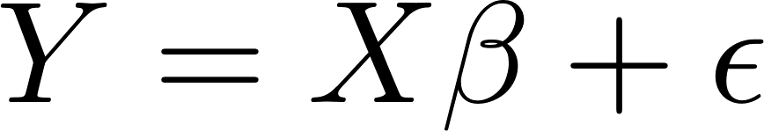
The Linear Regression Model
A matrix formulation…
Let X_{i} = (X_{i0}, …, X_{ip}) and ¯ = (¯₀, …, ¯_{p})^{T}; then
If we also stack Y = (Y₁, …,Y_{n})^{T}, X = (X₁^{T}, …, X_{n}^{T})^{T}, and ² = (²₁, …²_{n})^{T}, we can write
Has all the information of the Long Formulation
Lends itself to compact formulas & computation

Slide 8
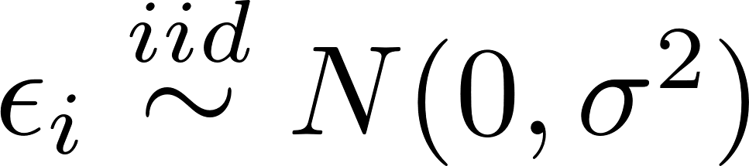
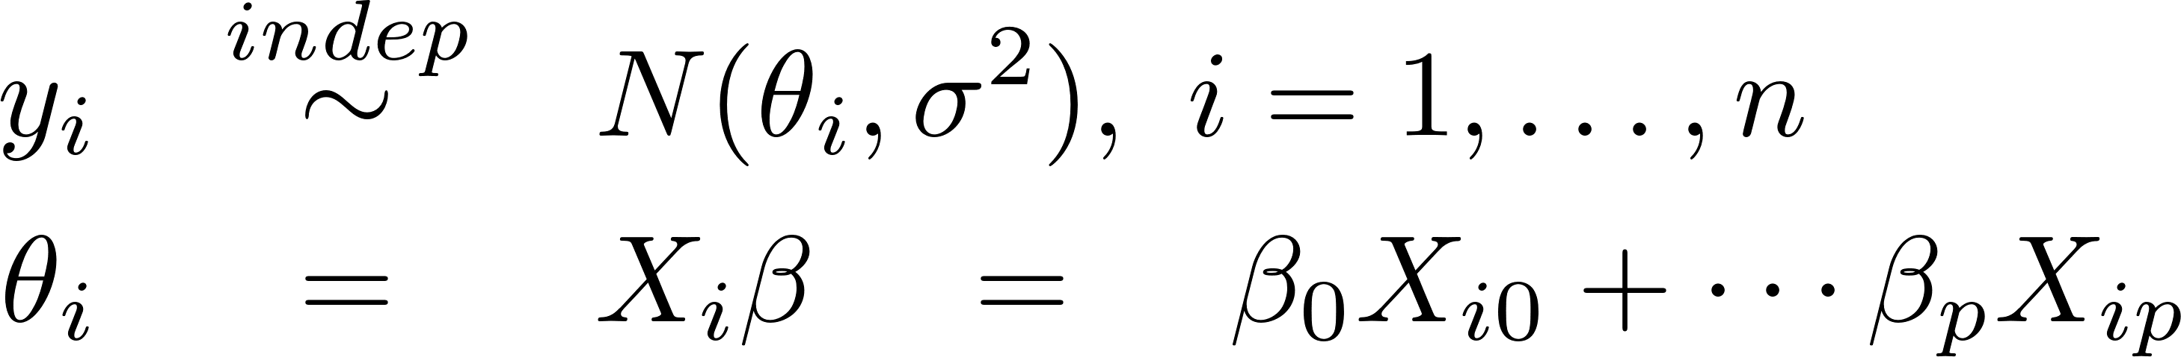
Linear Regression Model:
Mean + Error Distribution
In the model
It is usual to assume
We can write this as
  Each y_{i} ² (-1, 1) has some mean µi = E[y_{i}|X_{i}]
  Each µi has some linear structure
  There is a statistical distribution N( *, ¾²) that describes unmodeled variation around µ_{i} = E[y_{i}|X_{i}]

Slide 9
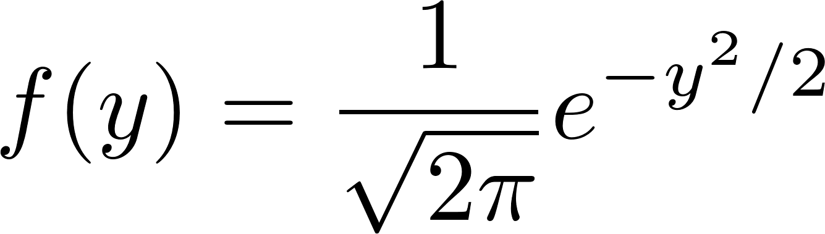
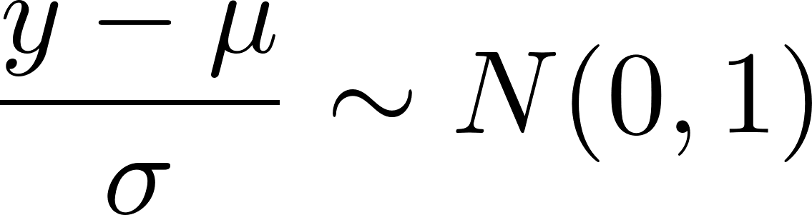
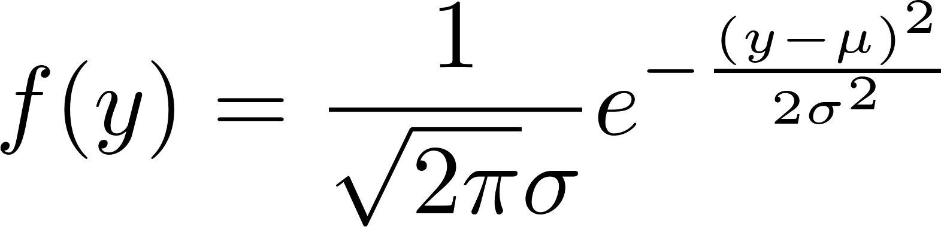
Aside: The Normal Distribution
Y ~ N(0,1) iff
Y ~ N(¹,¾²) iff

Slide 10
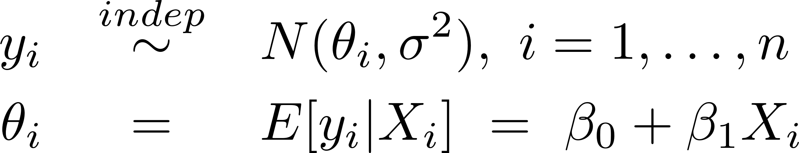
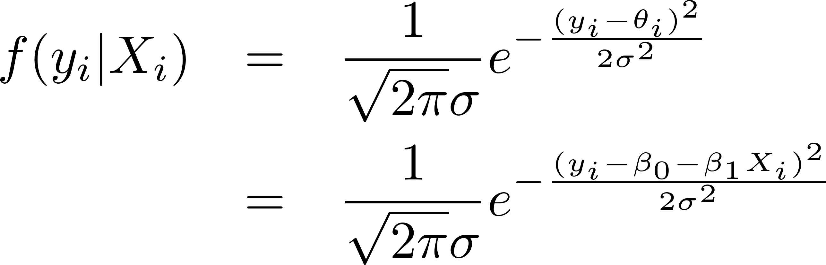
Least Squares for Simple Linear Regression, From the Model
Starting with the simple linear regression model
we see that the density for y_{i} is

Slide 11
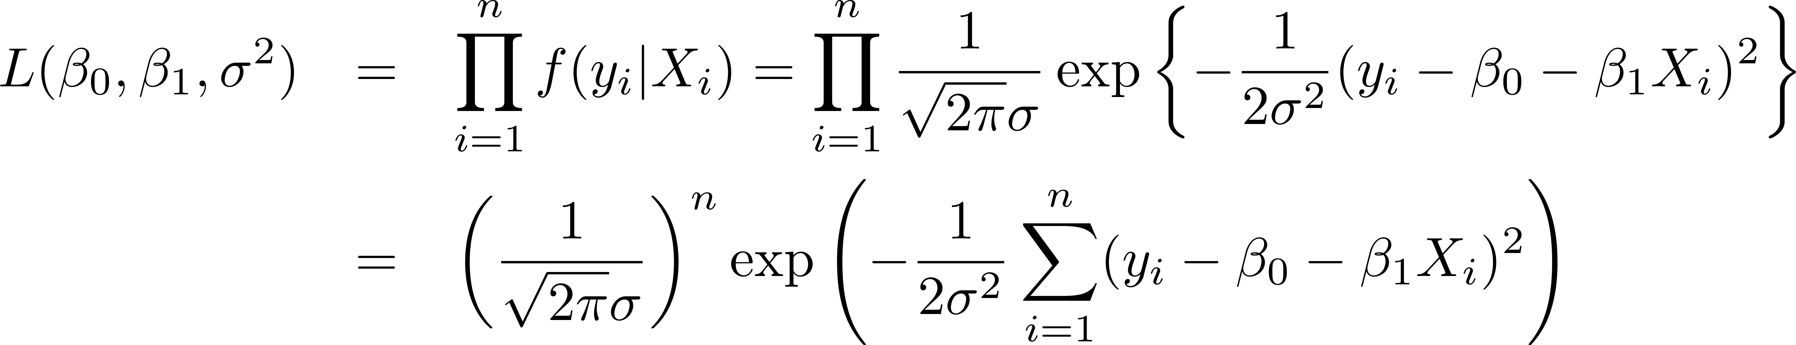
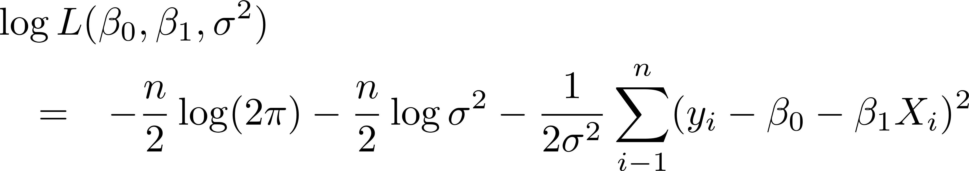
Least Squares & Maximum Likelihood
Independence allows us to write the likelihood as
The log-likelihood is then

Slide 12
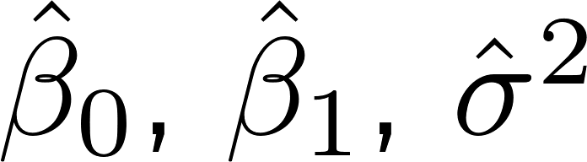
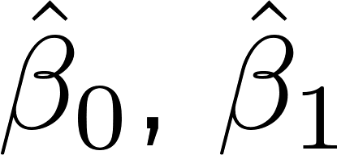
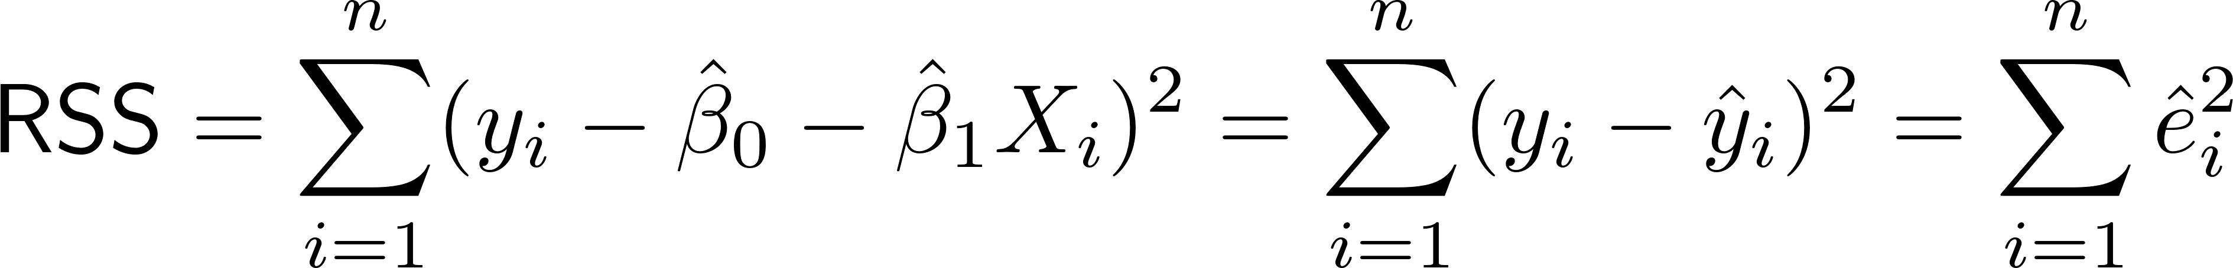
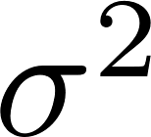
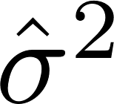
Least Squares & Maximum Likelihood
The MLE’s are found by maximizing
  MLE’s minimize the residual sum of squares
  for any positive .
  The MLE will then just depend on the minimized RSS.

Slide 13
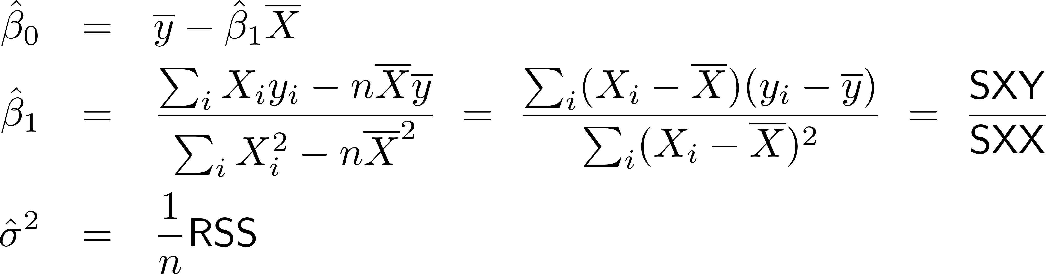
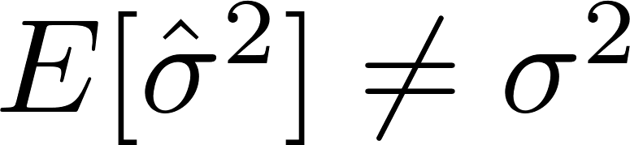
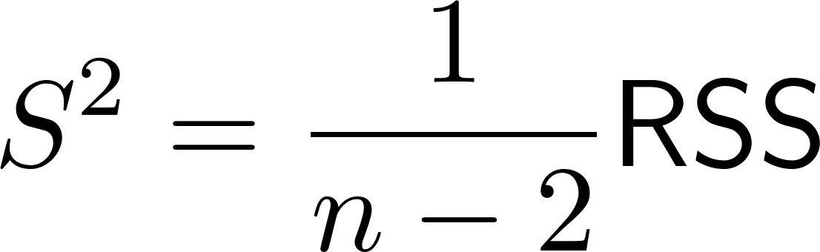
Least Squares & Maximum Likelihood
After a little calculus,
It can be shown that is biased: ;
instead we usually use the unbiased estimator¹
(2 = k = p+1 = number of estimated coefs = df)
¹See e.g. Weissberg (2013) Applied Linear Regression.

Slide 14
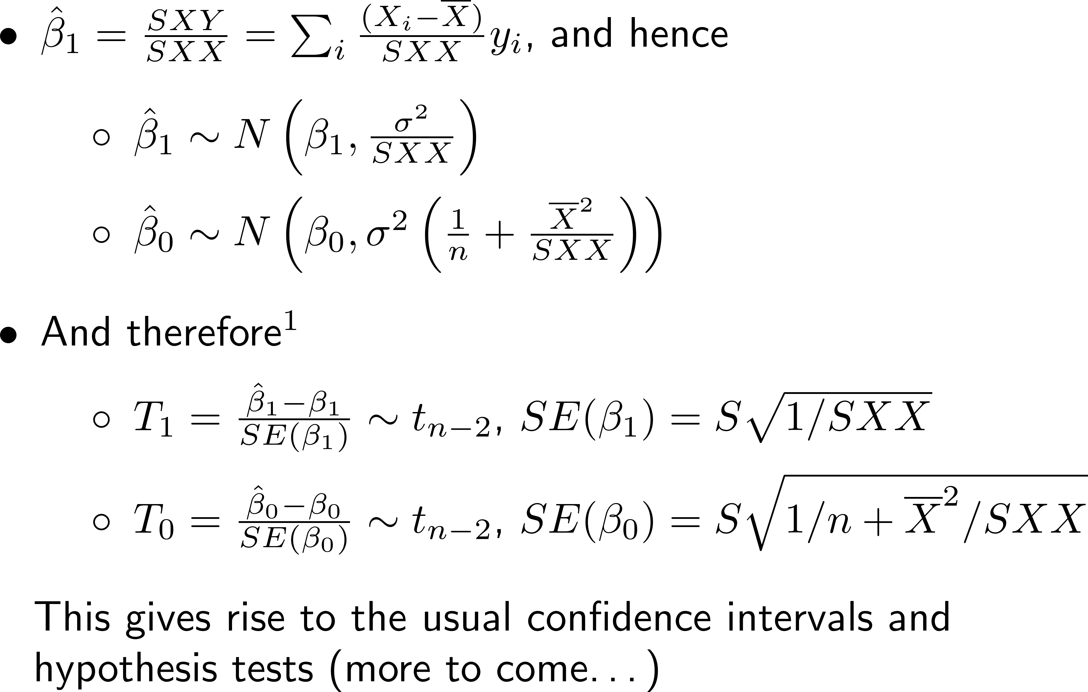
Distribution of Estimated Coefficients
¹See e.g. Weissberg (2013) Applied Linear Regression.

Slide 15
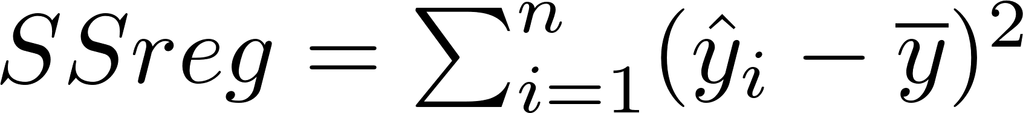
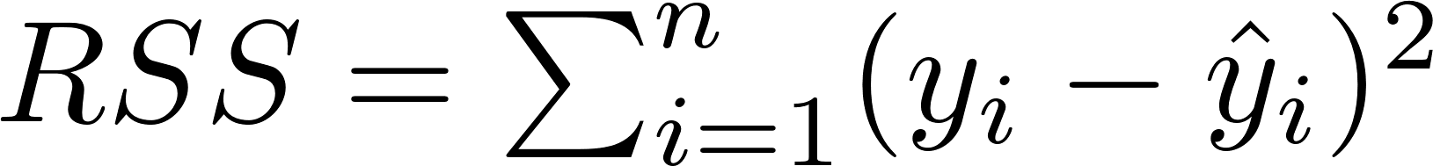
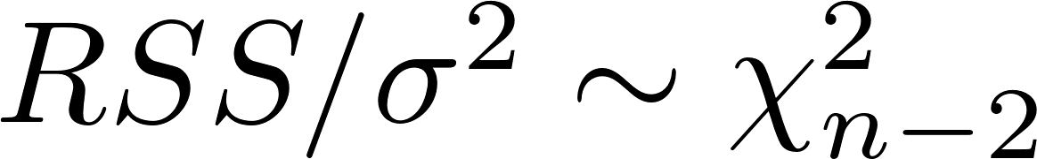
Partitioning Sums of Squares…
It’s easy to see that
If we square both sides and do a little algebra we get SST = SSreg + RSS, where
  (why isn’t this obvious? – you will show it in HW01!)
Moreover¹ SSreg is independent of RSS, and
¹See e.g. Weissberg (2013) Applied Linear Regression.

Slide 16
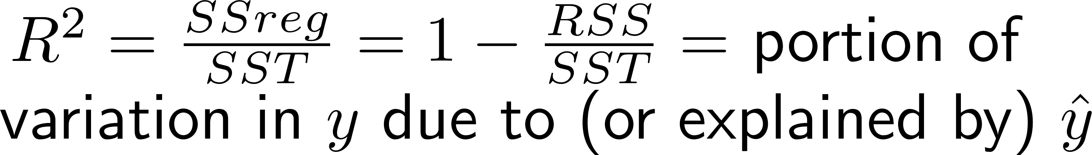
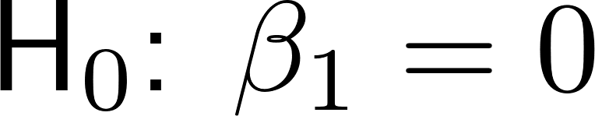
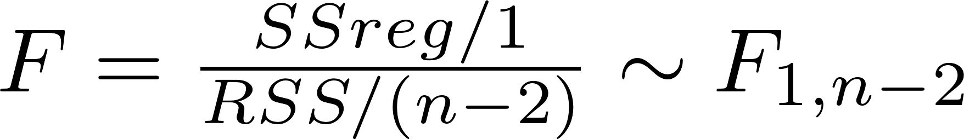
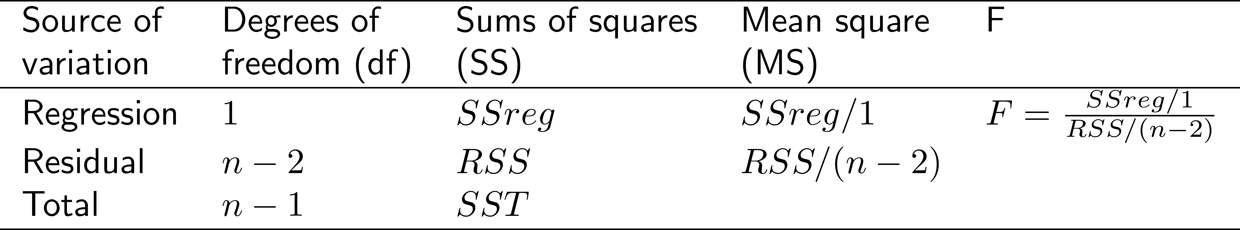
From SST = SSreg + RSS, Anova Table
  Also R² = [Corr(X,y)]² in the data (algebra!)
When is true,
The traditional Analysis of Variance table
will later be generalized to p>1 predictors X₁ , …, X_{p}

Slide 17

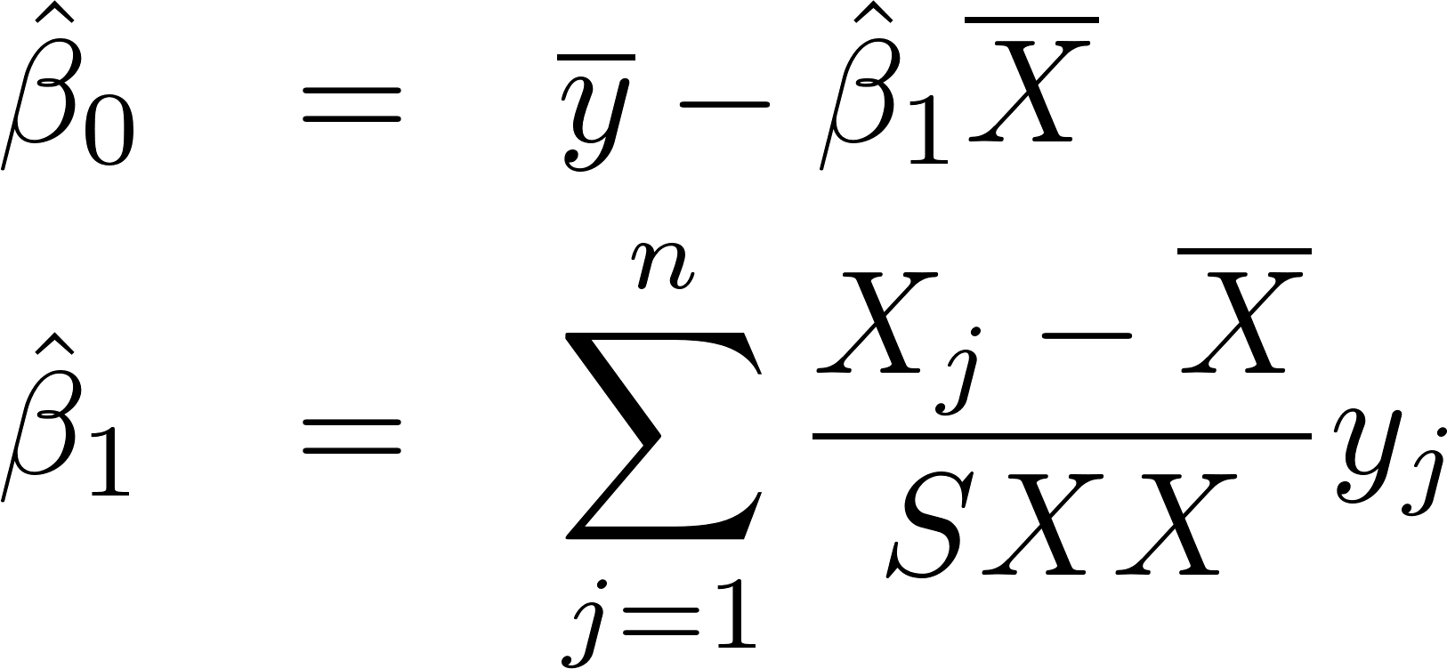
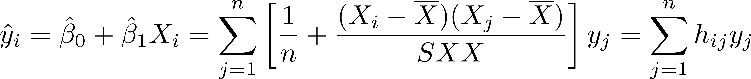
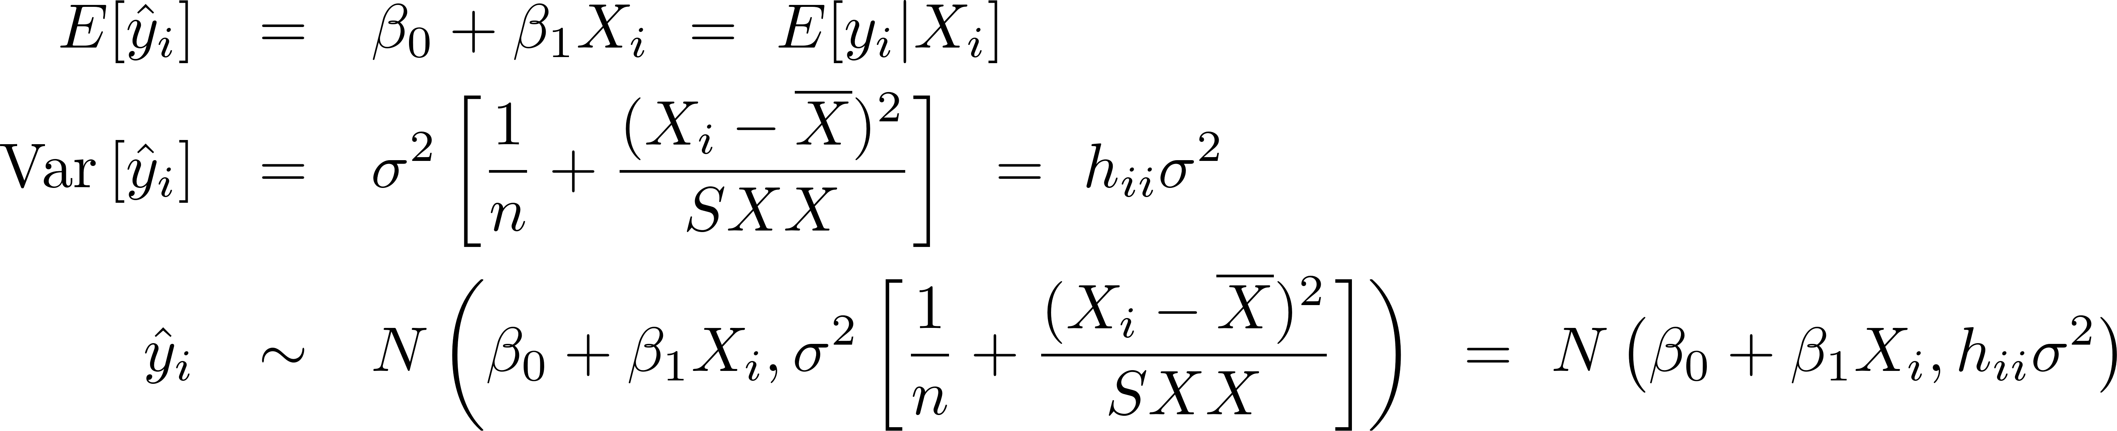
Distribution of
Combining
  with a little algebra, we can show
Therefore

Slide 18


Confidence Interval for a point y* on the regression line
Let X* be a new X value, and let y* be the new y value:
A CI for the point
on the regression line is
  where , and t is an appropriate cutoff (around 2 for a 95% interval, e.g.)

Slide 19
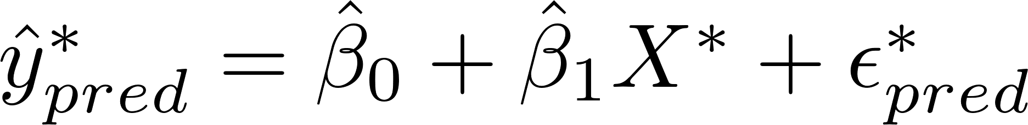
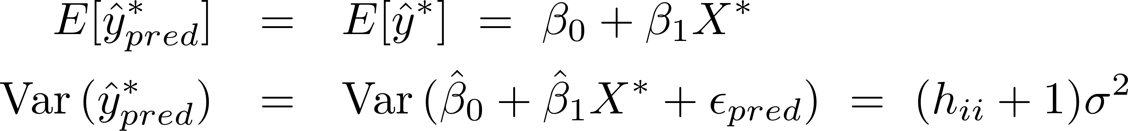
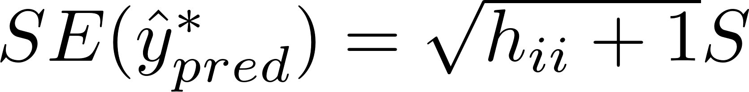
Prediction Interval for a new obs. y*
Again let X* be a new value, and now consider predicting y* itself at that X*:
Using the same sorts of calculations as before,
So a prediction interval for y*_{pred} would be
where

Slide 20
Example…

Slide 21
Summary
The Linear Regression Model
  The Lazy, Long and Matrix Formulations
  Least Squares and Maximum Likelihood
  Distribution of Estimated Coefficients
  SST = SSreg + RSS, R², Anova Table
  Confidence & Prediction Intervals for y’s
HW01 out later today – due next Tues
Read Ch 3 for next week
TA Office hours?

