Slide 1
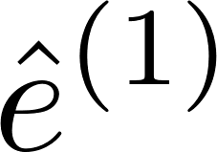
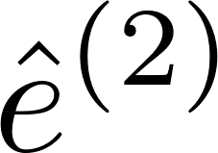
Added-Variable Plots (add Z? or f(Z)?)
Suppose the true model is
Let us fit the models
If we multiply the true model by (I-H_{X}), we get so, plotting (or regressing) on will reveal !

Slide 2
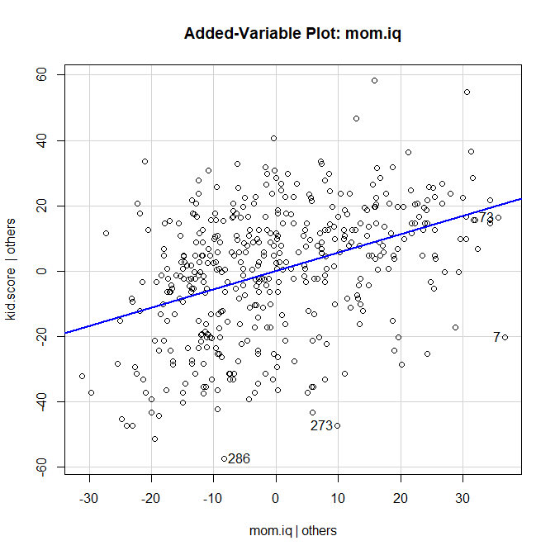
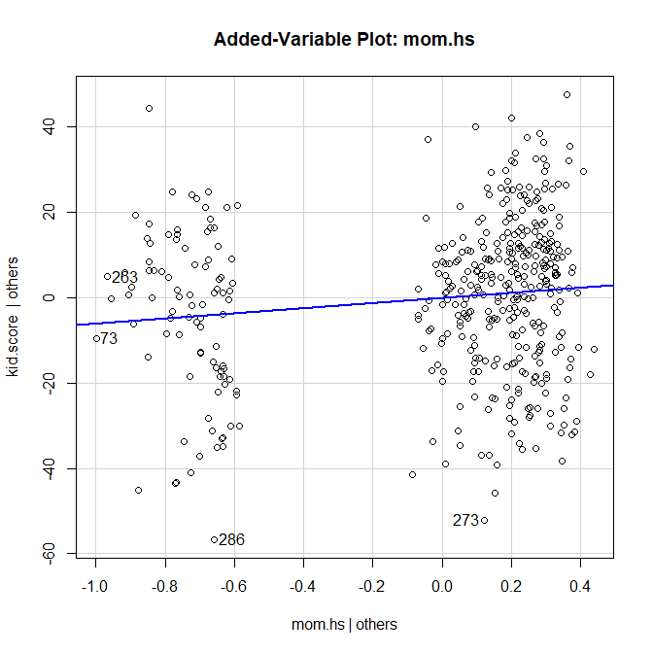
Added-Variable Plots – Example…
> library(car) > lm.3
Call:
lm(formula = kid.score ~ mom.iq + mom.hs, data = kidiq)
Coefficients:
(Intercept) mom.iq mom.hs
25.7315 0.5639 5.9501
> avPlot(lm.3,"mom.iq")
> avPlot(lm.3,"mom.hs")

Slide 3
Added-Variable Plots – Interpretations
Shows γ as the effect of Z after controlling for X, on Y, after controlling for X
Allows you to visually assess the importance of γ
Also allows you to check for nonlinearity in predicting Y from Z, after controlling for X
Another plot that allows us to assess nonlinearity is the marginal model plot – next week!

