Slide 1
36-617: Applied Linear Models
Multiple Regression
Brian Junker
132E Baker Hall
brian@stat.cmu.edu
TexPoint fonts used in EMF.
Read the TexPoint manual before you delete this box.: AAAAAAAAA

Slide 2
Announcements
HW01 is (finally!) available on Canvas
Due next Wed Sept 7, 11:59pm
Submit a single pdf to Gradescope within Canvas
Reading
For this week: Sheather Ch 5 (supplemental: ISLR 3.1, 3.2; G&H Ch 3)
For next week: ISLR 3.1, 3.2, 3.3.1, 3.3.2 (supplemental: G&H Ch 3)
“Monday Quiz” will be on Weds next week.
Available after class on Canvas
You have until 5pm Thu to do the quiz
Covers only Sheather Ch 5

Slide 3
Outline
Matrix Form of Multiple Regression Model
Regression - ML/LS Estimates
Distributional Properties
Standard Error vs Standard Deviation
R’s Casewise Diagnostic Plots
Confidence Intervals and Prediction Intervals

Slide 4
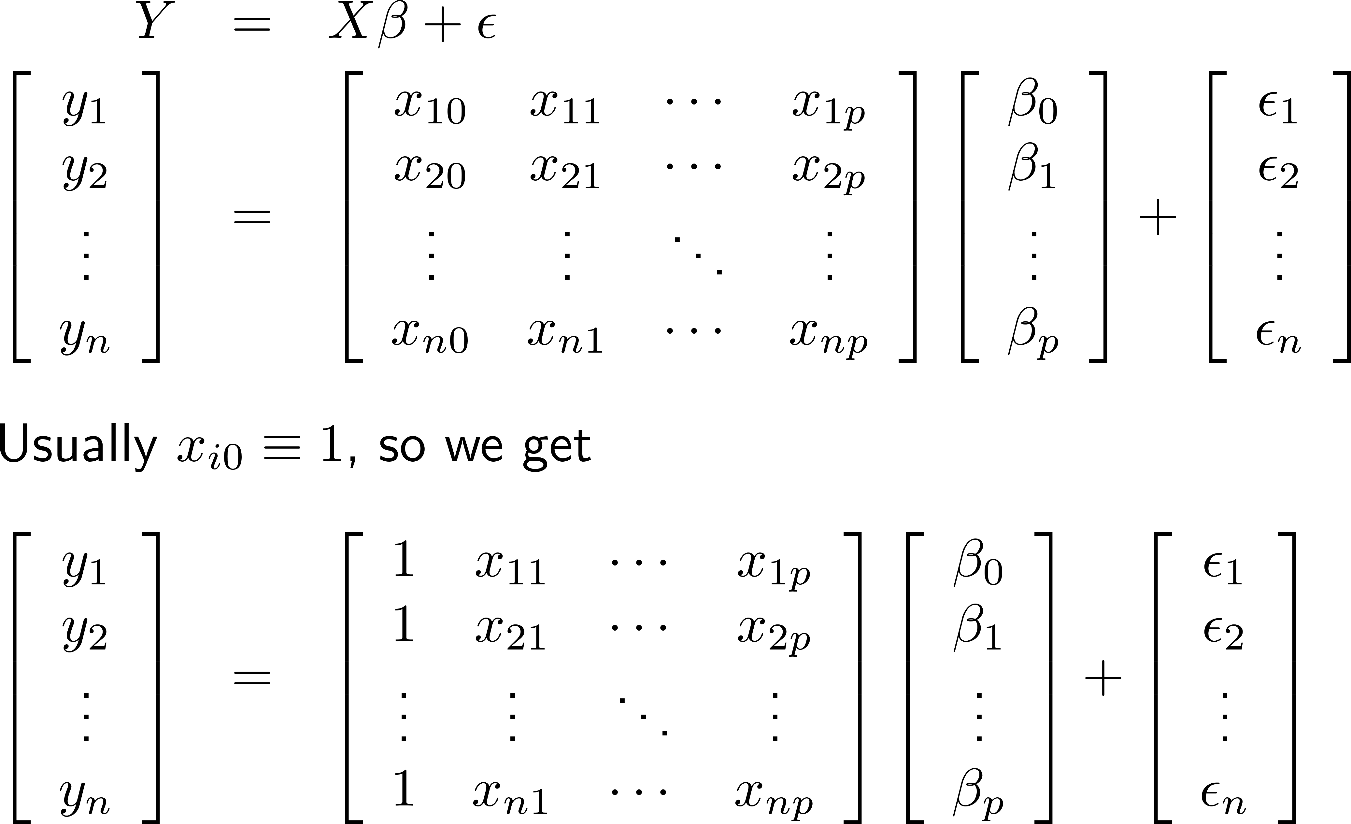
Matrix Form of Multiple Regression Model

Slide 5
Regression – ML/LS Estimates
The “residual SD” is the square root of
With a little more matrix algebra,
“Hat matrix”
Recall that k=p+1

Slide 6
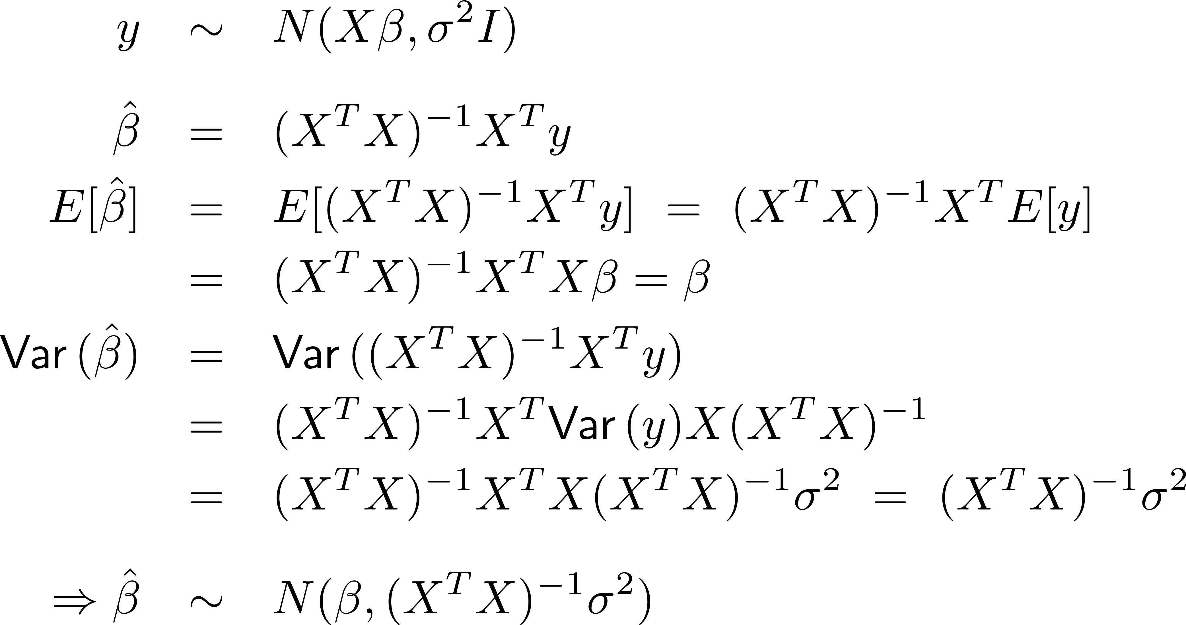
Distributional Properties:
c
c

Slide 7
Standard Error vs. Standard Deviation
Because $\hat{β}={\left(X^{T}X\right)}^{−1}X^{T}y$ is a function of the (random) data, $\hat{β}$ has a distribution: $\hat{β}∼N(β, {\left(X^{T}X\right)}^{−1}σ^{2})$
For each $j$, we know $Var\left({\hat{β}}_{j}\right)=diag{\left({\left(X^{T}X\right)}^{−1}σ^{2}\right)}_{j}≈$ $diag{\left({\left(X^{T}X\right)}^{−1}s^{2}\right)}_{j}$
An estimate of the standard deviation of ${\hat{β}}_{j}$ is $\sqrt{\hat{Var}\left({\hat{β}}_{j}\right)} =\sqrt{diag{\left({\left(X^{T}X\right)}^{−1}s^{2}\right)}_{j}}$
Because ${\hat{β}}_{j}$ is an estimator, we call this the standard error, $SE({\hat{β}}_{j})$, instead of standard deviation.

Slide 8
Regression – Example
Demographic factors and income…
> library("foreign") # use read.dta for STATA files... > heights <- read.dta("heights.dta") > str(heights)
'data.frame': 2029 obs. of 9 variables:
$ earn : num NA NA 50000 60000 30000 NA 50000 NA 51000 ...
$ height1: int 5 5 6 5 5 5 5 5 5 5 ...
$ height2: num 6 4 2 6 4 5 3 8 3 4 ...
$ sex : int 2 1 1 2 2 2 2 2 2 2 ...
$ race : int 1 2 1 1 1 1 3 2 1 1 ...
$ hisp : int 2 2 2 2 2 2 2 2 2 2 ...
$ ed : num 12 12 16 16 16 17 16 18 17 15 ...
$ yearbn : num 53 50 45 32 61 33 99 36 51 64 ...
$ height : num 66 64 74 66 64 65 63 68 63 64 ...

Slide 9
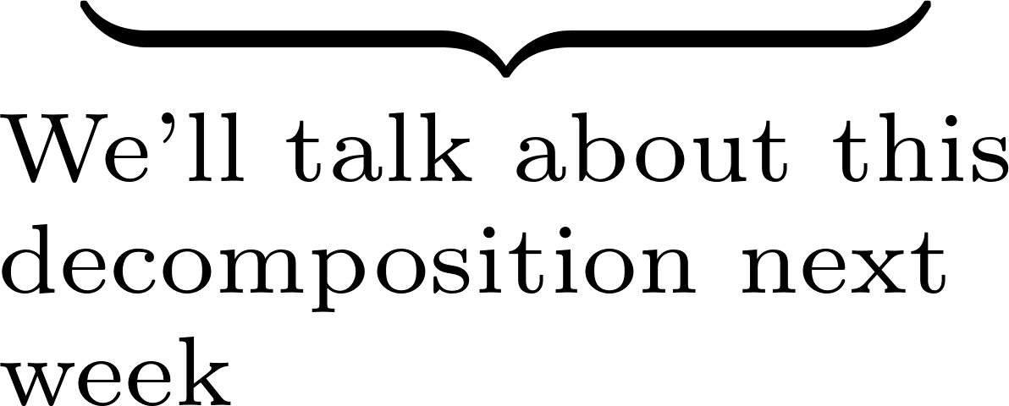
Regression – Example
> summary(lm(earn ~ height + ed, data=heights))
Coefficients:
Estimate Std. Error t value Pr(>|t|)
(Intercept) -106263.5 8564.7 -12.41 <2e-16 ***
height 1376.7 126.7 10.87 <2e-16 ***
ed 2590.8 197.7 13.11 <2e-16 ***
Residual standard error: 17780 on 1376 degrees of freedom
(650 observations deleted due to missingness)
Multiple R-squared: 0.1915, Adjusted R-squared: 0.1904
F-statistic: 163 on 2 and 1376 DF, p-value: < 2.2e-16

Slide 10
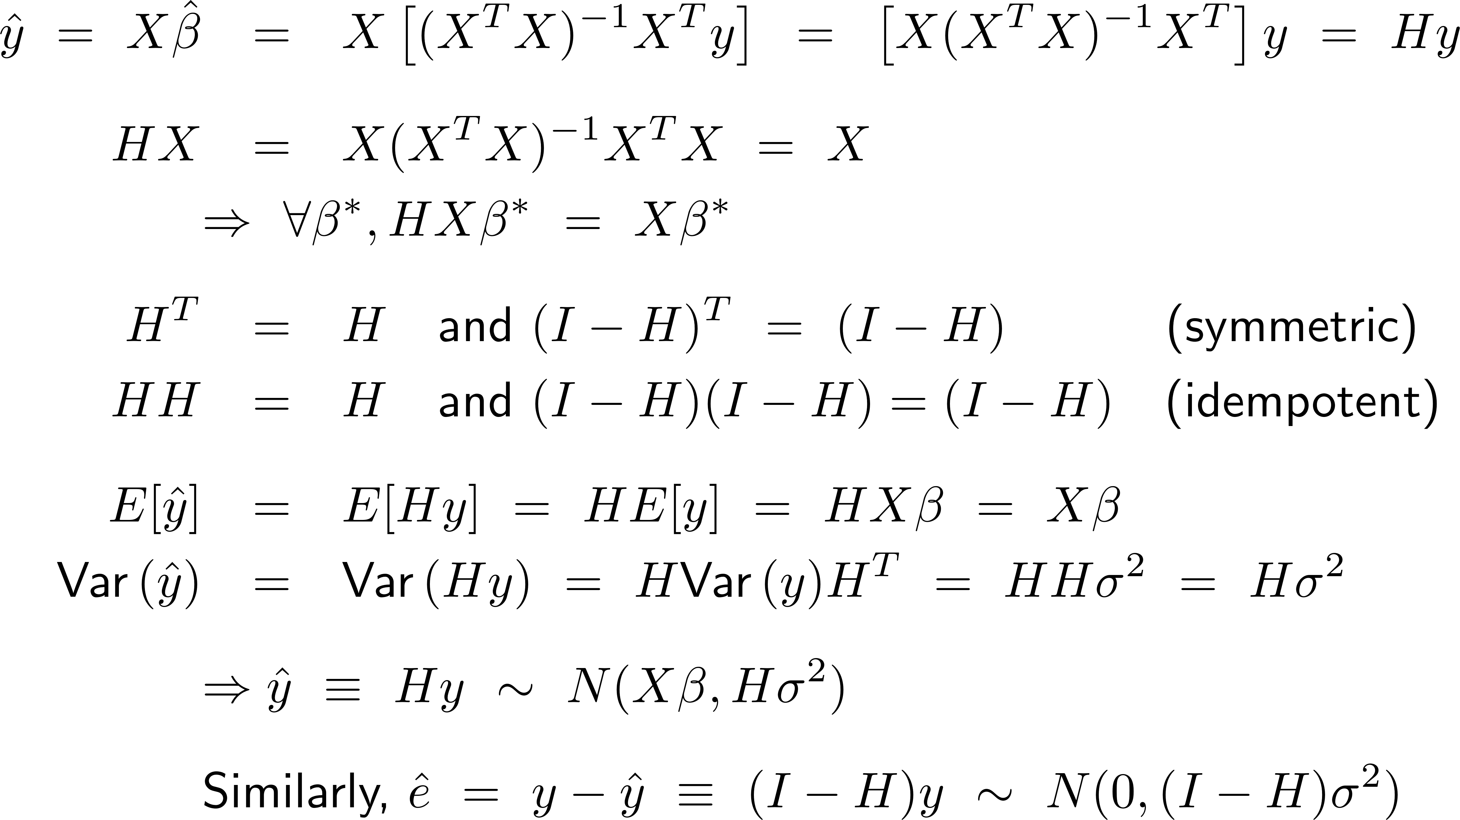
Hat Matrix H, & Distribution of
Hat matrix, H
c
c

Slide 11
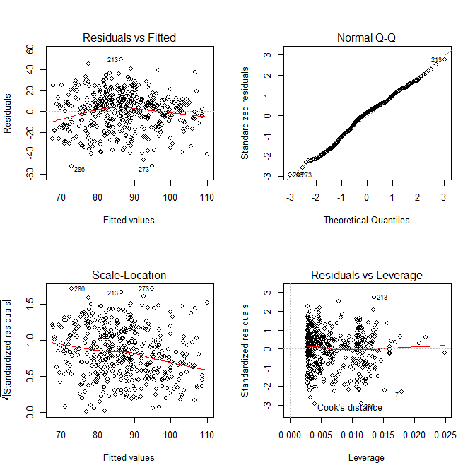
Casewise diagnostic plots
> kidiq <- read.csv("kidiq.csv",header=T)
> lm.3 <- lm(kid.score ~ mom.iq + mom.hs, data=kidiq)
> par(mfrow=c(2,2)); plot(lm.3)

Slide 12
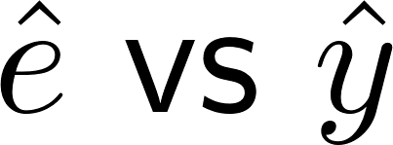
Raw residual plot:
If y = Xβ + ε holds, then
So expect to see
Mean 0
No functional dependence on $\hat{y_{i}}$
No outliers
Modest correlation between residuals (usually not a problem for interpreting plot)
Violations suggest nonlinearity / non-normality…

Slide 13
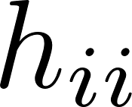
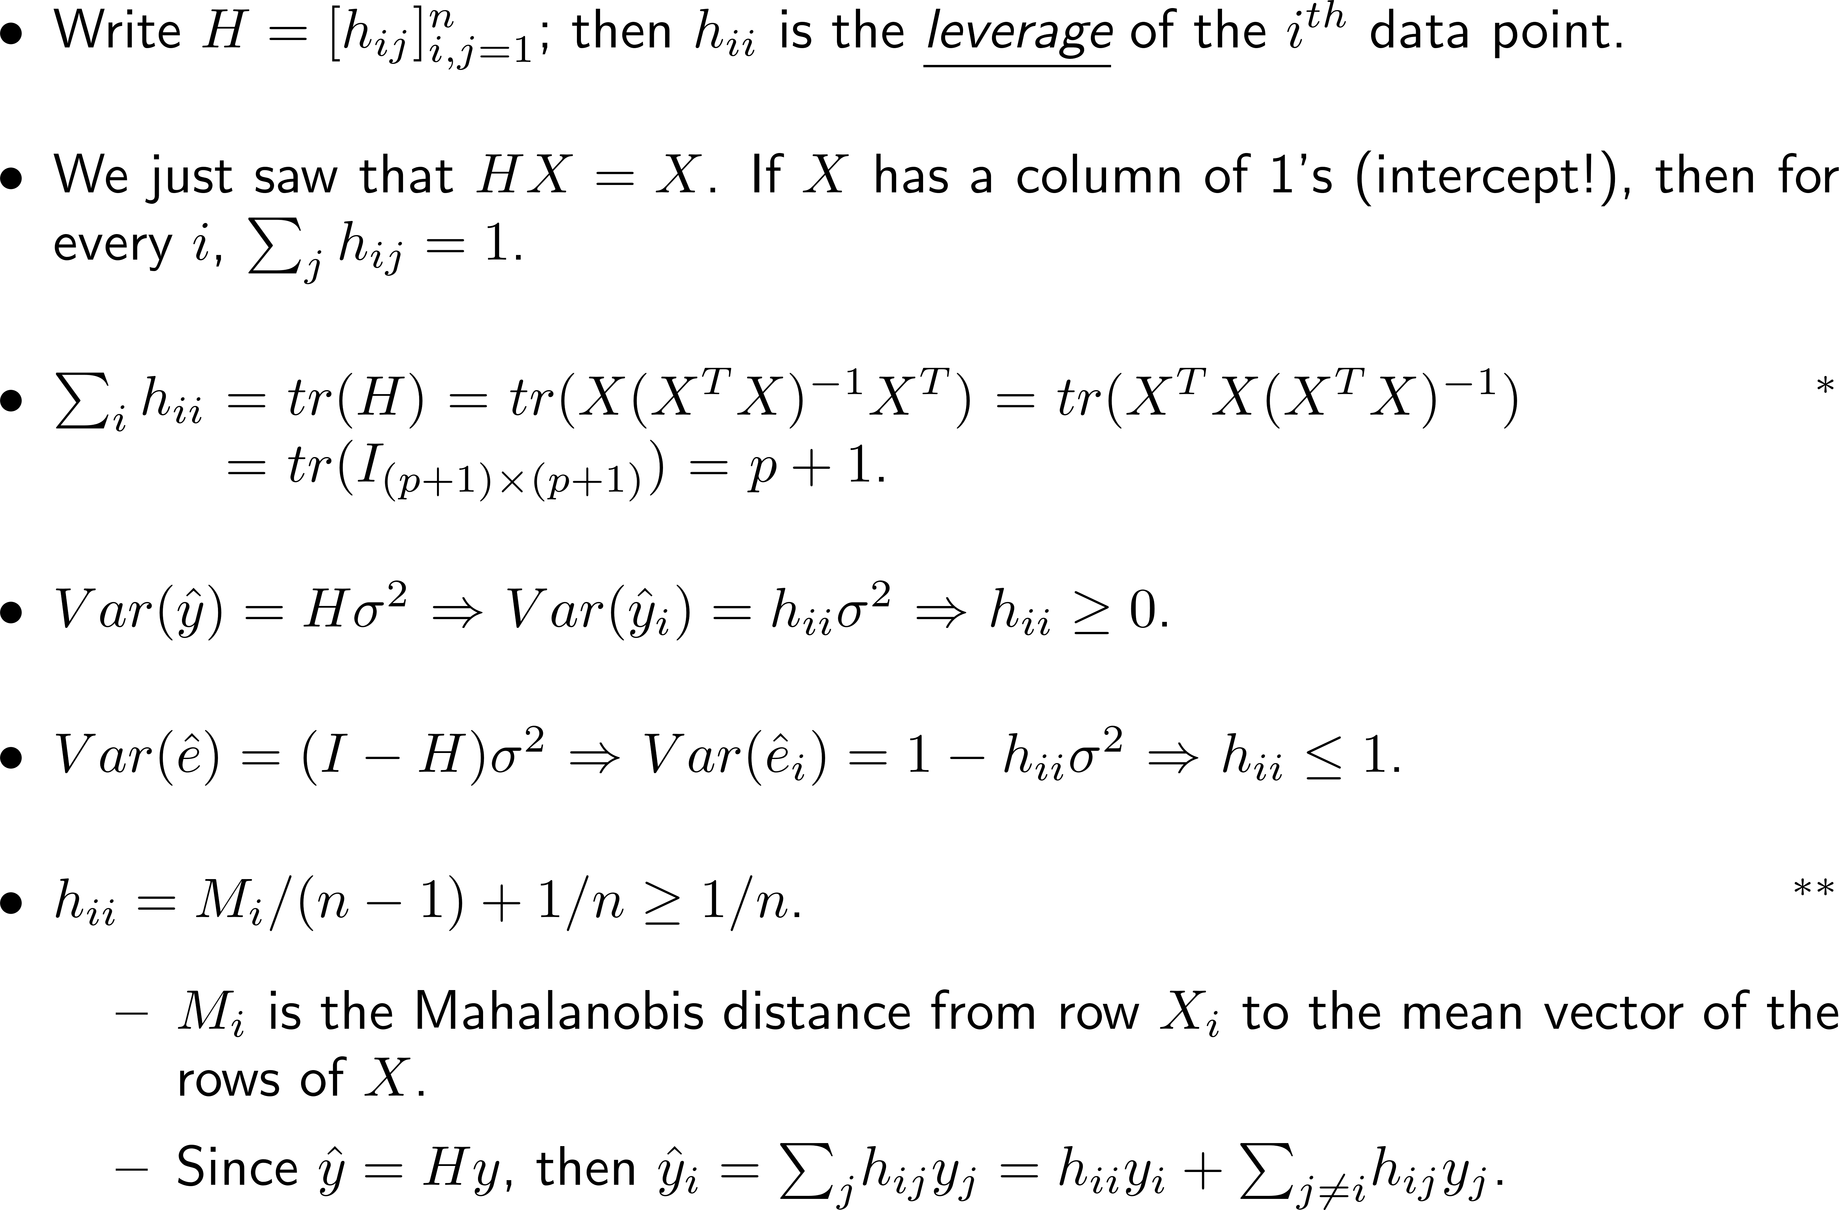
Leverage …
* Using the fact that $tr\left(AB\right)=tr(BA)$ when the multiplications both work ** See https://en.wikipedia.org/wiki/Leverage_(statistics)

Slide 14
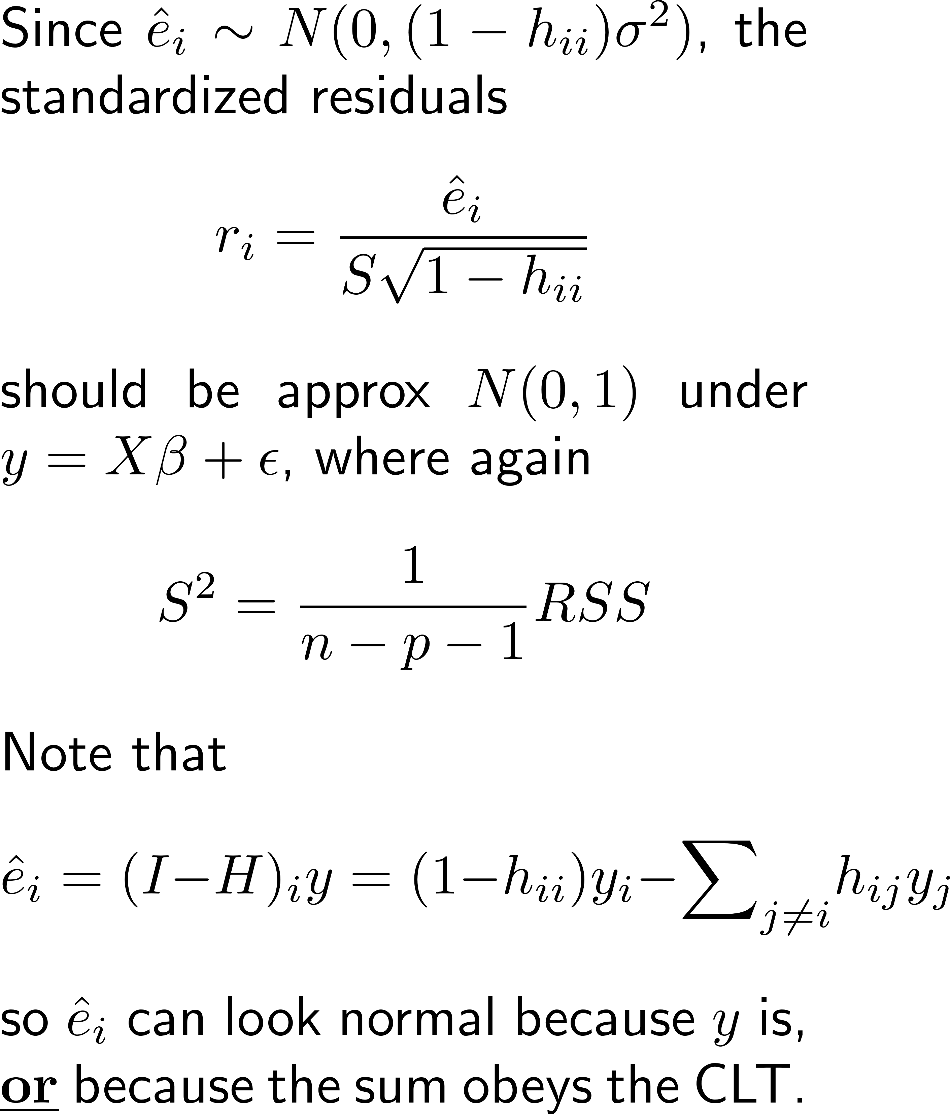
Normal Q-Q Plot of Stdized Resids r_{i}
Look for
Normal?
Outliers?

Slide 15
Scale-Location Plot:
If then should have constant variance
Dependence on ${\hat{y}}_{i}$?
Loess line helps eye
Careful of edge effects
Designed to catch patterns that depend on x_{i} (or y_{i}?)
Patterns can be caused by
Nonconstant variance in
Nonlinear relationship between x_{i} and y_{i}

Slide 16
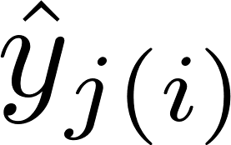
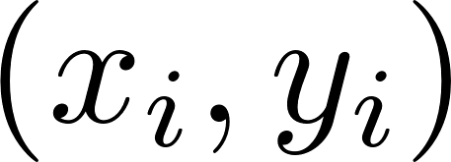
Leverage & Cooks’ Distance
Leverage measures how far is from .
To have an effect, must be large also.
How much effect can be measured by Cook’s D_{i}: where is the fitted value for , omitting the pair from the data set.

Slide 17
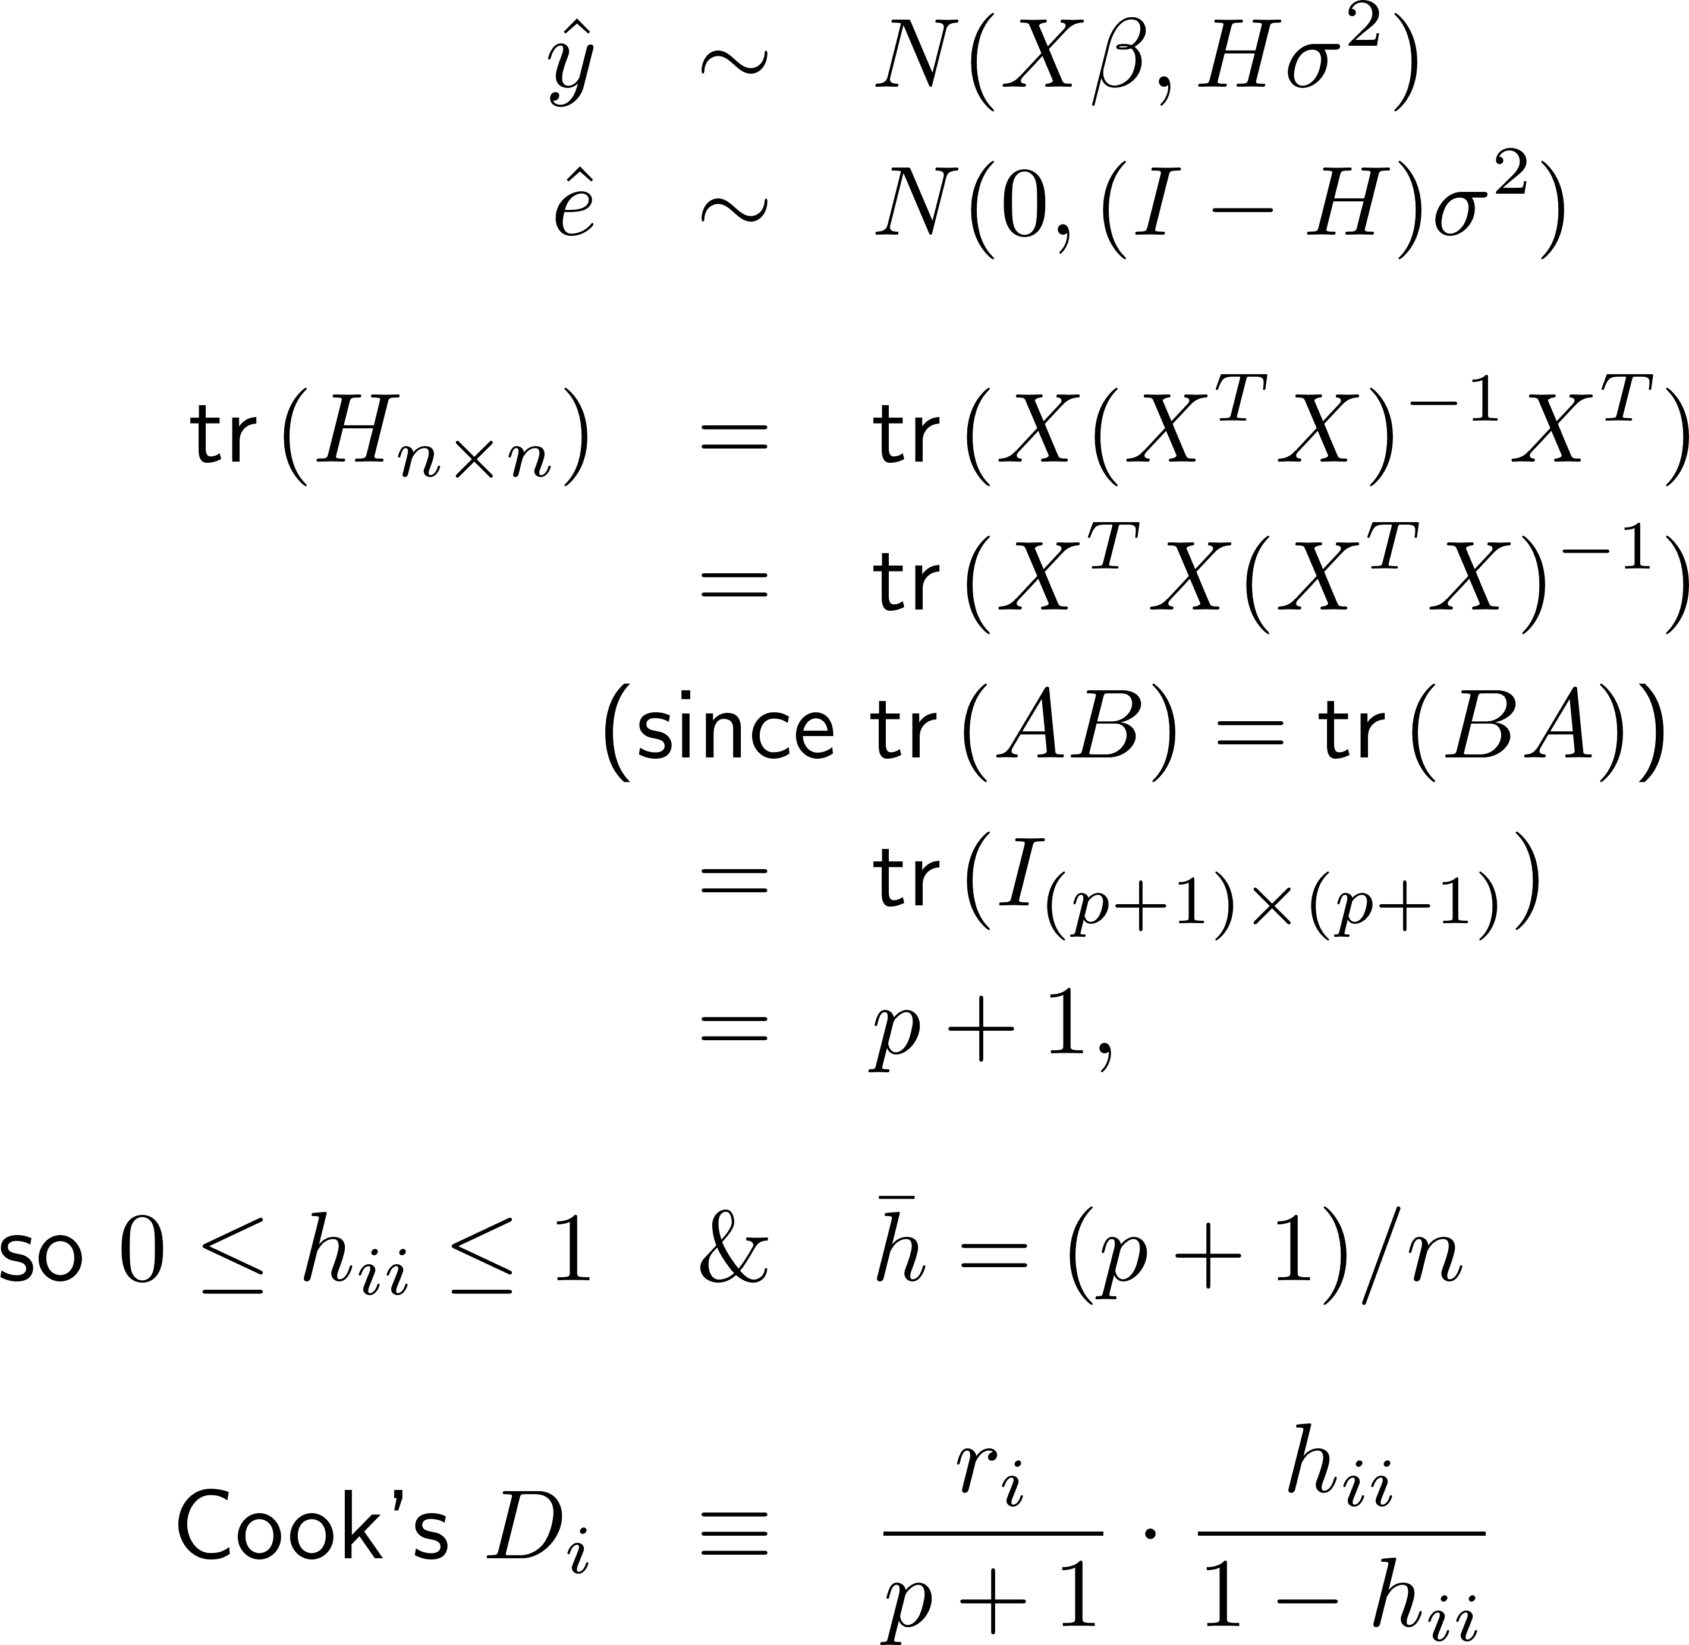
Leverage plot: h_{ii} vs D_{i}
Look for
NE and SE “corners”:
|r_{i}| > 2 or so?
h_{ii} > 2(p+1)/n or so?
D_{i} > 0.5 or so?

Slide 18
Some Leverage Examples
Source: https://stats.stackexchange.com/questions/58141/interpreting-plot-lm

Slide 19
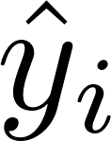
Casewise Diagnostics and Patterns
Mean zero?
Outliers?
Functional depen- dence on ?
Normal?
Outliers?
Constant variance?
Outliers?
Functional depen- dence on ?
NE & SE corners:
High leverage
High std resid
D_{i} > 0.5 or so?
Generally these are conversation points
Could reveal things investigator cares about!
Otherwise, look for data collection/recording errors
Delete data only with a good justification!

Slide 20
Confidence Interval for a fitted value ${\hat{y}}^{∗}$
Let x* be a new data point (new row of the X matrix) and let y* be the new y value:
A CI for the point is
where
${\hat{y}}^{∗}=x^{∗}\hat{β}$
$SE\left({\hat{y}}^{∗}\right)=\sqrt{\hat{Var}(x^{∗}\hat{β})}=\sqrt{x^{∗}{\left(X^{T}X\right)}^{−1}{x^{∗}}^{T}s^{2}}$
$t$ is an appropriate cutoff (around 2 for a 95% interval)

Slide 21
Prediction Interval for a new obs. $y^{∗}$
Again let x* be a new X row, and now consider predicting y* itself at that x*:
Using the same sorts of calculations as before,
So a prediction interval for y*_{pred} would be where

Slide 22
Example…
kidiq <- read.csv("kidiq.csv",header=TRUE)
fit.lm.1 <- lm(kid.score ~ mom.iq, data=kidiq)
plot(kid.score ~ mom.iq, data=kidiq,col="grey")
abline(fit.lm.1)
new.Xs <- data.frame(kid.score=0, mom.iq=(7:13)*10)
new.Ys.CI <- predict(fit.lm.1,new.Xs,interval="confidence")
points((7:13)*10,new.Ys.CI[, "fit"],pch=19,col="black")
points((7:13)*10, new.Ys.CI[,"lwr"],pch=19,col="green")
points((7:13)*10, new.Ys.CI[,"upr"],pch=19,col="green")
new.Ys.PI <- predict(fit.lm.1,new.Xs,interval="prediction")
points((7:13)*10, new.Ys.PI[,"lwr"],pch=19,col="blue")
points((7:13)*10, new.Ys.PI[,"upr"],pch=19,col="blue")
legend(120,40,legend=c("fitted value", "95% CI", "95% PI"),
pch=19,col=c("black", "green", "blue"))

Slide 23
Summary
Matrix Form of Multiple Regression Model
Regression - ML/LS Estimates
Distributional Properties
Standard Error vs Standard Deviation
R’s Casewise Diagnostic Plots
Confidence Intervals and Prediction Intervals

