Slide 1
36-617: Applied Linear Models
Introduction
Brian Junker
132E Baker Hall
brian@stat.cmu.edu

Slide 2
Classes Will Be Recorded
I plan to record and share these classes with Zoom with you for later viewing/review.
They will be available at cmu.canvas.edu
I’m sure the first few lectures will be pretty choppy, since I am just getting used to the tech in this classroom!
Watching recorded lectures does not replace being in class.
There is a “participation” component in your grade
If at any time you cannot be physically in class (travel problems, illness, etc.) I can give you a zoom link to join class remotely.

Slide 3
Outline
Introduction
Course Schedule & Syllabus Stuff
Valid vs Useful
Quick Review of Univariate Regression
R!
Reading:
Read/skim Ch’s 1-3 of Sheather
Look at Ch 5 of Sheather more closely
Supplemental:
G&H CH 3
ISLR 3.1,3.2, 3.3.1,3.3.2

Slide 4
Introduction – About Us
Instructor Brian Junker brian@stat.cmu.edu
TA Lorenzo Tomaselli ltomasel@stat.cmu.edu
Office hours:
MW Noon-1pm
132E Baker Hall
…or by appt (in person or Zoom)
Office hours:
TBA
…or by appt

Slide 5
Introduction – About The Course
Technical material: The machinery of linear regression and its generalizations
Disposition: When is a model adequate?
Translation: ABA⁻¹:
A: Translate from real world to quantitative question
B: Answer quantitative question using Statistics
A⁻¹: Translate back to real word
Lather, rinse, repeat…
Communication:
IMRaD -> IDMRaD
Clear sentences, paragraphs, sections.

Slide 6
Introduction – Course Materials
Technical material:
Sheather (2009). A Modern Approach to Regression with R. NY: Springer *
James et al. (2013). Introduction to Statistical Learning with R. NY: Springer *
Supplementary texts:
Gelman, A. & Hill, J. (2007). Data Analysis Using Regression and Multilevel/Hierarchical Models. NY: Cambridge Univ Press.
Lynch, S. M. (2007). Introduction to applied Bayesian statistics and estimation for social scientists. NY: Springer *
Software:
R, Rstudio, Stan (more on the next slide)
LaTeX (If you are new to TeX/LaTeX, try overleaf.com–free to CMU)
Help: I will post some links, but get used to googling!
* Available for free from link.springer.com if you connect
from campus or using CMU’s VPN service.

Slide 7
Introduction - Computing
We’ll mostly be working in R, RStudio and extensions of R (primarily stan).
R: https://cran.r-project.org/
RStudio: https://www.rstudio.com/
Rmarkdown: (just try it in RStudio, use google for help)
Stan: https://mc-stan.org/users/interfaces/rstan
In class I’ll use “raw R” more than RStudio, but you will find RStudio and Rmarkdown very convenient for hw, etc.
It is possible to do some of the work in Python, but the lectures, technical work and project are strongly geared to facilities in R.

Slide 8
Introduction – Online Resources
Online resources:
I will record lectures and make them available on Canvas.
Canvas (canvas.cmu.edu)
All course materials
Your grades
Monday quizzes
Submit and peer review project papers
Gradescope (within Canvas)
Submit weekly homework
Piazza (within Canvas)
Great for asking (and answering) questions outside of class
The TA and I will also monitor Piazza

Slide 9
General schedule for the semester
Take-home and project dates are approximate.

Slide 10
Syllabus Stuff – Work & Rules
20%: 10-ish HW’s
Please feel free to work with each other on hw; BUT you must list who you worked with.
10%: Monday Quizzes (on weekly reading/materials)
25%: Take-Home Midterm
25%: Final Report Project
10% Peer review of projects
10% Participation (Do I remember your name? What you did in class? In office hours? On Piazza?)
Credit where credit is due
Please list any person or any source you consulted in doing your work, in a list of references at the end of hw, project, take-home
All hw will be submitted via Canvas (Gradescope)
Generally we will not accept late hw or late take-homes…

Slide 11
Reading & HW
The first HW assignment will be available on Canvas later today (due next week).
Reading:
You should already have read Sheather Ch’s 1-3
For this week read Sheather Ch 5
ISLR 3.1 & 3.2, and G&H CH 3 are good supplemental reading
For next week: Sheather 5.3, and ISLR 3.3.1 & 3.3.2
Pdf’s for lecture notes etc. in the file area on Canvas
In general, you should do the reading before each week’s classes.

Slide 12
Introduction – Level
Hopefully you have seen calculus-based prob & stat, matrix algebra, and a little linear regression.
We need to talk like statisticians!
You have all different levels of experience with
Applied regression and statistical modeling
R
Writing scientific reports
Fill in the gaps
Learn on your own (Google)! Help each other!
Ask Lorenzo and me!

Slide 13
Let’s take a break and think about these two quotes…
“[I]t makes sense to base inferences or conclusions only on valid models” – S.J. Sheather (2007)
“All models are wrong but some are useful” – G.E.P. Box (1978)

Slide 14
Linear Regression – The Model
Let X_{i} = (x_{i0}, …, x_{ip}) and $β$= ($β$₀, …, $β$_{p})^{T}; then
If we also stack Y = (y₁, …,y_{n})^{T}, X = (X₁^{T}, …, X_{n}^{T})^{T}, and $ε$= ($ε$₁, … $ε$_{n})^{T}, we can write

Slide 15
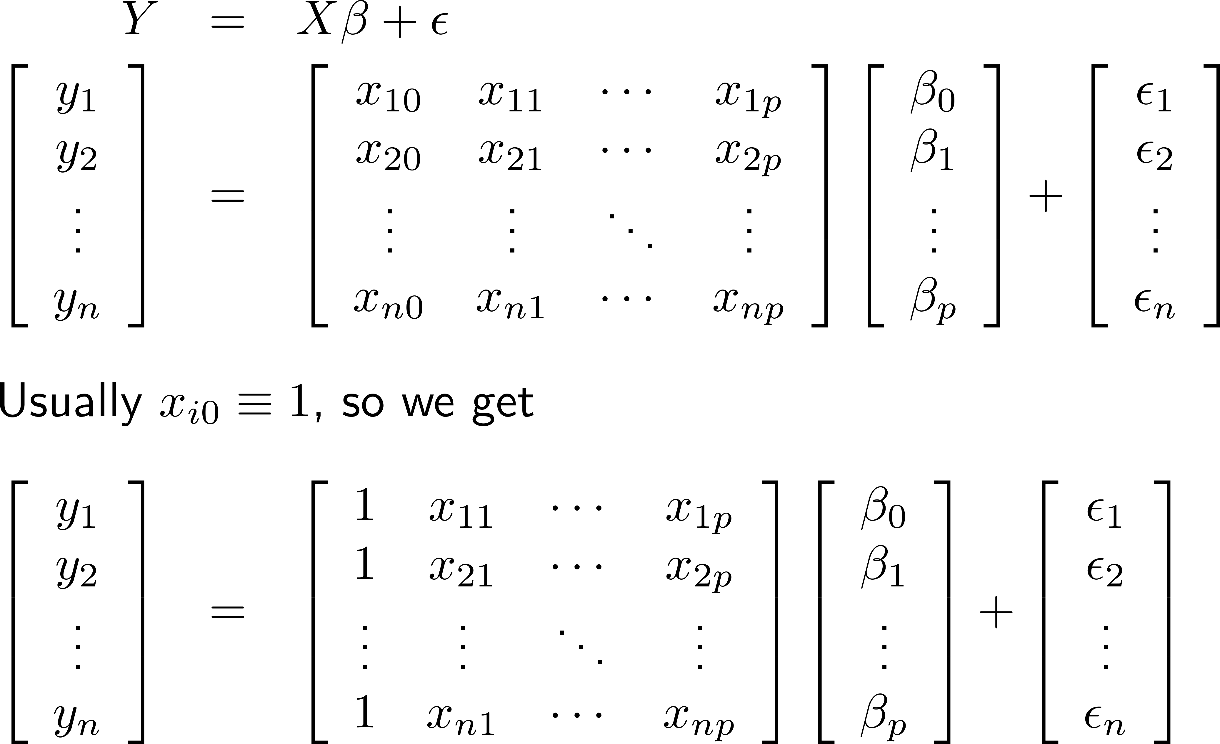
Linear Regression –The Model

Slide 16
Linear Regression – The Model
In the model
it is usual to assume
Recall
Y ~ N(0,1) iff
Y ~ N($μ$, $σ$²) iff

Slide 17
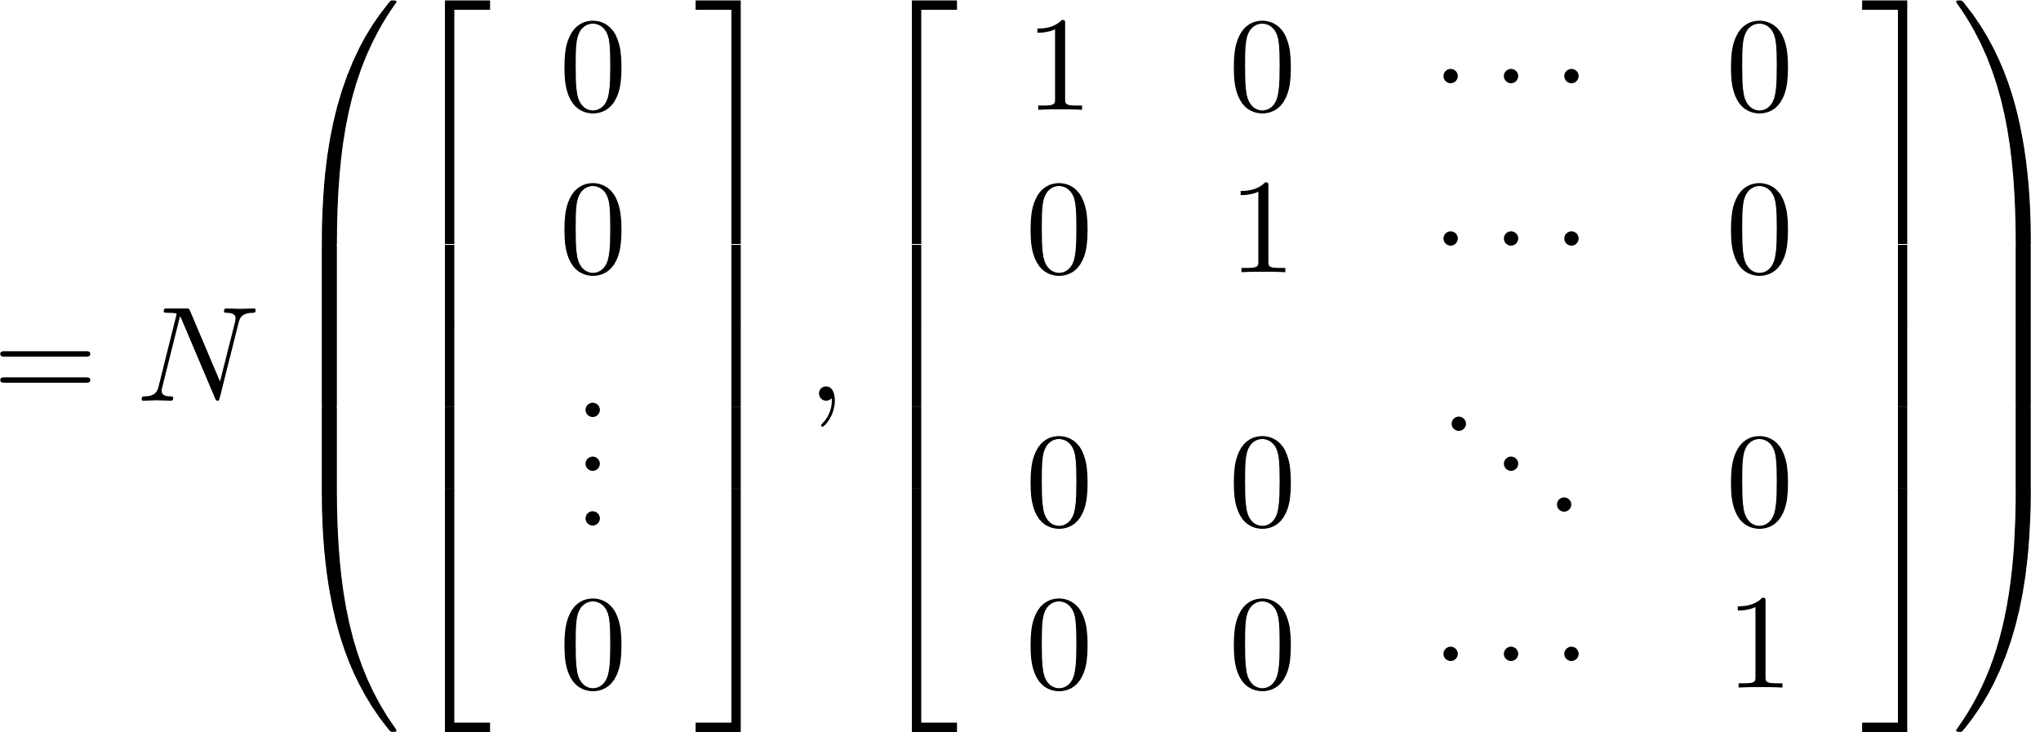
Digression – Multivariate Normal
Y = (Y₁, …, Y_{n})^{T} ~ N(0,I)
Y ~ N($μ$,∑) iff
…and some ugly formula
for f(y₁, …, y_{n})…

Slide 18
Digression – Multivariate Normal
When Y ~ N($μ$,∑), then

Slide 19
Regresssion – ML/LS Estimates
Y = X$β$ + $ε$, $ε$ $∼$N(0,$σ$²I)
So Var(Y_{i}) = E[(Y_{i} – X_{i} $β$)²] = E[$ε$_{i}²] = Var($ε$_{i}) = $σ$²
Then we can estimate (MoM!):
Fitting the model is basically just finding values $β$ to minimize $\frac{1}{n}RSS$, i.e., minimize
It turns out that

Slide 20
Regression – ML/LS Estimates
The “residual SD” is the square root of
With a little more matrix algebra,
“Hat matrix”
Recall that k=p+1

Slide 21
Regression – Example
Demographic factors and income…
> heights <- read.dta("heights.dta")
> str(heights)
'data.frame': 2029 obs. of 9 variables:
$ earn : num NA NA 50000 60000 30000 NA 50000 NA 51000 ...
$ height1: int 5 5 6 5 5 5 5 5 5 5 ...
$ height2: num 6 4 2 6 4 5 3 8 3 4 ...
$ sex : int 2 1 1 2 2 2 2 2 2 2 ...
$ race : int 1 2 1 1 1 1 3 2 1 1 ...
$ hisp : int 2 2 2 2 2 2 2 2 2 2 ...
$ ed : num 12 12 16 16 16 17 16 18 17 15 ...
$ yearbn : num 53 50 45 32 61 33 99 36 51 64 ...
$ height : num 66 64 74 66 64 65 63 68 63 64 ...

Slide 22
Regression – Example
> summary(lm(earn ~ height + ed, data=heights))
Coefficients:
Estimate Std. Error t value Pr(>|t|)
(Intercept) -106263.5 8564.7 -12.41 <2e-16 ***
height 1376.7 126.7 10.87 <2e-16 ***
ed 2590.8 197.7 13.11 <2e-16 ***
Residual standard error: 17780 on 1376 degrees of freedom
(650 observations deleted due to missingness)
Multiple R-squared: 0.1915, Adjusted R-squared: 0.1904
F-statistic: 163 on 2 and 1376 DF, p-value: < 2.2e-16

Slide 23
Regression - Example
Continuing in R…
heights.r in the week01 folder under “Files” on Canvas…

Slide 24
R!
Some people learning R for the first time; others have done extensive data analysis projects in R.
Some references on R:
http://www.cookbook-r.com
Quick-R: https://www.statmethods.net/
Online course: https://www.datacamp.com/courses/free-introduction-to-r
Lately I really like https://kieranhealy.org/publications/dataviz/
If you have not used R before…
http://www.cs.cmu.edu/~10702/R2/Rintro.pdf provides a good start
If you are new to R, type into R all the commands and examples in rintro.pdf
If you have worked with R before, read through rintro.pdf and try to predict what would happen with each command. If you are not sure, type in that command/example.

Slide 25
Summary
Introduction
Course Schedule & Syllabus Stuff
Valid vs Useful
Quick Review of Univariate Regression
R!
Reading:
Read/skim Ch’s 1-3 of Sheather
Look at Ch 5 of Sheather more closely
Supplemental:
G&H CH 3
ISLR 3.1,3.2, 3.3.1,3.3.2

