Slide 1
36-617: Applied Linear Models
Bayes, Shrinkage, and Multi-Level Models
Brian Junker
132E Baker Hall
brian@stat.cmu.edu
TexPoint fonts used in EMF.
Read the TexPoint manual before you delete this box.: AAAAAAAAAAAAAAAAAA

Slide 2
Announcements
Project 02 Schedule:
  Fri Nov 19: Draft Technical Appendix with HW 10.
  Mon Nov 29 (or earlier): Full IDMRAD paper first draft.
  Fri Dec 3: Peer reviews due.
  Fri Dec 10 (or earlier): Full IDMRAD paper final draft!
Regular classes Nov 22, 29 & Dec 1
No more graded hw’s or quizzes
  I may give one more ungraded hw, if I have time to set it up
  End of semester feedback for me Nov 29
BJ’s remaining office hours will be in the MSP space in FMS – not in his office.

Slide 3
Outline
Today:
  Shrinkage
  Review of MLE
  Crash course in Bayes
  Normal-Normal Model & Shrinkage
  MLM’s and Shrinkage
Mon:
  Multilevel glm’s (multilevel binomial, poisson, etc.)
After Thanksgiving:
  Some ideas from nonparametric regression

Slide 4
An MLM phenomenon: Shrinkage
The fitted multilevel model
underpredicts high obs’s
and overpredicts low ones.
The distribution assumptions
underlying lmer() “smooth out”
extreme observations!
Multi-level models provide more
smoothing/shrinkage to groups
with smaller sample sizes (since
there is less evidence that their
values should be different from
“grand mean”.)
We’ll talk about why today…

Slide 5
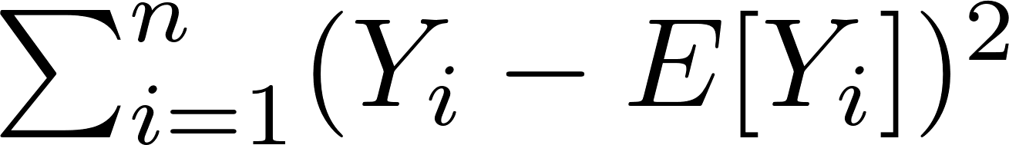
Methods of Estimation – How can we systematically construct “good” estimators?
Several methods have proven useful:
  Method of Moments (MoM): The k^{th} moment of X is E[X^{k}]. MoM estimators combine unbiased estimates of moments of X.
  Least Squares (LS): Obtained by minimizing squared error
  . Ordinary linear regression!
  Maximum likelihood (ML): The likelihood is the probability of the data we observed. ML estimators (MLE’s) choose parameter values that maximize the likelihood.
  Bayesian Estimation (Bayes): Treat the parameters as random variables, and use Bayes’ rule to pick the parameter value most likely, given the data (the “reverse” of ML!)

Slide 6
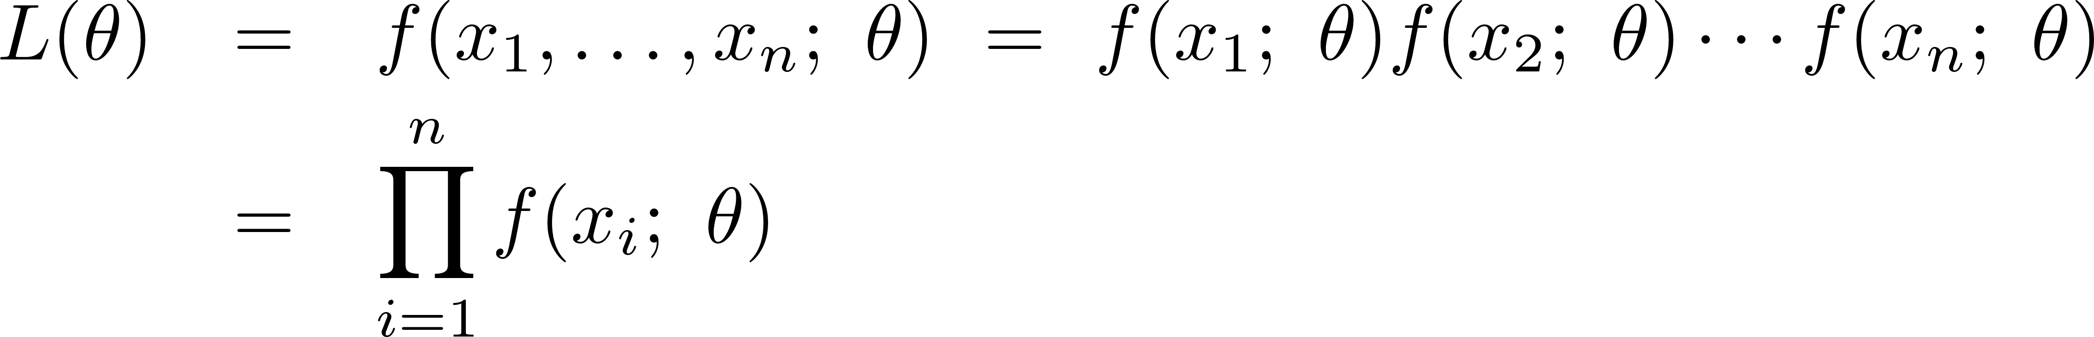
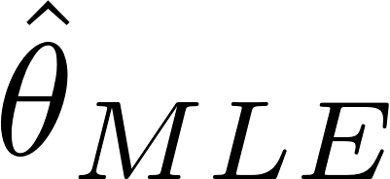
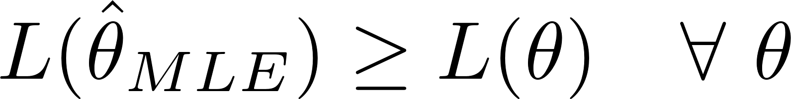
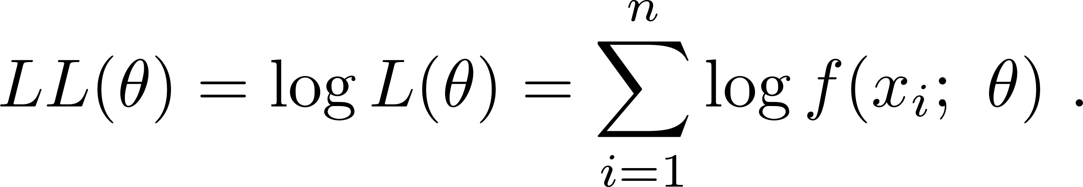
Maximum Likelihood Estimators (MLE’s)
Let X₁, …,X_{n} be an iid sample from f_{X}(x;µ), x₁, …, x_{n} are the observed values
The likelihood of the sample is the joint density
The maximum likelihood estimate maximizes L(µ):
Strategy: It’s usually (but not always) easier to work with the log likelihood

Slide 7
Florida, 2020 Pre-Election Poll
Donald Trump (R) running for election to the presidency against Joe Biden (D)
In a Suffolk University Poll (October 1-4, 2020):
  451 of 500 voters expressed a preference for Trump or Biden.
  Of those 451: 226 prefer Donald Trump.
In most polling, weights are attached to each response, to adjust the “representativeness” of the response for things like
  who is likely to be home when survey worker calls
  who refuses to answer
  etc
We will ignore weights etc and treat the 451 as a simple random sample.

Slide 8
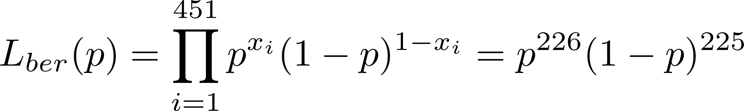
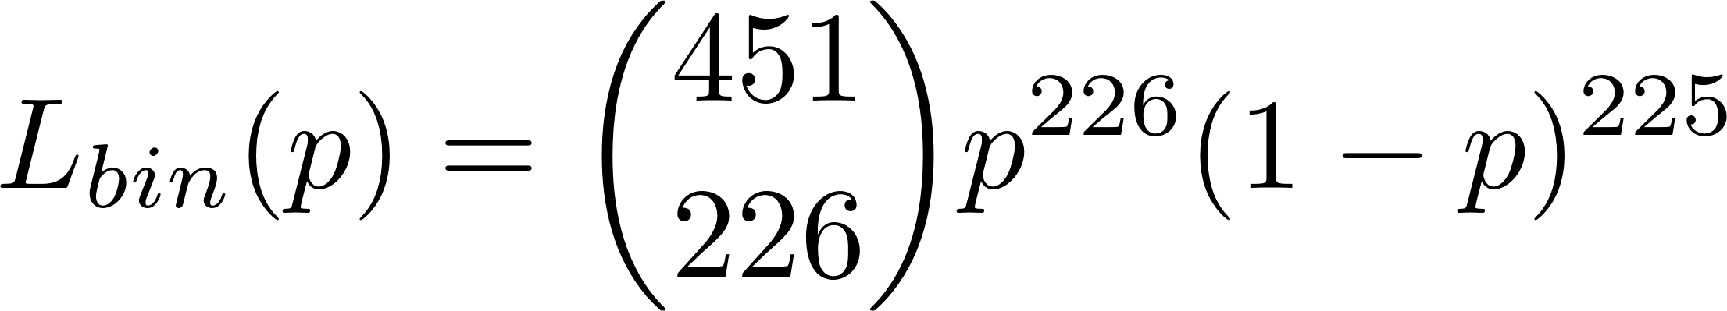
Possible models for the data
451 individual Bernoulli coin flips, x_{i} = 1 for Trump, x_{i} = 0 for Biden
451 trials, 226 “successes” (Trump voters)
What matters for MLE and SE is shape, not size!

Slide 9
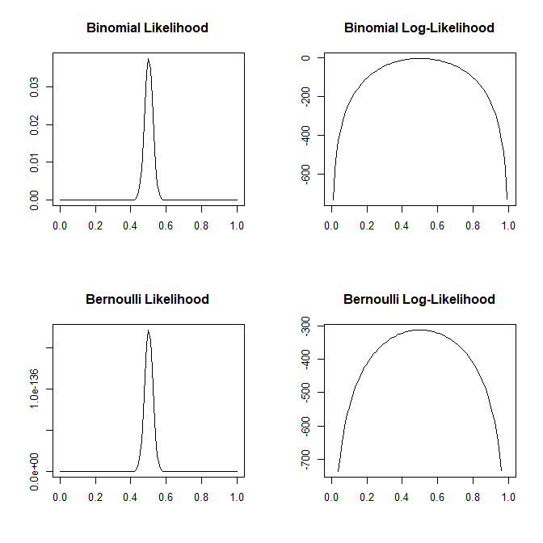
Binomial and Bernoulli Likelihoods

Slide 10
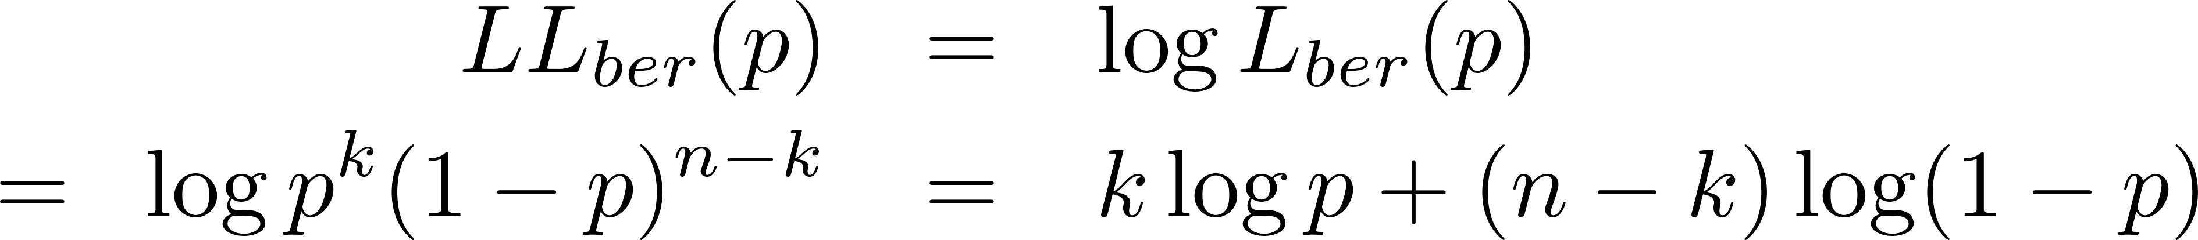
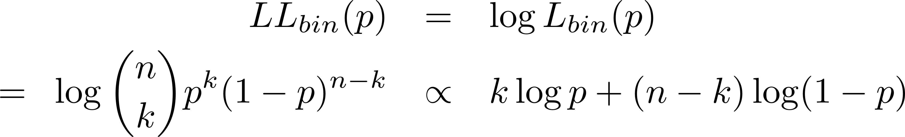
Finding the MLE…
If we use the Bernoulli likelihood,
If we use the Binomial likelihood
Either way we want to maximize
with k = 226, n=451

Slide 11
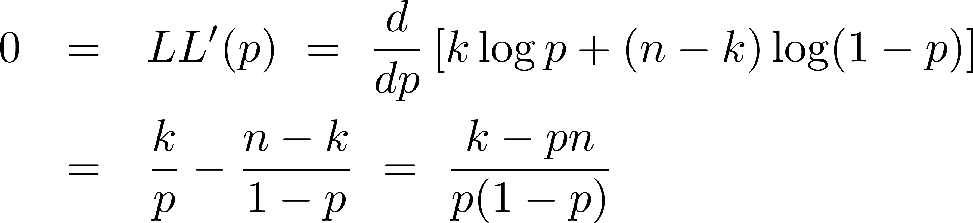
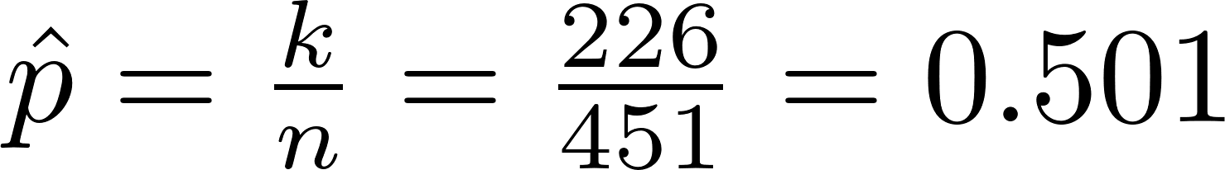
MLE: Point Estimate
Differentiating and setting to zero…
so, clearly,

Slide 12
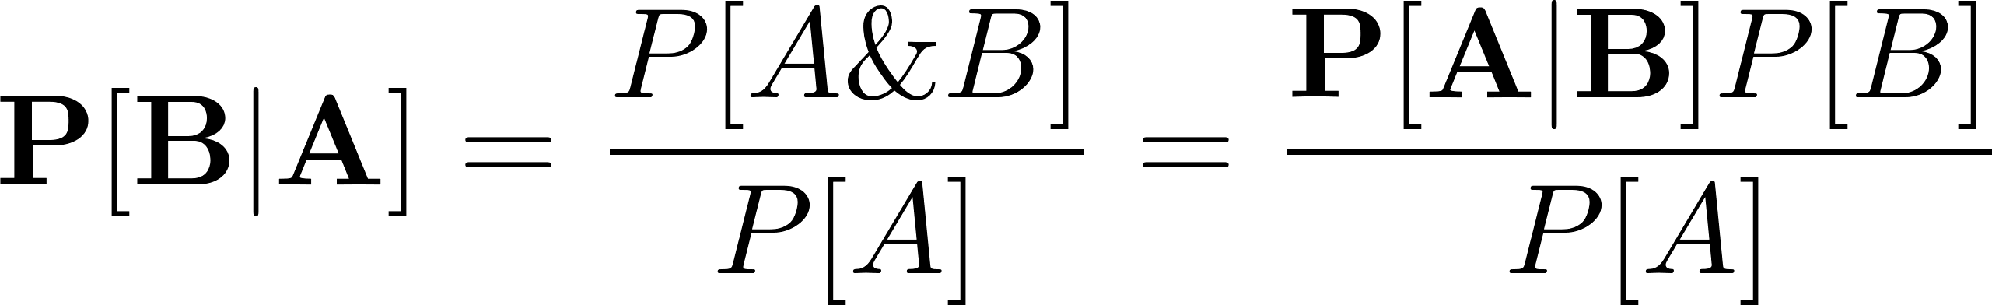
Bayes’ Rule (a.k.a. Bayes’ Theorem)
A very simple idea with very powerful consequences
We often start with information like P[A|B] and what we really want is P[B|A]. Bayes’ Theorem lets us “turn the conditioning around”:
See https://arbital.com/p/bayes_rule/ for lots of examples and proselytizing.

Slide 13
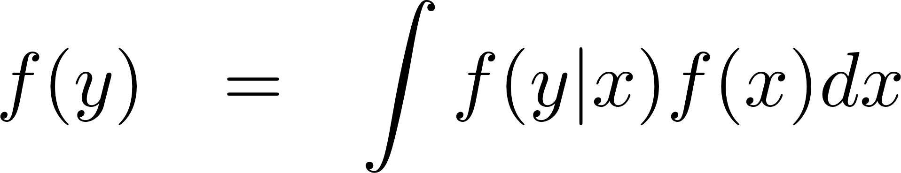
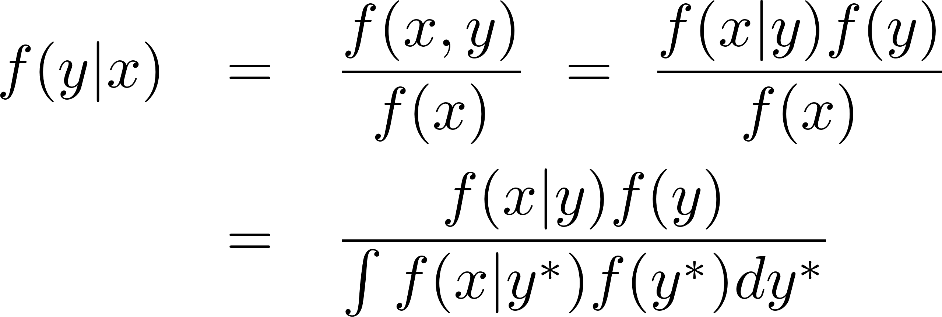
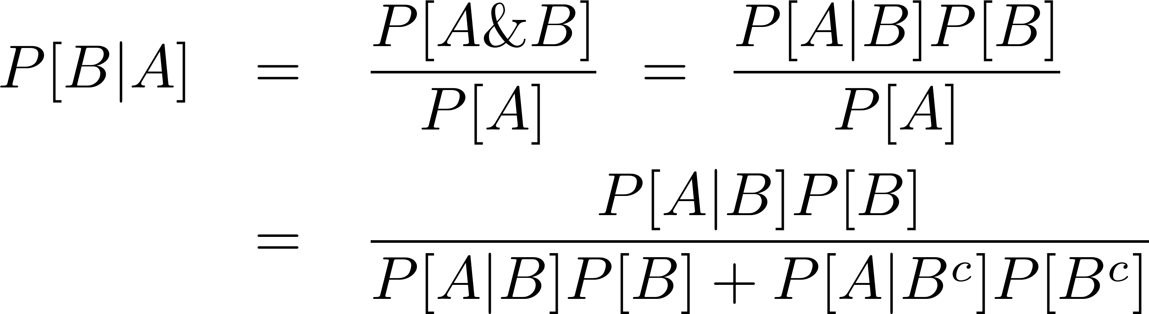
Conditional probability & conditional density
P[A|B] = P[A&B]/P[B]
P[B] = P[B|A]P[A] + P[B|A^{c}]P[A^{c}]
P[A & B] = P[B|A]P[A]
Bayes’ Theorem:
f(x|y) = f(x,y)/f(y)
f(x,y) = f(y|x) f(x)
Bayes’ Theorem:

Slide 14
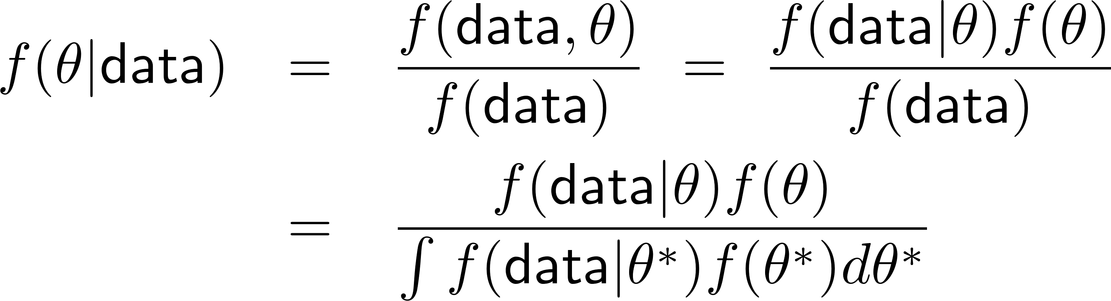
Bayes’ Theorem for Data
Bayes’ Theorem
Let x = data, y = µ (parameter!); then
Dummy variable of integration

Slide 15
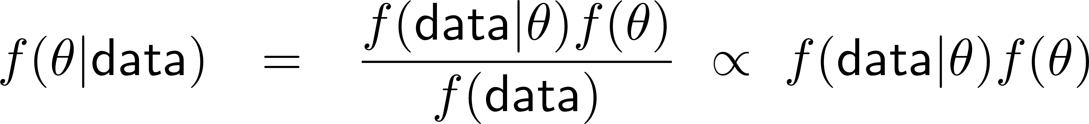
Bayes’ Theorem for Data
We call
  f(µ) the prior distribution
  f(data|µ) = L(µ) the likelihood
  f(µ|data) the posterior distribution
So Bayes’ Theorem says
Slogan: (posterior) / (likelihood)£(prior)

Slide 16
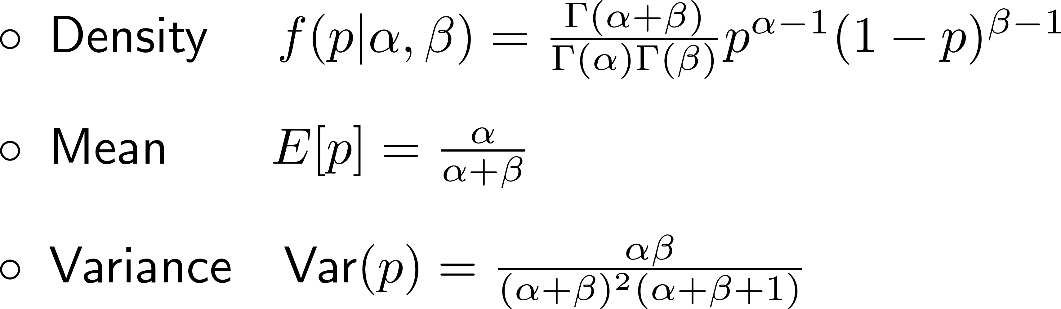
Back to 2016 Florida pre-election poll
The likelihood is the same as before:
L(p) / p^{k} (1-p)^{n-k}
We need a prior distribution. One good choice is a beta distribution, with
Some graphs of beta densities appear on the next slide

Slide 17
Some Beta Densities

Slide 18
Some Beta Densities
uniform distribution!

Slide 19
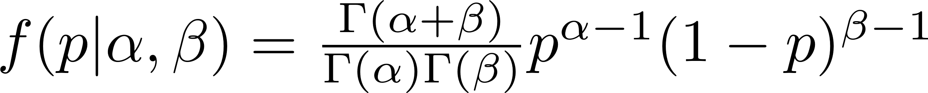
Choosing prior parameters…
The likelihood is the same as before:
L(p) / p^{k} (1-p)^{n-k} = p²²⁶(1-p)²²⁵
The prior distribution is a beta distribution
  ® = 1, ¯ = 1 gives a uniform distribution – no preference for one p over another!
  Suppose that in a previous poll, 942 prefer Trump and 1008 prefer Biden. Could set ®=942, ¯=1008

Slide 20
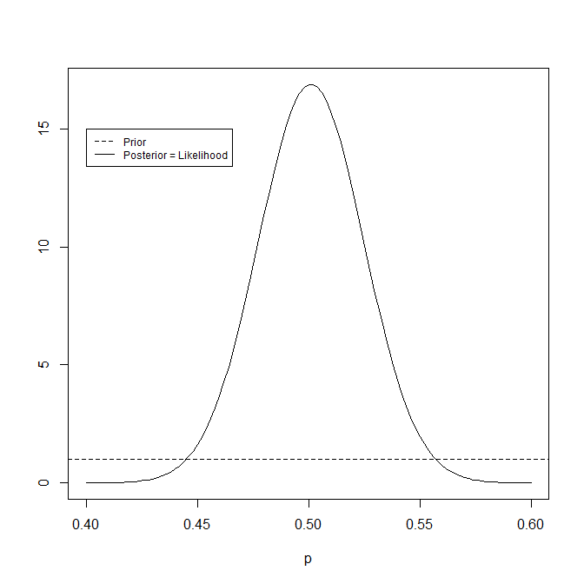
If ®=1 and ¯=1…
(posterior) / (likelihood)£(prior):
Since f(p|data)=L(p),
posterior mode = MLE
= 226/451 = 0.5011086
Since f(p|data) is a beta
with ®=227, ¯=226,
E[p|data] = 227/453 = 0.5011038

Slide 21
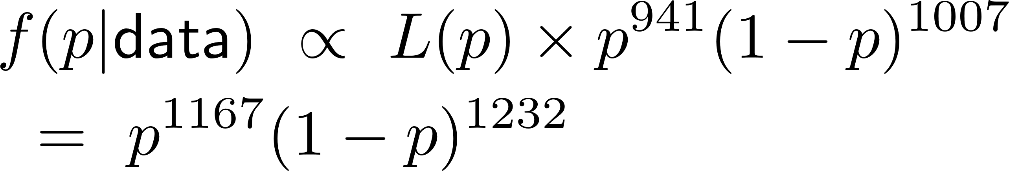
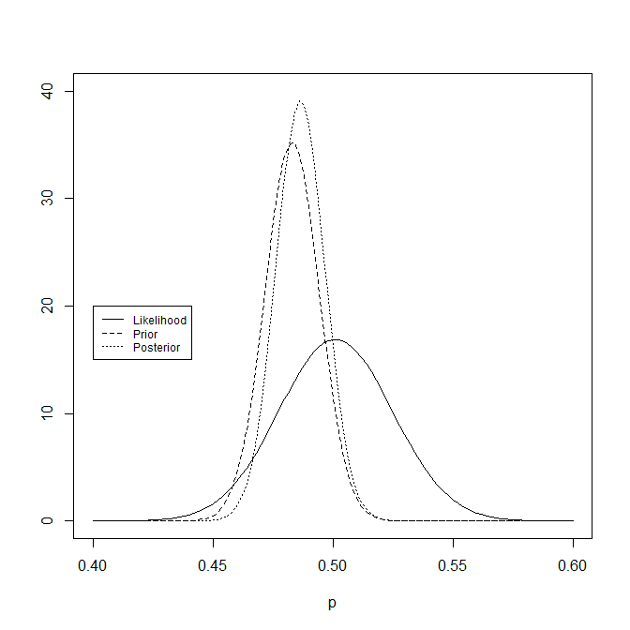
If ®=942, ¯=1008…
“shrinkage”:
posterior between
prior & likelihood
(posterior) / (likelihood)£(prior):
Since f(p|data) =
beta(p,1168,1233),
E[p|data] = 1168/2401
= 0.486 vs MLE=0.501

Slide 22
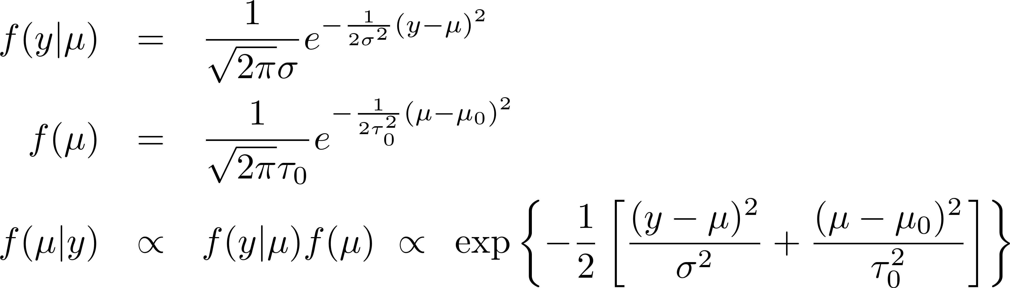
Normal Model: Estimate ¹, with ¾² Known, One Observation y » N(¹,¾²)
For our prior distribution, we’ll assume μ » N(¹₀,τ₀²):
Posterior must be normal for ¹ (quadratic in ¹!); to identify it, complete the square…

Slide 23
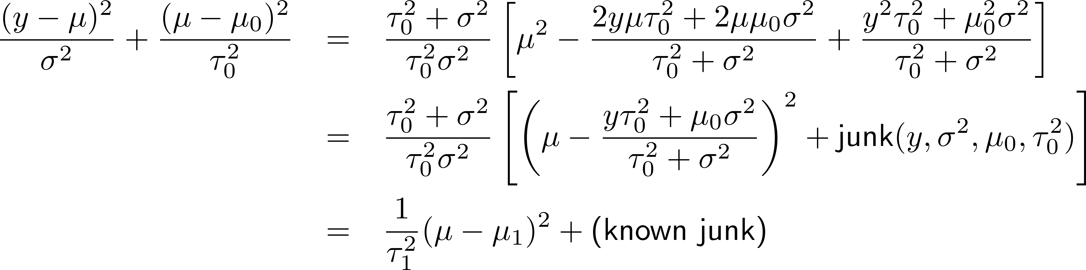
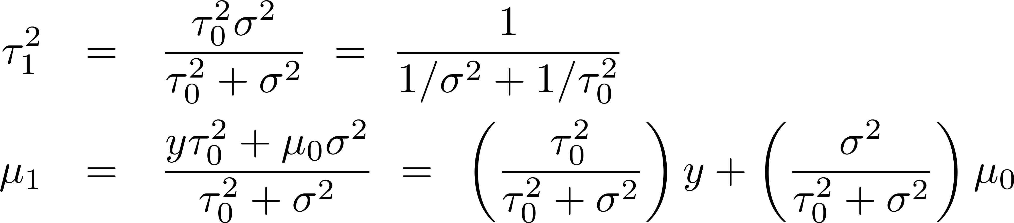
The exponent of f(¹|y) looks like -1/2 times
so that ¹|y » N(¹₁, ¿₁²), where

Slide 24
The exponent of f(¹|y) looks like -1/2 times
so that ¹|y » N(¹₁, ¿₁²), where

Slide 25
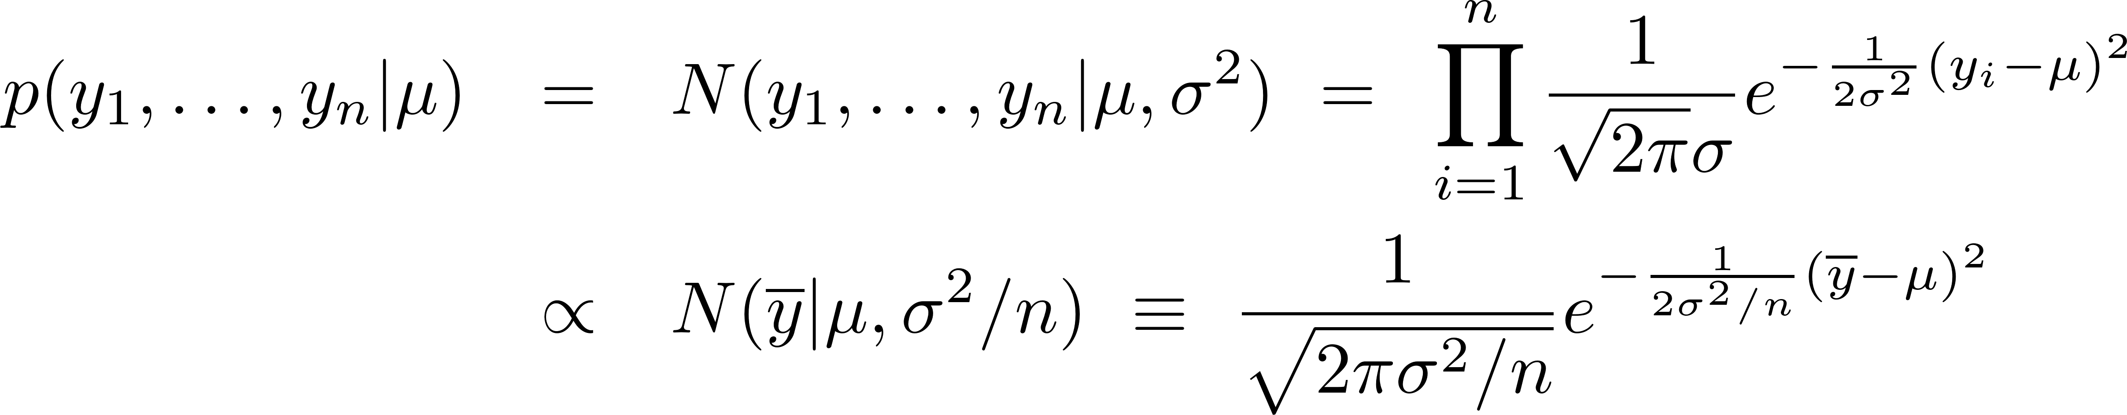
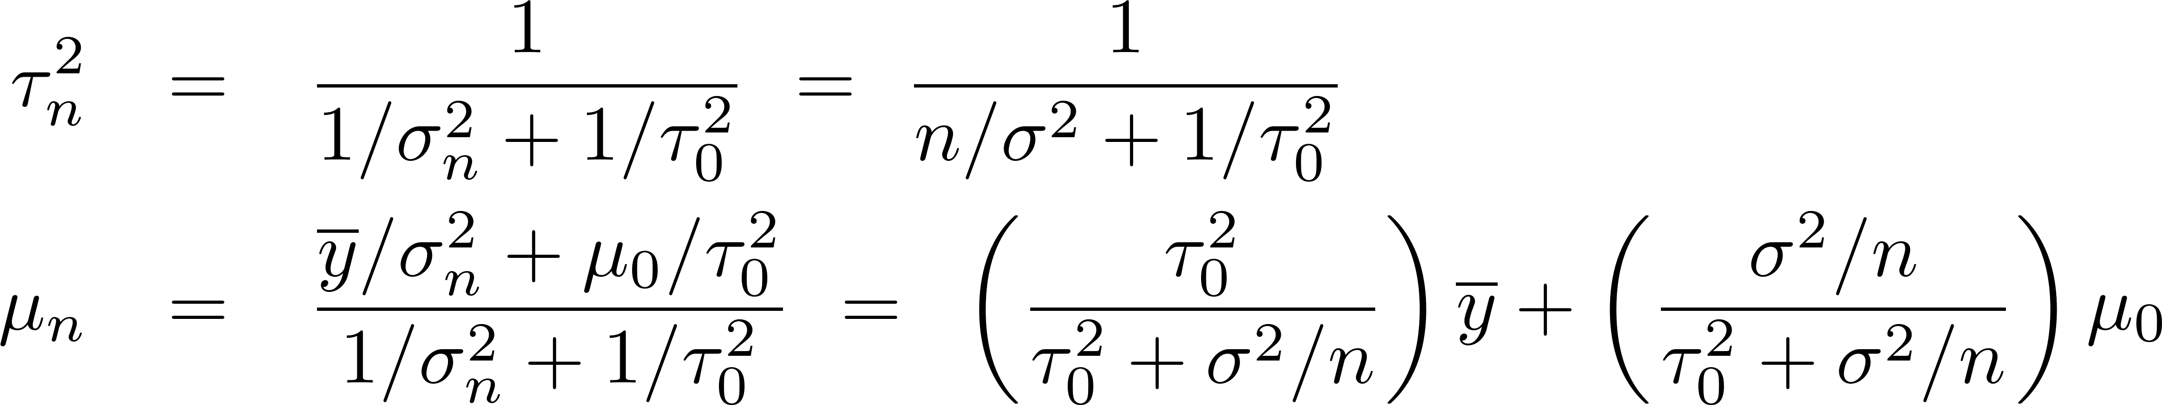
n Observations y_{i} » N(¹,¾²)
Since
we can apply the results for one observation
  p(y₁, …, y_{n}|¹) / N(y|¹, ¾n²), ¾n² = ¾²/n
  p(¹) = N(¹|¹₀, ¿₀²)
  p(¹|data) = N(¹|¹_{n} , ¿_{n}²) where

Slide 26
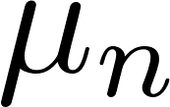

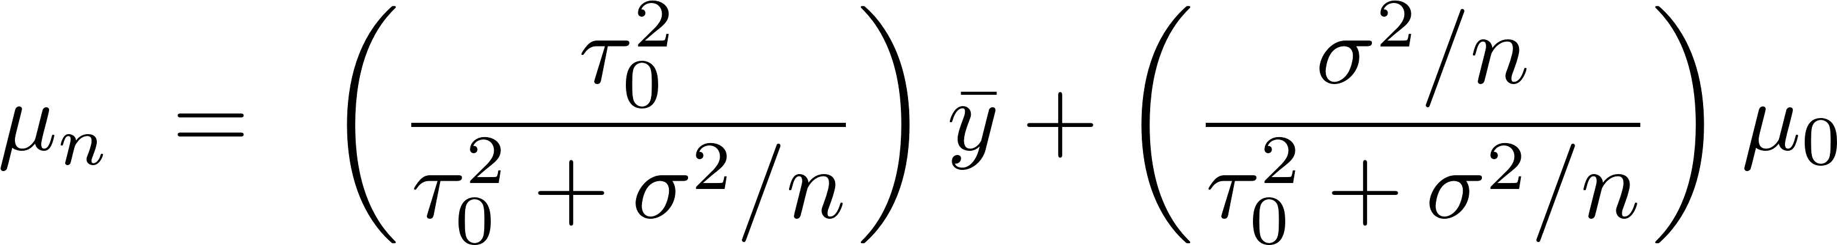
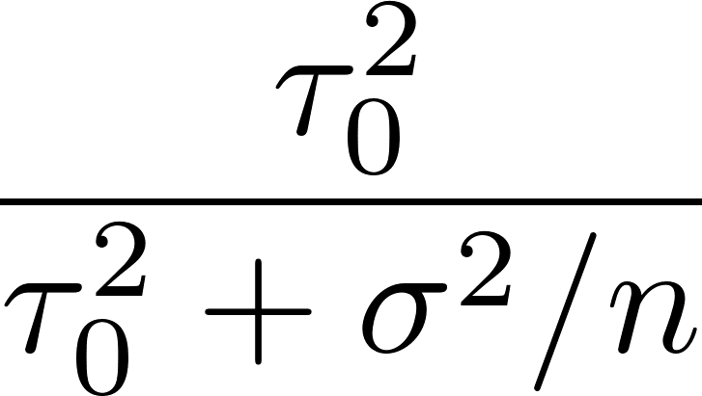

Normal Mean, Example
“shrinkage”:
posterior between
prior & likelihood
Suppose we know ¾=12, we look at n=169 IQ scores, and we find y = 100.
We use as prior N(¹₀, ¿₀²) with ¹₀=90, ¿₀² = 4
Shrinkage determined by
is the reliability
n larger )
reliability larger )
less shrinkage

Slide 27
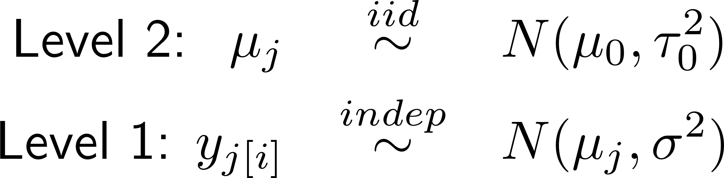
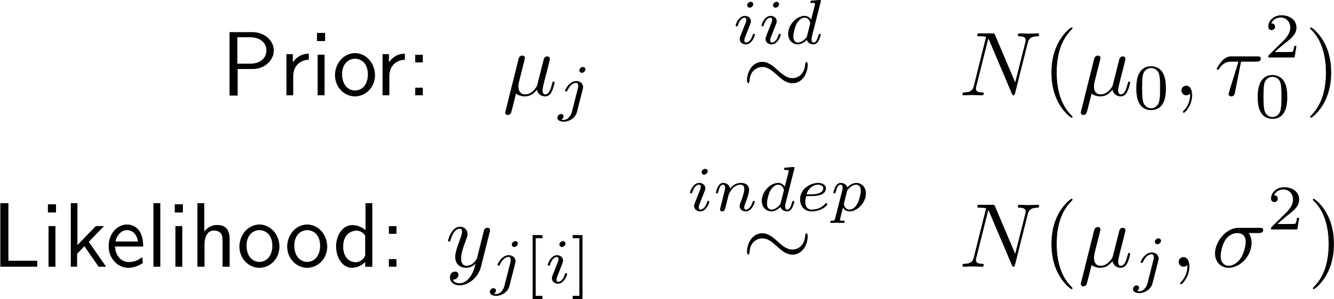
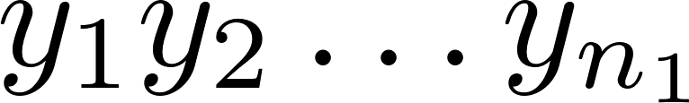
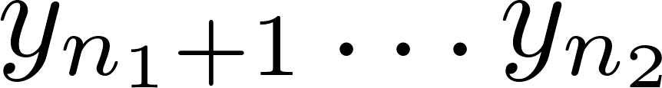
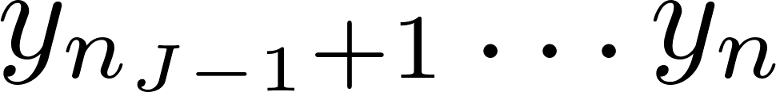
Minnesota Radon Example
Emphasize Distribution Structure
Emphasize Bayesian point of view
Emphasize two-stage (multistage) sampling
Mean radon across MN
County-level differences
from grand mean
individual house levels

Slide 28
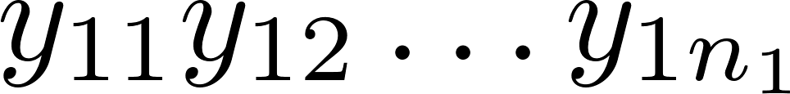
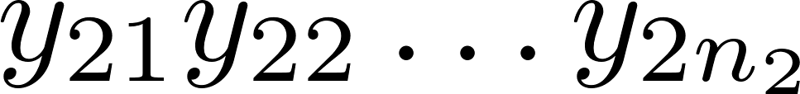
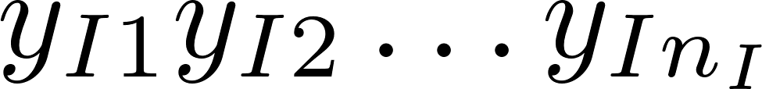
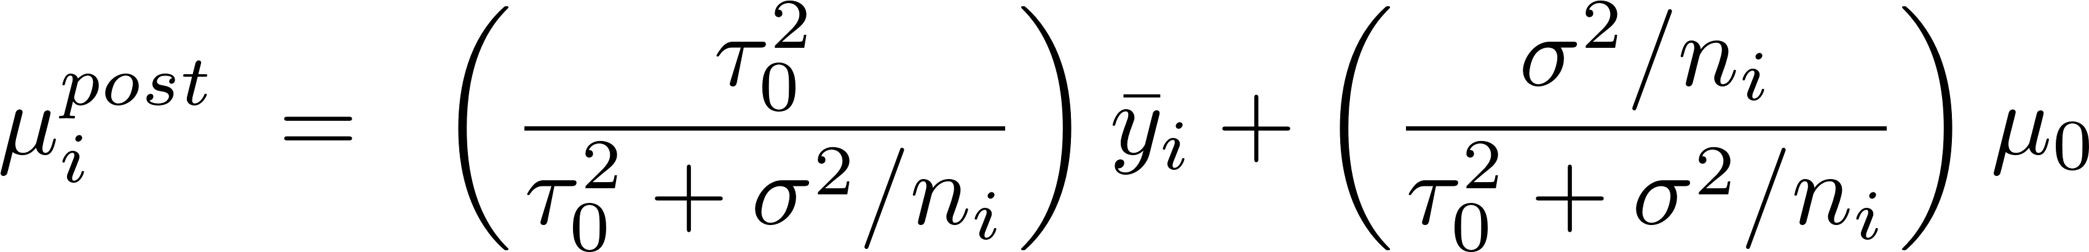
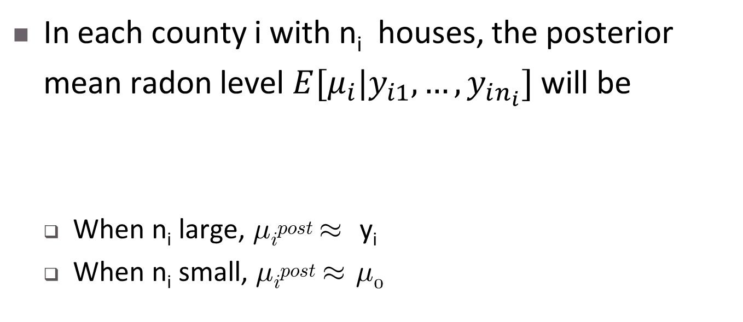
Minnesota Radon Example
Mean radon across MN
County-level differences
from grand mean
individual house levels
In each county i with n_{i} houses, the posterior
mean radon level $E[μ_{i}|y_{i1}, …,y_{in_{i}}]$ will be
  When n_{i} large, ¹_{i}^{post} ¼ y_{i}
  When n_{i} small, ¹_{i}^{post} ¼ ¹₀

Slide 29
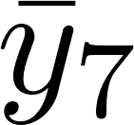
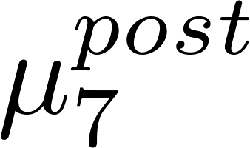
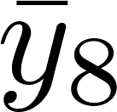
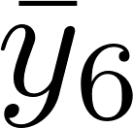
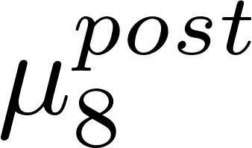
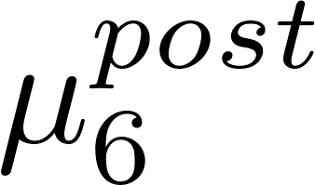
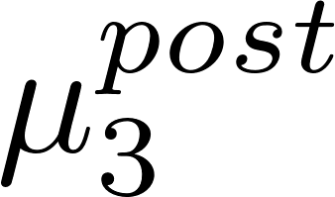
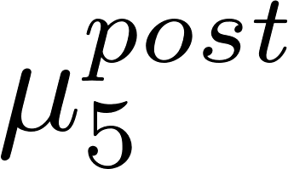
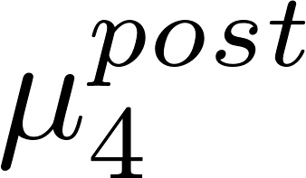










Minnesota Radon Example
In the figure, the grand mean is ¹₀
In each county i with n_{i} houses, posterior mean is
  When n_{i} large, ¹_{i}^{post} ¼ y_{i}
  When n_{i} small, ¹_{i}^{post} ¼ ¹₀

Slide 30
MLM’s and Shrinkage
The random effect “estimates” that lmer produces with ranef()are a form of posterior means E[η|data] for each η.
The posterior means E[η|data] are always shrunk toward the prior mean 0, so that the random effects α are always shrunk toward the corresponding
level-2 fixed effects β.
The Bayesian pov not only provides insights, but also
  Novel ways to expand the multi-level model framework
  Simulation-based methods of estimation (MCMC with jags, Hamiltonian MC with stan, etc.)
  (all for a different course focusing on MLM’s & Bayes!)

Slide 31
Summary
Today:
  Shrinkage
  Review of MLE
  Crash course in Bayes
  Normal-Normal Model & Shrinkage
  MLM’s and Shrinkage
Mon:
  Multilevel glm’s (multilevel binomial, poisson, etc.)
After Thanksgiving:
  Maybe a little practical Bayes / MCMC

