Slide 1
Bayesian +/- for basketball
MSP

Slide 2
Plus-Minus (+/-)
Points scored: s₁
Points allowed: a₁
Points scored: s₂
Points allowed: a₂
$$\sum_{i=1}^{n}{(s_{i}−a_{i}) }$$
.
.
.
Points scored: s_{n}
Points allowed: a_{n}

Slide 3


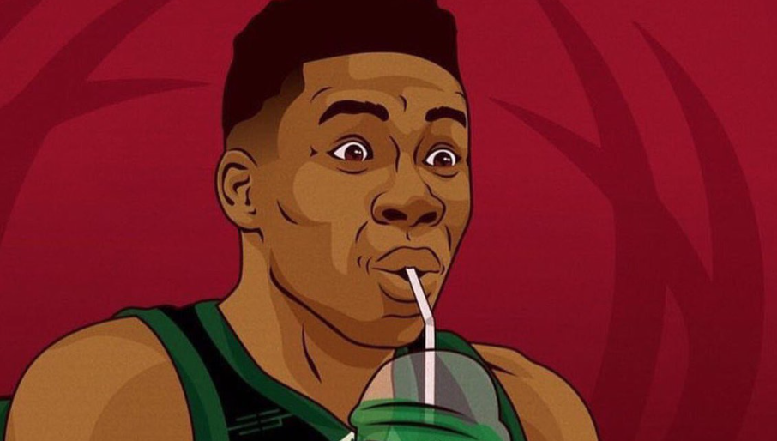


Plus-Minus (+/-)
.
.
.

Slide 4
Adjusted Plus-Minus
Controls for the presence of other players on the court
  Both offense and defense
Each stint is a data point
  DV: PM/possession
  IVs: Dummy variables for all players
    1 for home team players in the stint, -1 for visiting team players in the stint and 0 for the rest

Slide 5
Adjusted Plus-Minus
Pass all the stints through a linear regression
The coefficient for each player α_{i} is the adjusted plus-minus of the player
$y=a_{1}x_{1}+a_{1}x_{1}$+…+$a_{r}x_{r}+ε$

Slide 6
Adjusted Plus-Minus
Home edge: 3.2pts/game
Cavs: 9 points
Celtics: 7 points
Cavs: 9-(3/48)*.5(3.2) =8.9
Celtics: 7+(3/48)*.5(3.2) = 7.1
3 mins

Slide 7
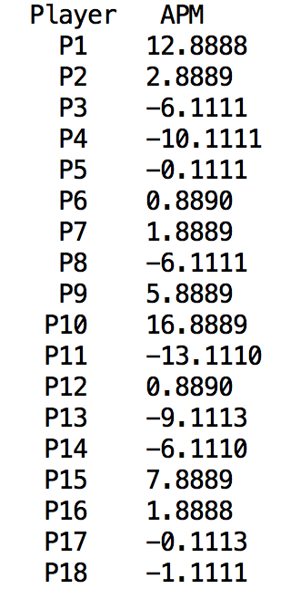
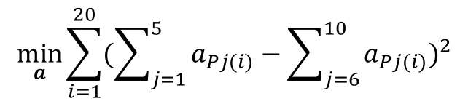
Adjusted Plus-Minus
Team 1(P1-P5): Players 1 through 9
Team 2(P6-P10): Players 10 through 18
Stints are full games (i.e., 48 minutes)
Assume no home edge (neutral court)
$$\min_{a}{\sum_{i=1}^{20}{(\sum_{j=1}^{5}{a_{Pj(i)}}−\sum_{j=6}^{10}{a_{Pj(i)}})^{2}}}$$

Slide 8
Adjusted Plus-Minus Critiques/Enhancements
Noisy metric
  Not statistically significant coefficients
  Inconsistency across seasons
Collinearities
  Subset of players being in all of their stints together

Slide 9
Adjusted Plus-Minus Critiques/Enhancements
Regularization added to improve predictive performance
Box score prior added to account that LeBron James and Dennis Smith Jr are not starting from the same expectations
Still we cannot get an estimate for the uncertainty of the player rating

Slide 10
Bayesian regression for +/-
An alternative is to set a prior for the player ratings based on a non-court related signal
  Contract value: this reflects the value a team puts on a player
We can then estimate the posterior distribution using a similar set up with the adjusted plus/minus regression

