Slide 1

AphasiaBank
Brian MacWhinney, Ph.D. – PI
Department of Psychology
Carnegie Mellon University
started in 2007, funded by NIH (NIDCD)

Slide 2
What is Aphasia?
Aphasia is a communication disorder that results from damage to the parts of the brain that control language (typically in the left half of the brain).
Most common cause: stroke
Disorder can range from mild to severe

Slide 3
How common is aphasia?
Prevalence: ~ 1 million individuals have aphasia in U.S. (National Institute on Neurological Disorders & Stroke)
Incidence: ~ 80,000 new cases of aphasia per year (National Stroke Association)
More common in middle aged and older people

Slide 4
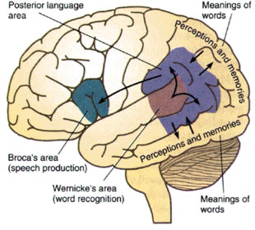
General types of aphasia depend on site and size of brain lesion

Slide 5
types of aphasia, cont.
Global aphasia
  most severe
  poor comprehension
  limited production
Broca’s aphasia
  non-fluent, reduced output
  relatively good comprehension
  video example … (AQ=57.5)

Slide 6
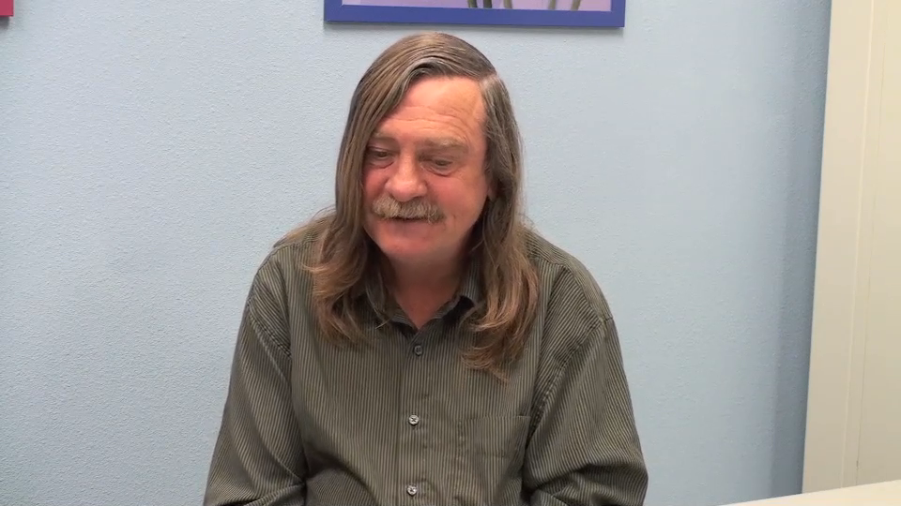

Slide 7
General types of aphasia, cont.
Anomic aphasia
  mildest
  relatively good comprehension
  mostly fluent, meaningful output with word-finding problems
  video example … (AQ=78.6)

Slide 8
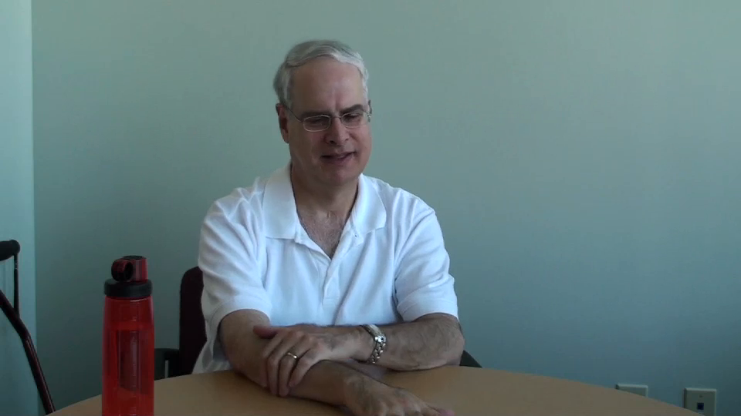

Slide 9
General types of aphasia, cont.
Wernicke’s aphasia
  fluent but often irrelevant, meaningless output
  poor comprehension
  video example … (AQ=33.4)

Slide 10
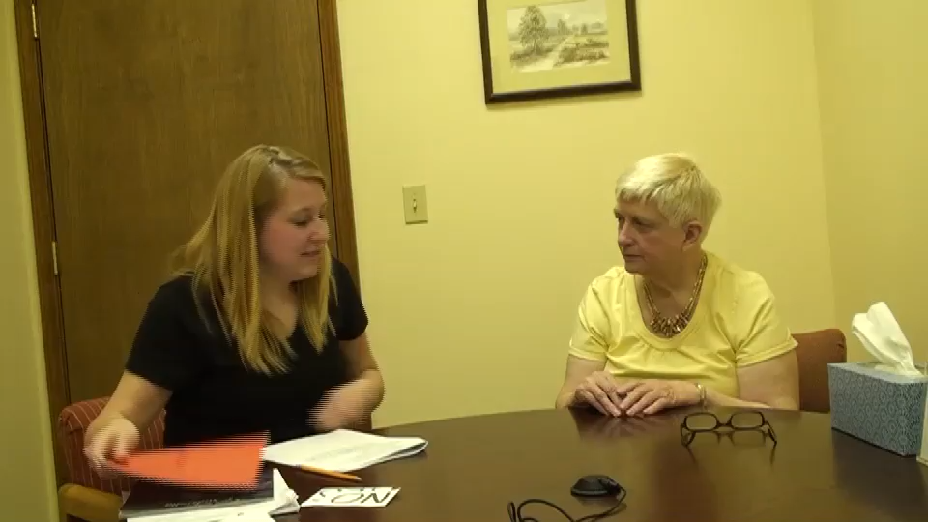

Slide 11
Signs and symptoms of aphasia
difficulty producing language
  finding words
  saying the wrong word (e.g., chicken/fish, radio/ball)
  making sound errors in words (e.g., stisser/sister)
  using made-up words (e.g., shivler/fever, larn/umbrella)
  putting words together to make a sentences
difficulty understanding language
difficulty reading and writing

Slide 12
Aim of AphasiaBank
To create a shared database
of multi-media interactions
for the study of communication in aphasia

Slide 13
AphasiaBank is part of the TalkBank project
Goal: to foster fundamental research in the study of human communication with an emphasis on spoken communication.
repositories in 14 research areas – aphasia, dementia, fluency, bilingualism, child language, etc.
contributions from researchers all over the world, many different languages

Slide 14
TalkBank project
... one more thing
CLAN!
In addition to shared databases ...
Computerized Language Analysis (MacWhinney, 2000)
set of programs for automatic analysis of language and discourse structures
free and downloadable from TalkBank
has been used in over 7,000 publications – mostly in child language development

Slide 15
CLAN, cont.
*PAR: &-uh &-uh bread &=fingers:two two .
*PAR: &-uh &=ges:spread peanut butter &-uh
spread it .
*PAR: &-uh &=ges:spread jelly, spread it .
*PAR: &-uh &=ges top .
*PAR: &-uh cut it half .

Slide 16
CLAN, cont.
*PAR: &-uh &-uh bread &=fingers:two two .
%mor: n|bread det:num|two .
*PAR: &-uh &=ges:spread peanut butter &-uh spread it .
%mor: n|peanut n|butter v|spread&ZERO pro:per|it .
*PAR: &-uh &=ges:spread jelly, spread it .
%mor: n|jelly cm|cm v|spread&ZERO pro:per|it .
*PAR: &-uh &=ges top .
%mor: n|top .
*PAR: &-uh cut it half .
%mor: v|cut&ZERO pro:per|it n|half .

Slide 17
CLAN, cont.
CLAN has many commands for running automatic language analyses that have traditionally been done by hand.
We are working to move the field of aphasia forward by automating most popular analysis tools.
more later ...

Slide 18
AphasiaBank
Standardized Protocol for Discourse
Personal Narratives
  How’s your speech
  Stroke story
  Recovery
  Important event

Slide 19
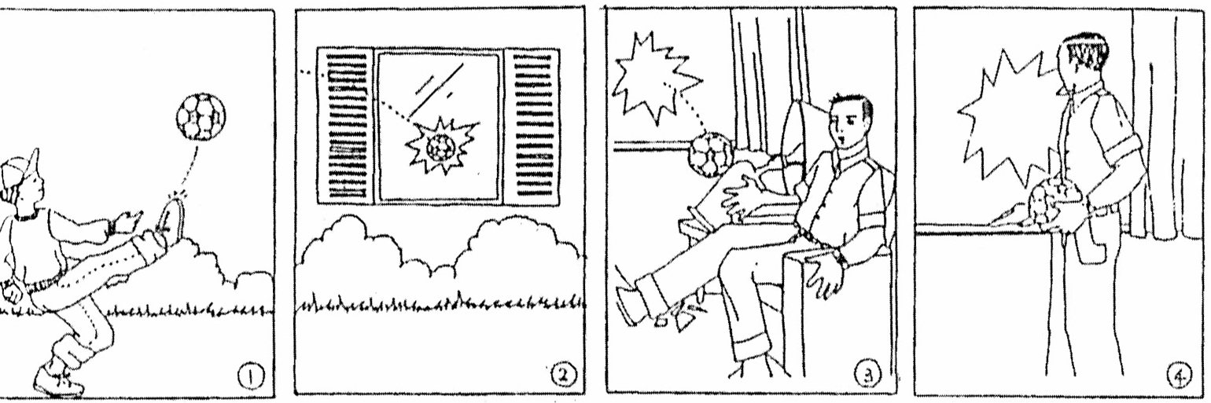
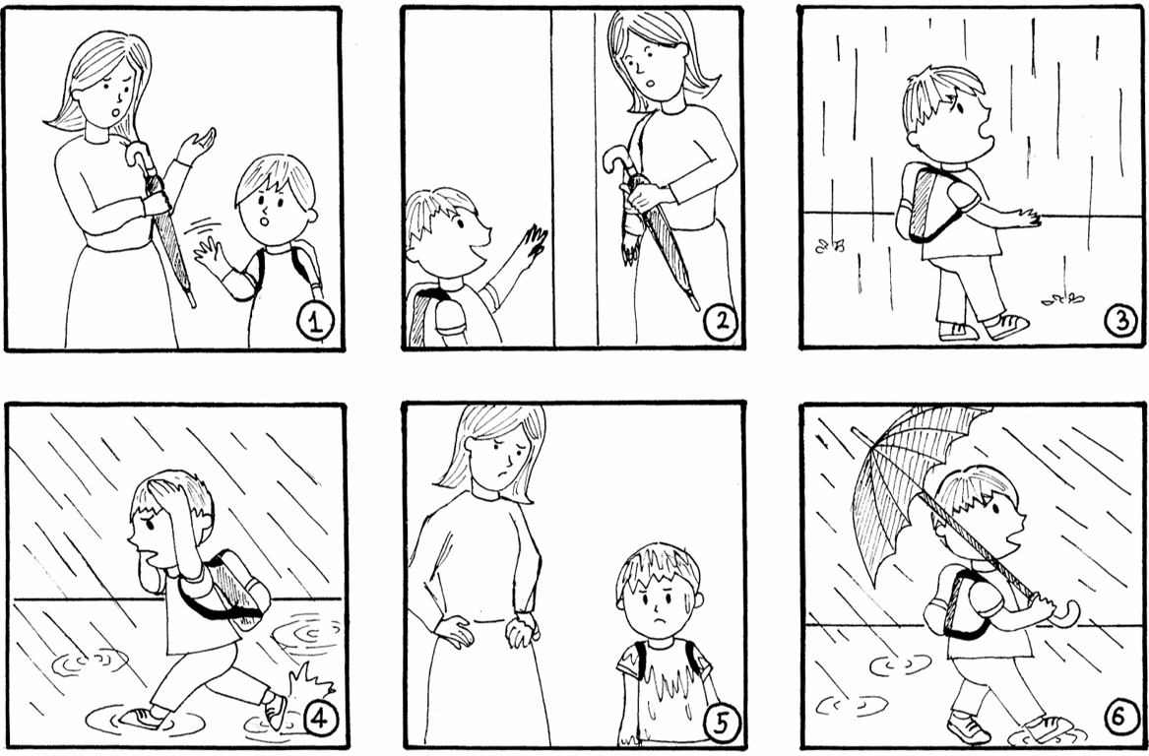
Picture sequence stories
Broken Window
Refused Umbrella

Slide 20
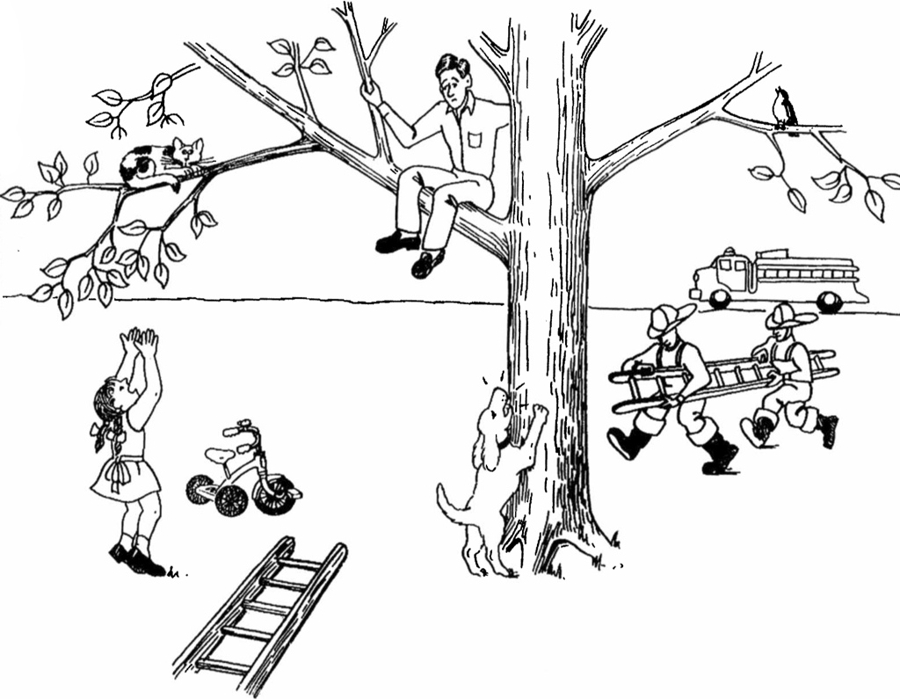
Picture description, cont.
Cat in the tree

Slide 21
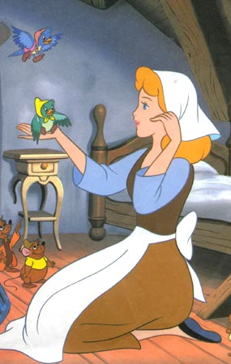
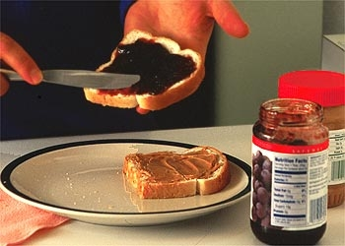
Discourse tasks, cont.
Cinderella retelling How to make a PBJ

Slide 22
AphasiaBank Database as of January 2020
436 language samples from 306 persons with aphasia (PWA) from 22 sites
247 language samples from 181 controls from 5 sites
~ 40 test result data fields
  aphasia test, verb naming test, noun naming test, repetition test, auditory comprehension test
~ 40 demographic data fields
  age, gender, race, handedness, occupation, aphasia duration, aphasia etiology, physical status, etc.

Slide 23
Research Question #1
Clinical Classification
determine presence, severity and type of aphasia (depends on size and site of lesion in brain)
compare with similar clinical patterns for prognosis and treatment planning
provide baseline for detecting change
contribute to research on language and cognition in normal and disordered populations -- e.g., test theories of language function, language-brain relationships

Slide 24
clinical classification, cont.
Traditionally done with formal test – Western Aphasia Battery (WAB) –> 8 types
Based on subtest scores – free speech, auditory comprehension, repetition, naming -- a “type of aphasia” is assigned
Cut scores for the WAB taxonomy were developed after reviewing data from first standardization sample and were chosen to classify all PWA.

Slide 25
clinical classification, cont.
***our goal***
To use the large AphasiaBank database – discourse, demographics, test data -- to better inform and differentiate syndrome classifications.

Slide 26
clinical classification, cont.
Wilson & Hula, 2019
“Multivariate Approaches to Understanding Aphasia and its Neural Substrates”
“Considering the clear-cut multidimensionality of aphasia and its neural underpinnings, it is no surprise that multidimensional approaches have been growing in prevalence and prominence over the last few years.
Disentangling multiple behavioral and neural variables requires large datasets, so it is encouraging that the field of language neuroscience is becoming increasingly collaborative, with the emergence of a number of large scale projects that will generate datasets of the size and substance that will form a sound basis for future progress.”

Slide 27
Research Question #2
Automated vs. Manual Discourse Analysis
Language sample analysis – what to measure, how to measure
Research studies in aphasia have used over 500 unique measures to analyze language in discourse
  # of words
  mean length of utterance
  # of errors
  rate of speech
  ratio of unique words to total words
  word classes – nouns, verbs, adjective, adverbs, prepositions, pronouns, conjunctions, etc.
  morphology – past tense markers (regular and irregular), plurals (regular and irregular), possessives, progressives, etc.

Slide 28
automated vs. manual discourse analysis, cont.
Manual scoring is used most frequently
Some linguistic analysis systems combine measures to quantify specific aspects of language in aphasia
  QPA – Quantitative Production Analysis (Saffran et al., 1989)

Slide 29
automated vs. manual discourse analysis, cont.
QPA
Quantitative Production Analysis
  system of rules for manual transcribing and manually computing of various syntactic measures
  developed ~30 years ago
  utterances → spreadsheet, scored on 23 measures
  those scores → another spreadsheet that has formulas to compute 40 summary scores

Slide 30
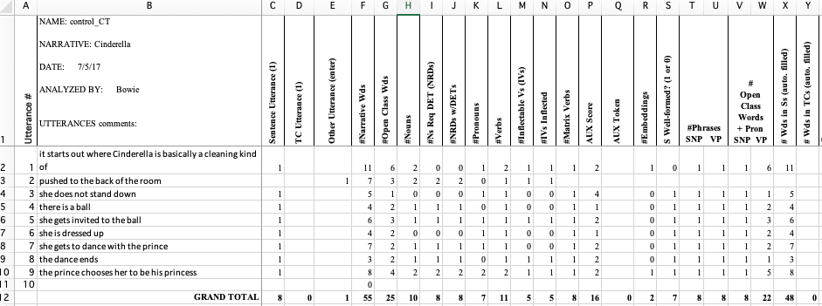
QPA – sentence by sentence analysis
Includes measures for lexical content, auxiliary analysis, and structural analysis

Slide 31
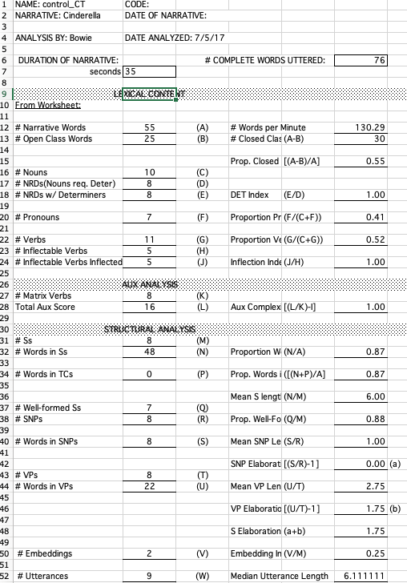
QPA -- summary sheet

Slide 32
automated vs. manual discourse analysis, cont.
***our goal***
To determine the agreement between manual QPA coding results and results generated automatically by the CLAN QPA program
For areas of disagreement, drill down to determine if error is on the human or machine side.

Slide 33
automated vs. manual discourse analysis, cont.
110 narrative samples scored by hand by experienced QPA scorers and the same samples analyzed by the CLAN QPA program
10 controls, 100 left hemisphere stroke

Slide 34
automated vs. manual discourse analysis, cont. advantages of automated analysis
faster (MUCH!) analysis
less demand for training on the QPA analysis rules
less demand for linguistic expertise
replicability

Slide 35

The End

