Slide 1
How to improve our on-campus parking system?
Team C
Silvia Manolache, Nicholas Thieme, Shu Wang, Yijia Zhou

Slide 2
Agenda
Research Question and Motivation
Questionnaires
Sample Design and Selection
Survey Methodologies
Data Analysis
Discussions and Conclusions

Slide 3
Motivation
Over the past year, the rates at the metered parking spots on Frew Street, Tech Street, and around Schenley Park have increased to $2 per hour and payment times increased up until 10 PM
Research and personal evidence suggests this caused discontent and a large decrease in use of the spaces
Article citing CMU Marketing Professor Jeff Galak
Meter rates higher than US average

Slide 4
Research Question
Research question: how satisfied is the CMU community with the current metered parking?
Effects on use of spaces?
What attributes specifically cause dissatisfaction, if any?
Are there any solutions we can propose to ameliorate the situation?
Acceptance of coins other than quarters at meters
Fewer times when meters must be paid
Acceptance of credit/debit cards at meters

Slide 5
Questionnaire
3 types of questions
Demographic (eg. Gender, year of study at CMU)
Satisfaction-measuring
Gathering information about use of spaces
Measure satisfaction for different solutions as well as for current system

Slide 6
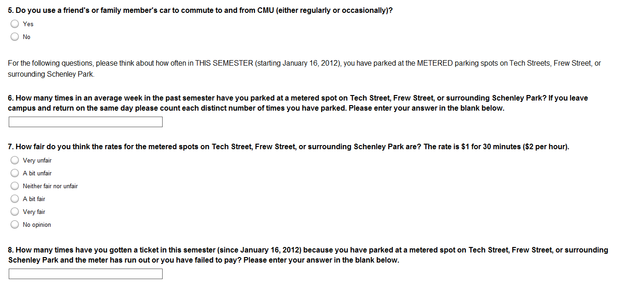
Questionnaire - Example

Slide 7
Sample Selection
Target Population:
Active and current undergraduate and graduate students and faculty members of the Carnegie Mellon Community
Sampling Frame: Carnegie Mellon C-book
Methods: Random number generator

Slide 8
Survey Methodologies
Have extra numbers
for nonresponse
purpose
Student Emails
Generator
Identifier | Page | Column | Line
74-2-27 | 74 | 2 | 27
12-2-39 | 12 | 2 | 39
93-1-9 | 93 | 1 | 9
31-2-1 | 31 | 2 | 1
100-2-31 | 100 | 2 | 31
34-2-17 | 34 | 2 | 17
53-1-14 | 53 | 1 | 14
86-2-25 | 86 | 2 | 25
68-1-2 | 68 | 1 | 2
Silvia
Identifier | Page | Column | Line
11-1-23 | 11 | 1 | 23
11-1-35 | 11 | 1 | 35
12-1-12 | 12 | 1 | 12
12-2-25 | 12 | 2 | 25
13-1-36 | 13 | 1 | 36
13-2-1 | 13 | 2 | 1
13-2-16 | 13 | 2 | 16
14-1-22 | 14 | 1 | 22
14-1-31 | 14 | 1 | 31
14-2-37 | 14 | 2 | 37
Nick
Identifier | Page | Column | Line
11-2-16 | 11 | 2 | 16
11-2-24 | 11 | 2 | 24
11-2-28 | 11 | 2 | 28
12-1-20 | 12 | 1 | 20
12-1-32 | 12 | 1 | 32
12-2-31 | 12 | 2 | 31
13-2-12 | 13 | 2 | 12
14-2-9 | 14 | 2 | 9
14-2-10 | 14 | 2 | 10
14-2-14 | 14 | 2 | 14
Faculty Emails
Shu
Identifier | Page | Column | Line
126-2-27 | 126 | 2 | 27
134-2-14 | 134 | 2 | 14
133-2-40 | 133 | 2 | 40
139-2-19 | 139 | 2 | 19
127-2-8 | 127 | 2 | 8
Yijia
Identifier | Page | Column | Line
128-1-19 | 128 | 1 | 19
140-1-1 | 140 | 1 | 1
136-1-32 | 136 | 1 | 32
135-2-24 | 135 | 2 | 24
124-1-11 | 124 | 1 | 11

Slide 9
Data Analysis
Deleted 6 data
Missing important items (cost satisfaction/overall satisfaction)
People who do not own a car
Cannot answer questions like “How many times in an average week do you park in XX street ”
Still valid if they answered all opinion-based questions
Fixed some responses
For the question above: (numerical values)
Once every two weeks → 0.5
Several times → average of all car owners

Slide 10
Data Analysis
Two Response Variables
Cost Satisfaction and Overall Satisfaction
Unsurprisingly, highly correlated
Much more interesting, relationships between explanatory variables and response variables

Slide 11
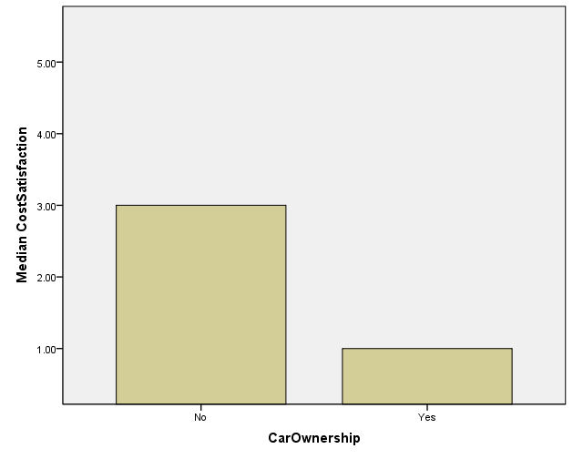
Data Analysis
Car Owners were significantly (at the .00 alpha level) less satisfied with the Price of Parking on Campus
There were very large outliers, so median was used rather than mean (mean is +.3 for yes, and -.7 for no)
95% Confidence Interval of the mean is (1.68,2.02)

Slide 12
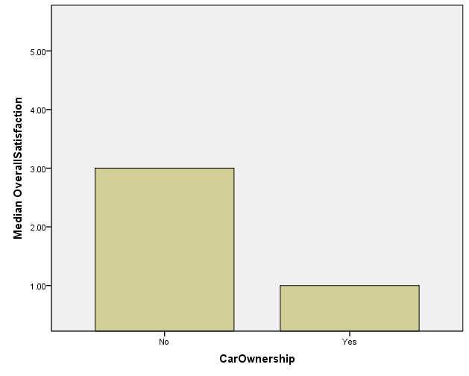
Data Analysis
Car Owners were significantly (at the .00 alpha level) less satisfied with the Quality of Parking on Campus
There were very large outliers, so median was used rather than mean (mean is +.51 for yes, and -.59 for no)
95% Confidence Interval of the mean is (1.80, 2.14)

Slide 13
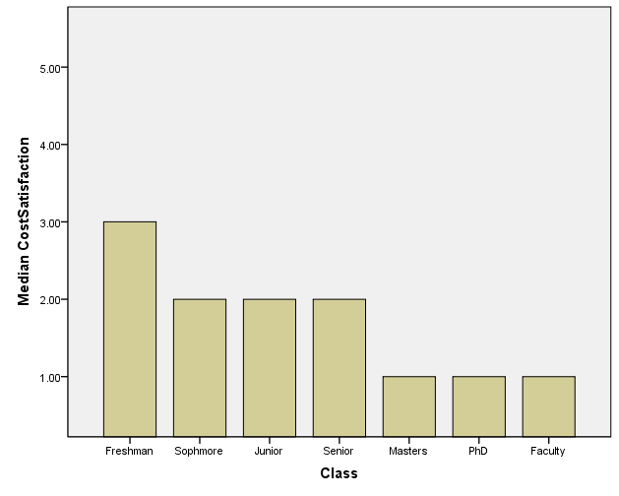
Data Analysis
Median Cost satisfaction has a significant relationship (alpha=.00) for every class with Freshman.
95% CI for the mean
Freshman (2.67,3.09)
Sophmore (1.57,2.42)
Junior (1.42,2.11)
Senior (1.43,2.39)
Masters (.88,1.77)
Ph.D (1.05,1.71)
Faculty (1.13,2.59)
Significant difference from Freshman and Freshman CI allows us to say that all groups have negative cost satisfaction

Slide 14
Data Analysis
Median Cost satisfaction has a significant relationship (alpha=.00) for every class with Freshman.
95% CI for the mean
Freshman (2.67,3.09)
Sophmore (1.57,2.42)
Junior (1.42,2.11)
Senior (1.43,2.39)
Masters (.88,1.77)
Ph.D (1.05,1.71)
Faculty (1.13,2.59)
Significant difference from Freshman and Freshman CI allows us to say that all groups have negative cost satisfaction

Slide 15
Data Analysis Results
Car Owners are less satisfied both with the cost and with the quality of the parking on campus.
All members of the CMU community by class have negative opinions of both the cost of parking, as well as the quality of parking.

Slide 16
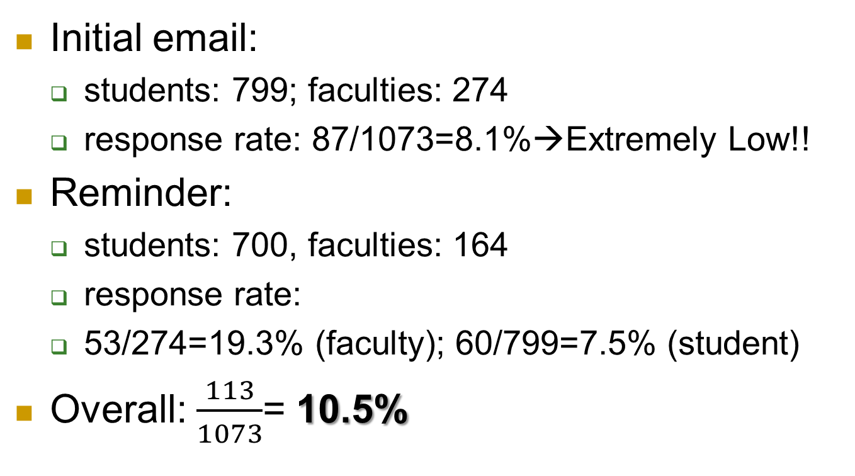
Data Collection
Initial email:
students: 799; faculties: 274
response rate: 87/1073=8.1%→Extremely Low!!
Reminder:
students: 700, faculties: 164
response rate:
53/274=19.3% (faculty); 60/799=7.5% (student)
Overall: $\frac{113}{1073}$= 10.5%

Slide 17
Data Collection Period
Initial email:
April 1 – 14 (2 weeks)
Only 87 responses
Reminder email and extra emails:
April 15 – 25 (1.5 weeks)
Additional 26 responses

Slide 18
Non-responses Analysis
10.5% response rate → extremely low
Unit non-response
failure of making contact with the sample units
Item non-response
Approximately 60% skipped questions regarding the situations of parking metered spaces
Did not own cars or have relevant parking experience
Own campus parking permit → don’t care

Slide 19
Take-home message
Overall: dissatisfaction
the cost and the quality of the metered parking spots on campus
Low response rate: lack of sufficient incentives (i.e. raffle of gift cards)
Potential conflicts with other parking locations available around the campus

Slide 20
Future work
Finish our post-survey analysis and complete all writing parts of project
Design posters and present at MoM ☺

