Slide 1
What do Elementary School Children know about Architecture?
36-303: Sampling, Surveys, and Society
April 28, 2011
Erica D Cochran & Kelly S. Lyons

Slide 2
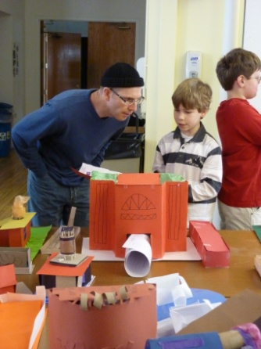
Table of Contents
Introduction / Review
Sample
Estimates
Actual Data
Lessons from Pre-Test
Challenges and Changes
Results & Analysis
Coding of Drawings
Next Steps

Slide 3
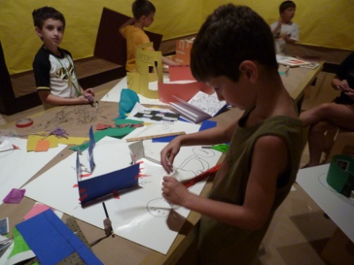
Introduction Our Research and Contribution
What do students already know
(based on what we want them to know)?
What does an architect do?
Visual literacy (“reading” drawings)
Mapping skills
Measurement skills
Knowing this helps architectural educators plan programming that is educationally appropriate

Slide 4
Target Population and Sampling Frame
Target Population
3rd, 4th, and 5th graders
Two Pittsburgh Public School Academies
Carmalt Academy
Lincoln Academy
Sampling Frame
Rosters of enrolled 3rd, 4th, and 5th grade students at both schools

Slide 5
Sample Size Expected “Sample” Size
Student body
Lincoln (K-8) = 455 students
Carmalt (K-8) = 621 students
Assuming equal number of students per grade level
Lincoln = 51 students / grade
Carmalt = 69 students / grade
3 grade levels at each school
Lincoln = 153 students in 3rd – 5th grades
Carmalt = 207 students in 3rd – 5th grades
Total population = 360 students
Attendance rates – reduction of sample size
Lincoln = 90% attendance rate required for admission
Carmalt = 94% reported attendance rate
Other unavailability – further reduction of sample size
Assume worst case is 1 student per class
Estimated class size 18 students
Final Estimation of Expected Respondents for Census
((153 x .90) + (207 x .94)) x (17/18) = 314 students

Slide 6
Sample Size Calculations
314 Students
Margin of Error = 2
Accurate within +/- 2 questions
Standard Deviation = 8
Pilot Survey SD = 2
Increased due to more questions on test (14 to 35)
Increased due to biased sample
Simple Random Sample Calculations
n_{o} = 2² * SD² / ME² = 2² * 8² / 2² = 64 students
n = (N*n_{o})/(N + n_{o}) = 314*64/(314+64) = 57 students

Slide 7
Actual Population and Current Sample (so far)
Third Grade
Total in School: 66
Eligible to be tested: 61
Tested so far: 37 (61%)
Fourth Grade
Total in School: 63
Eligible to be tested: 62
Tested so far: 0
Fifth Grade
Total in School:70
Eligible to be tested: 65
Tested so far: 22 (34%)

Slide 8
Lessons from Pre-Test
Questionnaire took about 10 – 15 minutes to complete
Biased Sample
Ceiling Effect
Questionnaire did not address what an architect does – so more questions were added:
Does an architect work in a hospital?
Does an architect design buildings?
One drawing question relied on memory, not just ability, so an ability question was added to assess students ability to create a floor plan
“In the space below, draw a map of your classroom from a “birds-eye” view. Include the walls, door, windows, furniture, and anything else you think should be included.

Slide 9
Unexpected Challenges & Changes
Scheduling
Pregnancy and Illness
Poor response from busy teacher
Unexpected “ineligible” population
Life Skills Students
Not Mainstreamed
Coding Graphical Responses (Drawings)
Data Entry for larger population

Slide 10
Sample Population Demographics
?
?

Slide 11
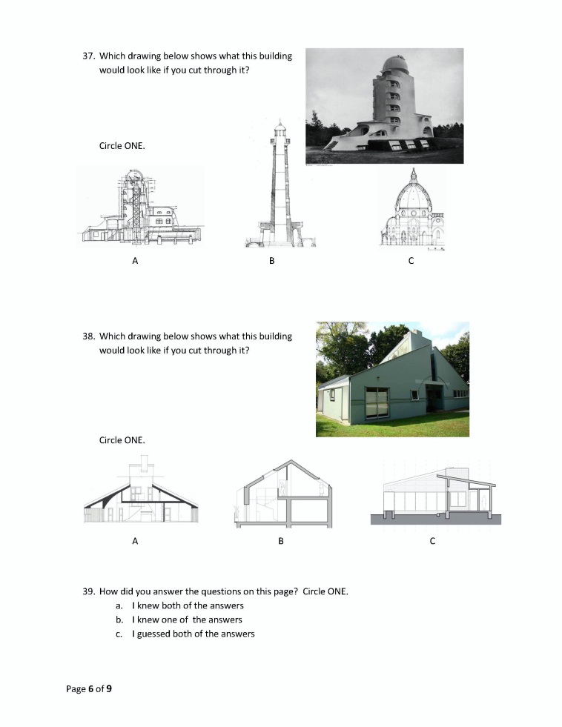
Survey Questions
Visual Literacy - Sections
Visual Literacy – Floor Plans

Slide 12
Results from Questionnaire
 | Mean | Min | Median | Max
Pilot | 79% | 64% | 79% | 100%
Sample | 67% | 31% | 69% | 90%
Gender: 90% CIs For Mean
Level N Mean StDev ----------+-----------+-----------+-----------+-
B 32 0.6703 0.1360 (----------------*----------------)
G 27 0.6692 0.1161 (--------------------*-------------------)
-----------+-----------+-----------+-----------+-
0.650 0.675 0.700 0.725
Homeroom Teacher: 90% CIs For Mean
Level N Mean StDev --------+-----------+-----------+-----------+---
Deal 21 0.6371 0.1203 (-------*-------)
Maben 22 0.7476 0.0709 (------*------)
Worhatch 16 0.6056 0.1430 (-------*-------)
---------+-----------+-----------+-----------+---
0.600 0.660 0.720 0.780

Slide 13
Results from Questionnaire Mean Total Score
Significant at 90% CI
Grade
Zip Code?
Neighborhood?
Noteworthy
Homeroom teacher
Age
Type of class outside of school?
Not Significant at 90% CI
Sex (Boy/Girl)
Number of Years in current school
Grade started current school.
Number of classes outside of school
Mode of Transportation

Slide 14
Results from Questionnaire Residential Analysis
Neighborhood
Zip Code
Neighborhood 90% CIs For Mean
Level N Mean StDev -+----------+----------+----------+---------
Allen town 1 0.7241 * (------*-----)
Allen Town 1 0.6897 * (------*-----)
Banksville 1 0.7241 * (------*-----)
Beechview 5 0.6414 0.1023 (--*--)
Belsuver 1 0.7931 * (------*-----)
Beltzhoover 1 0.7931 * (------*-----)
Brightwood 1 0.6897 * (------*-----)
Brookline 14 0.7463 0.0723 (-*-)
Carick 2 0.7931 0.0975 (----*---)
Carnick 1 0.5172 * (------*-----)
Carrbook 1 0.5517 * (-----*------)
Carrick 3 0.6552 0.1034 (---*---)
East Hills 1 0.6897 * (------*-----)
Elliot St. 1 0.7931 * (------*-----)
Hill 1 0.4138 * (------*-----)
Hill district 2 0.3966 0.1219 (----*---)
Knoxville 4 0.6034 0.1305 (--*--)
Mt. Oliver 6 0.7184 0.1099 (--*-)
Mt. Washington 1 0.8621 * (-----*------)
Oak hill 1 0.5862 * (------*------)
Oakland 1 0.6897 * (------*-----)
Overbrook 1 0.6897 * (------*-----)
Shearden 1 0.3793 * (-----*------)
Sheraden 2 0.6207 0.0975 (----*---)
Sherden 1 0.6552 * (-----*------)
West End Elliot 1 0.6207 * (------*-----)
-+----------+----------+----------+---------
0.25 0.50 0.75 1.00
Zip Code 90% CIs For Mean
Level N Mean StDev -+----------+----------+----------+---------
1510 1 0.5517 * (-------*-------)
1520 1 0.7586 * (-------*--------)
1666 1 0.6552 * (-------*--------)
15204 4 0.5690 0.1394 (---*--)
15210 12 0.6810 0.1266 (-*-)
15211 1 0.8621 * (---------*---------)
15212 1 0.6897 * (----------*---------)
15216 2 0.7241 0.0488 (-----*-----)
15219 2 0.3621 0.0731 (------*------)
15220 1 0.6207 * (--------*--------)
15226 10 0.7552 0.0698 (-*--)
15299 1 0.6552 * (--------*---------)
15502 1 0.6552 * (--------*---------)
-+----------+----------+----------+---------
0.25 0.50 0.75 1.00

Slide 15
Results from Questionnaire
Things they Do Not Know
Things they Might Know
Question # | Question text | % Answered correct
21 | Type of drawing | 3.39%
40 | Name drawing (Section) | 16.95%
43 | Name drawing (Elevation) | 32.20%
31 | Count # Windows | 37.29%
30 | Identify window | 42.37%
42 | Name drawing (Elevation or Detail) K or L both correct | 52.54%
41 | Name drawing (Floor Plan) | 55.93%
33 | Measure 1.5" | 57.63%
15 | Engineers | 59.32%
17 | Does an Arch work in an Office | 61.02%
35 | Measure 9.5 mm | 61.02%
11 | Does an Arch work in a Library | 67.80%
22 | # Bedrooms | 67.80%
10 | Does an Arch use a Computer | 69.49%
19 | Does an Arch get Licensed | 69.49%
Question # | Question text | % Answered correct
34 | Measure 3.25" | 71.19%
29 | Identify blackboard | 72.88%
24 | Identify bathroom | 74.58%
14 | Does an Arch drive a Bulldozer | 77.97%
38 | Identify Section (Venturi House) | 77.97%
25 | Identify hallway | 81.36%
37 | Identify correct section (Einstein Tower) | 83.05%
27 | Identify door | 84.75%
12 | Does an Arch Design buildings | 88.14%
16 | Does an Arch Build models | 89.83%
13 | Does an Arch work in a Restaurant | 94.92%
23 | Identify stair | 94.92%
28 | Identify teacher's desk | 96.61%
18 | Does an Arch work in a Hospital | 100.00%

Slide 16
Results from Questionnaire Question Responses
Significant
Measurement skills
Others?
Not Significant
Type of drawing
Windows identification
Hall Identification
Places an Architect works
Architectural Tools
Mode of Transportation?

Slide 17
Coding Drawing Responses
For School Map (Total number of items to yield a score – continuous variable)
Number of School Landmarks (e.g. baseball field, playground, flagpole, crosswalk, parking lot, bus loading area, triangular wedge driveway, steps in front of school, stairs behind school)
Number of Neighborhood Landmarks (e.g. local businesses, neighborhood park)
Number of Streets (drawn reasonably accurately)
Number of Other Building Groups (sets of houses)
No identifiable or accurate information drawn = 0

Slide 18
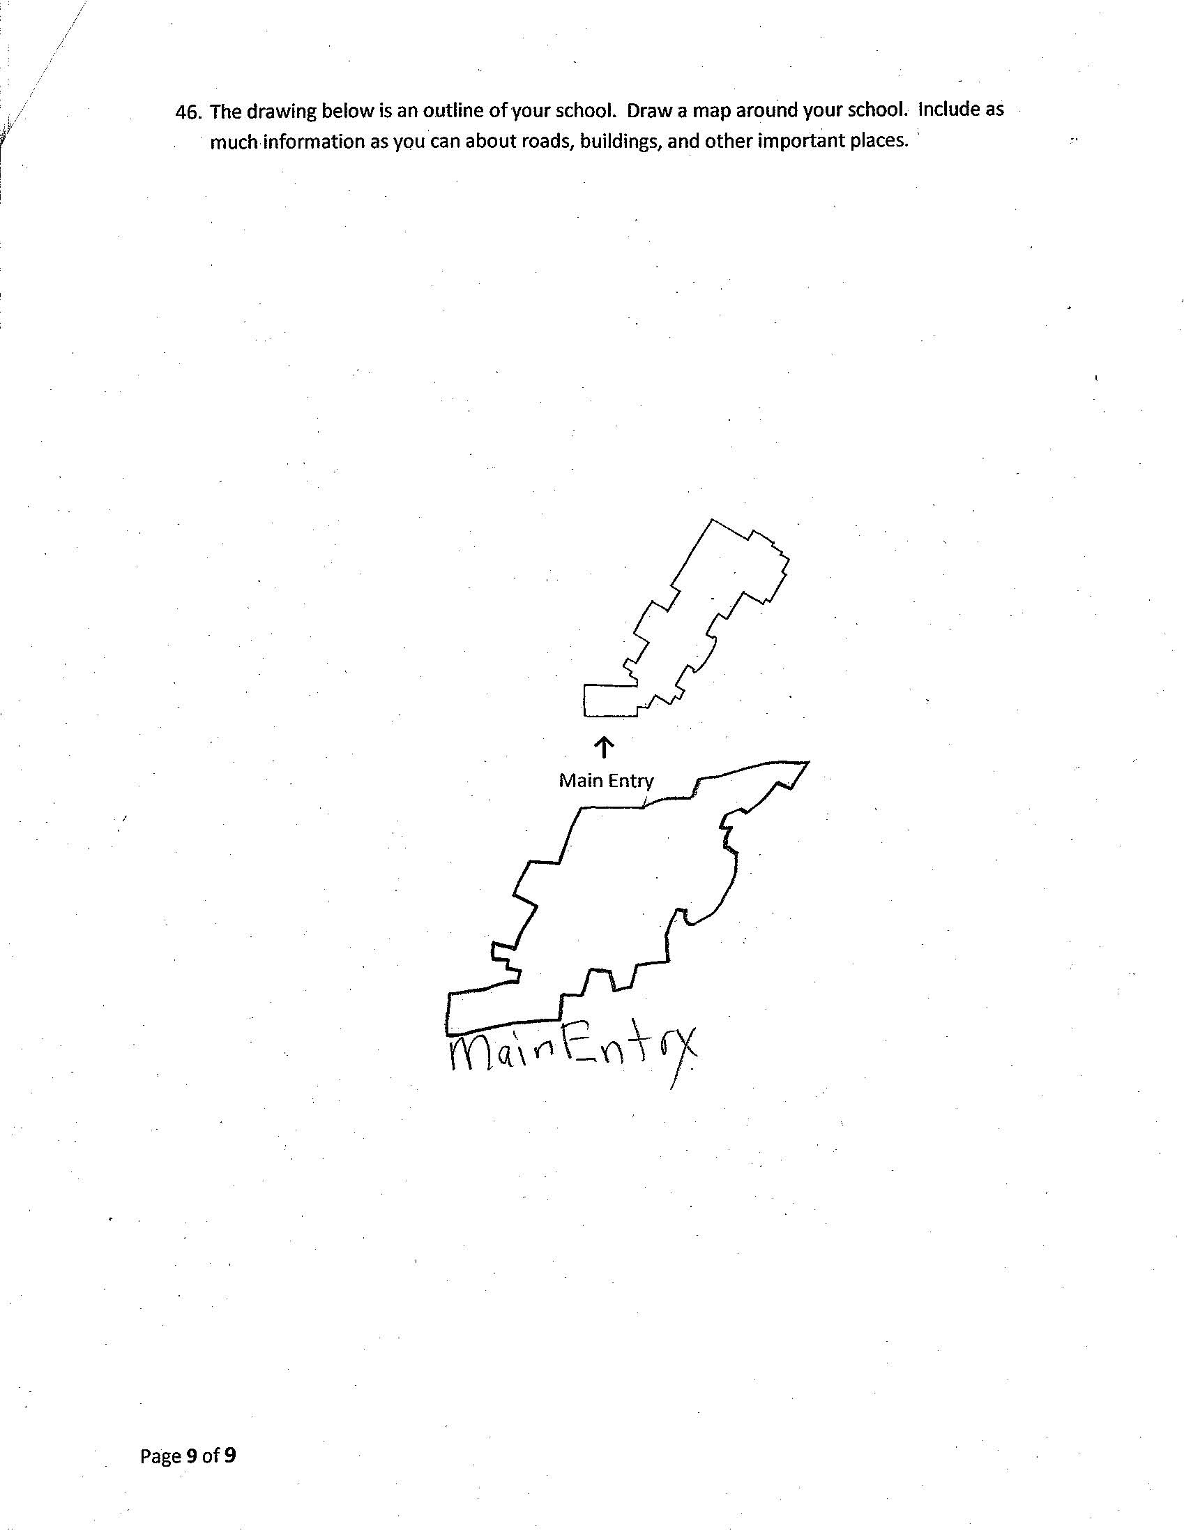
Sample Coding
School Landmarks = 0
Neighborhood Landmarks = 0
Streets = 0
Building Groups = 0
TOTAL SCORE = 0

Slide 19
Sample Coding
School Landmarks = 2
Playground
Parking Lot
Neighborhood Landmarks = 0
Streets = 0
Building Groups = 0
TOTAL SCORE = 2

Slide 20
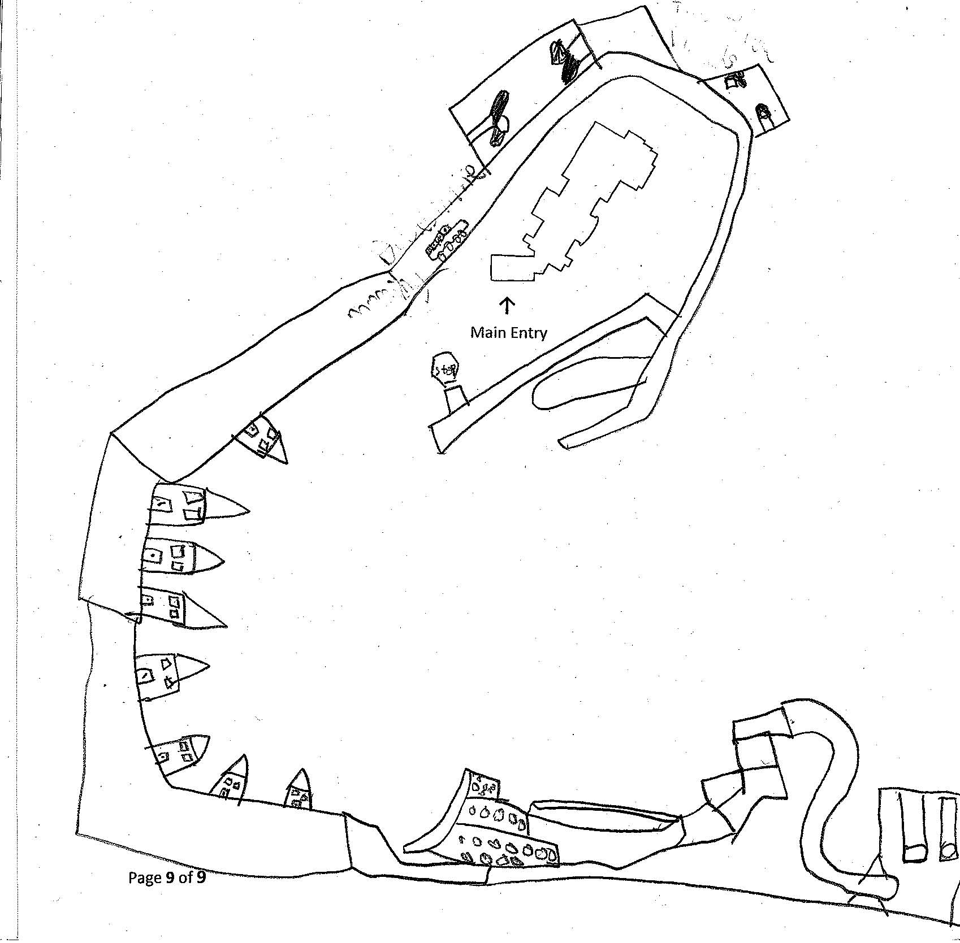
Sample Coding
School Landmarks = 3
Basketball Courts
Bus Driveway
Stop Sign
Neighborhood Landmarks = 1
Playground/Park
Streets = 1
Building Groups = 2
Houses
Community Center
TOTAL SCORE = 7

Slide 21
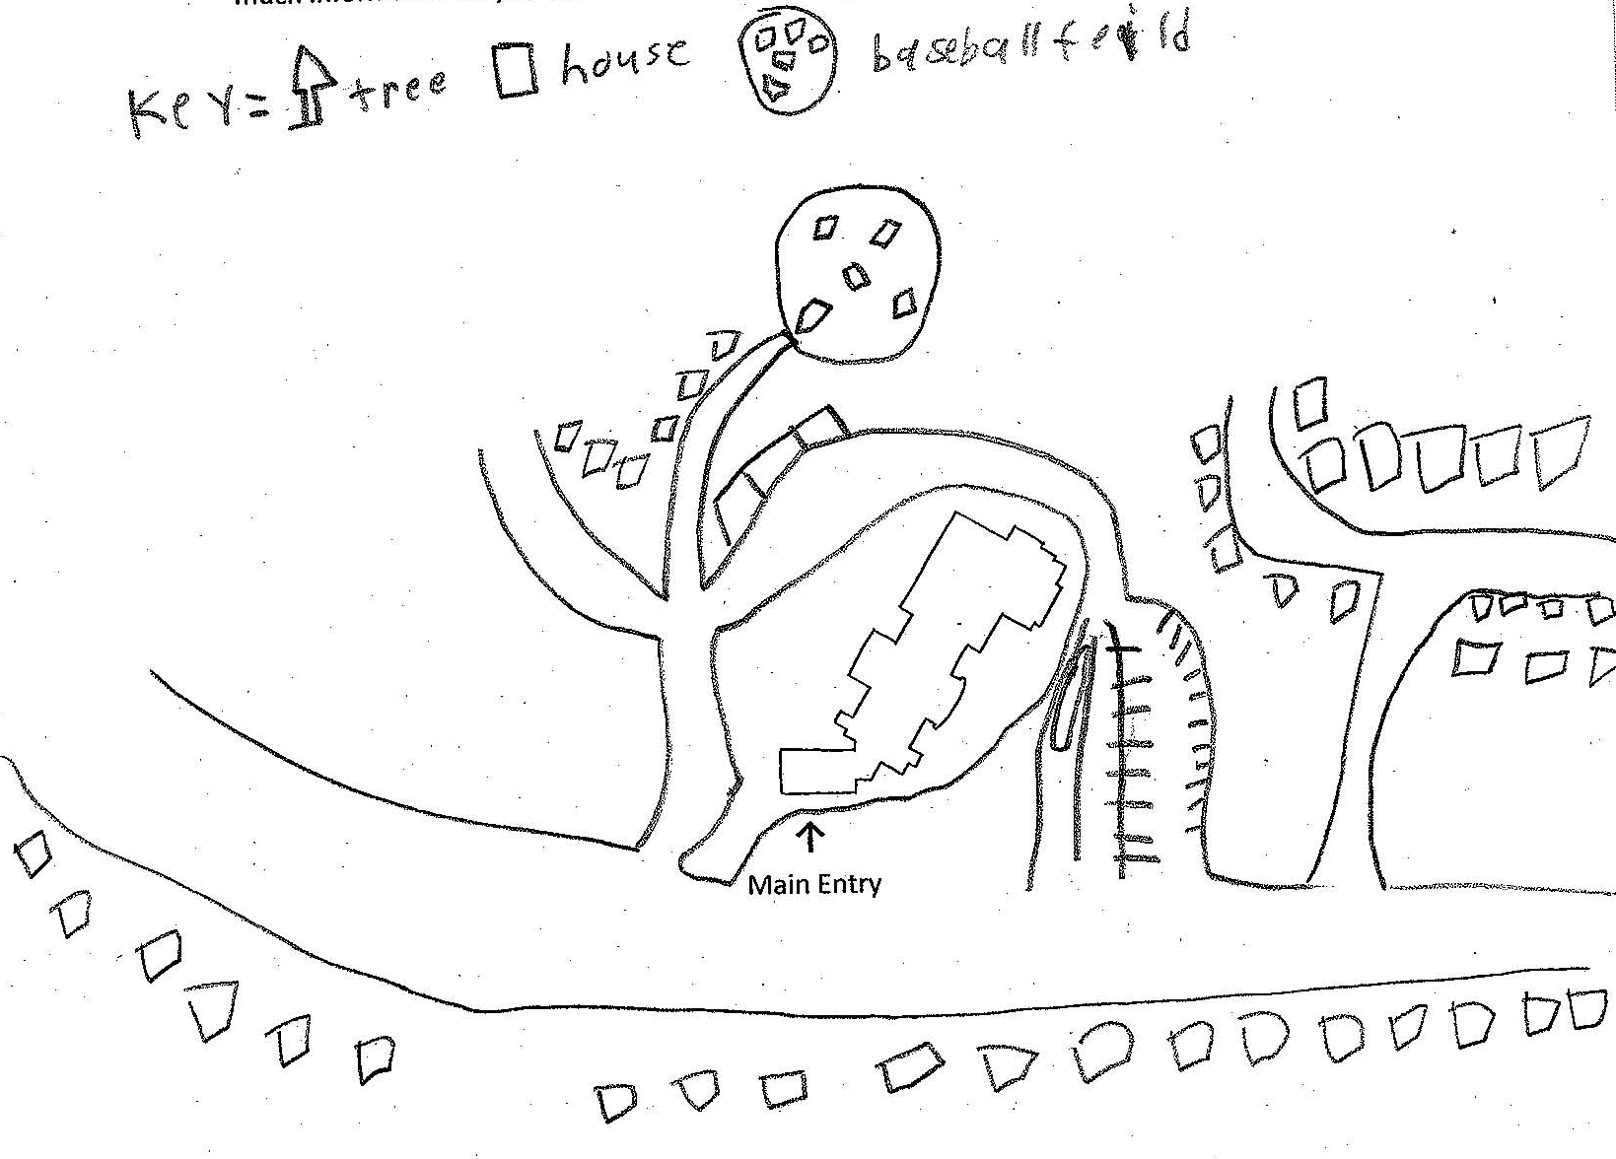
Sample Coding
School Landmarks = 4
Baseball field
Playground
Parking Lot
Bus driveway
Neighborhood Landmarks = 0
Streets = 3
Building Groups = 3
TOTAL SCORE = 10

Slide 22
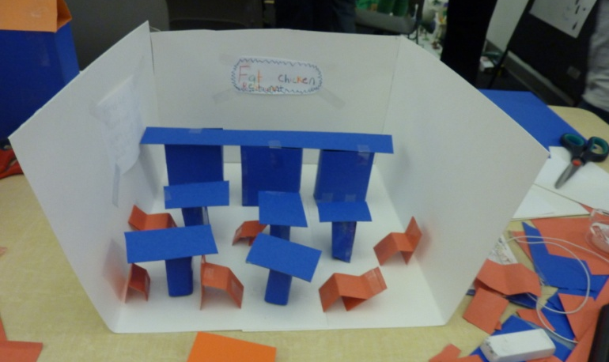
Next steps Analysis
Continue administering Survey
Analysis
Descriptive Statistics
Chi Square Tests
ANOVA
Post Sample Analysis
Randomly select 57 surveys
Compare results with “census” results
Compare “census” with initial 59 unit sample
Share findings

Slide 23
Thank you
Questions?

