Slide 1
Undergraduate Prospects After Graduation
Jason Sun, Erika Tang, Zhiyi Tang, David Zimmerman

Slide 2
Question
What are the job placement and graduate school opportunities available to Carnegie Mellon Undergraduates?

Slide 3
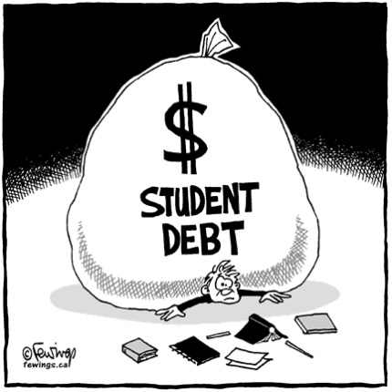
Motivation
Evidence that law schools have been inflating job placement ratings
Many students choose to take out massive loans in order to gain more education, but can they really pay it off how

Slide 4
Overview
Questionnaire
Our Data
Sample Selection
Method
Set Backs
Nonresponse
Successes
Analysis
What is Left

Slide 5
“Questionnaire”
Employment Rates
Graduate School Opportunities
Corr(Major, Job)
Distance from Pittsburgh
Salaries
Survey methods

Slide 6
Our Data
From the Career Center
Includes almost all of the students who graduate as undergraduates from CMU
Constructing Frame from response to surveys
http://www.studentaffairs.cmu.edu/career/Students/gps1/explore/survey/pdf/statistics-2009-post-grad-one-sheet.pdf

Slide 7
Sample Selection
Original Calculations for Proportions
95% CI, ME = .05
FPC with N = 1200 (estimate)
n = 292
Meta Analysis
n= 100, 300, 600, 900

Slide 8
Method
Compile all Career Center data
Enter additional data
Test various survey methods

Slide 9
Glitches
Data lacking uniform
Some data is aggregate
Non-response units
Bias?
Graduate school rankings
Fiske and US News
Actual vs. perceived job correlation

Slide 10
Non-response
Already have data!
Have response rates

Slide 11
Successes
Career Center cooperation
Beginnings of data synthesis

Slide 12
Analysis
CMU Prospects
CMU grads vs. other university grads
Effectiveness of Survey Methods
Clustered vs. stratified sampling
Effect of sample size

Slide 13
What is Left to do
Copy of Career Center’s questionnaire
Finish data compilation
Enter additional data
Compute desired statistics
Test various survey methods

Slide 14
Questions

